Slide 1
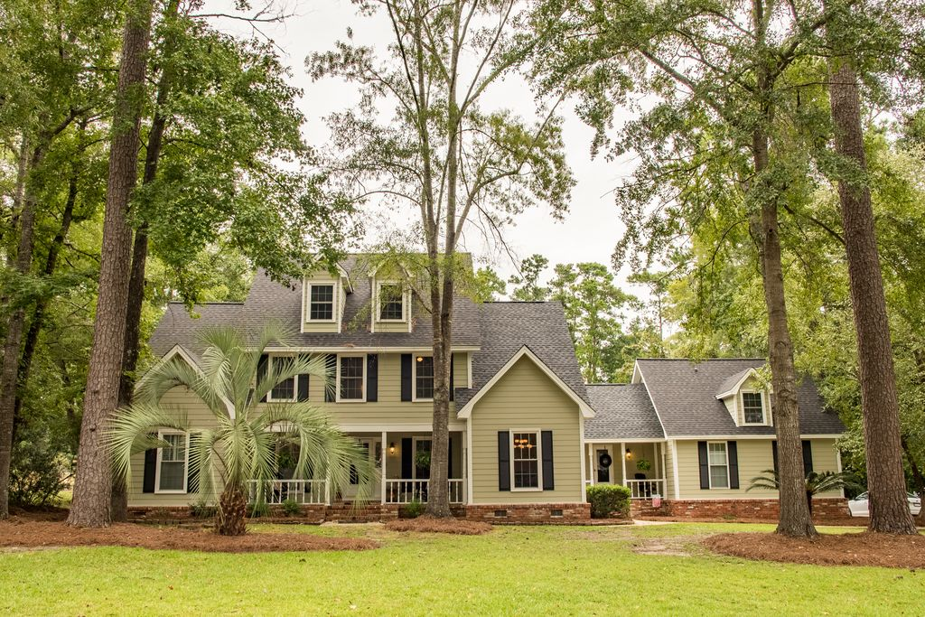
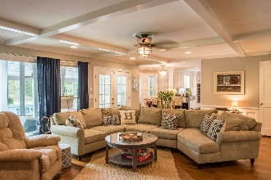
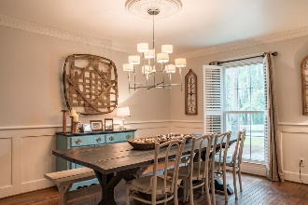
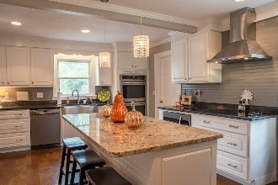
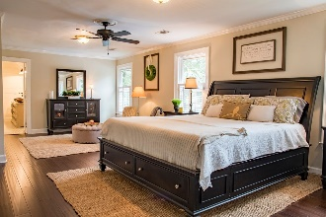
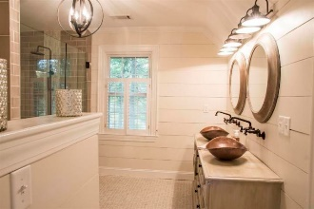
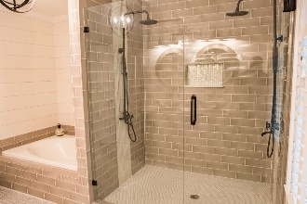
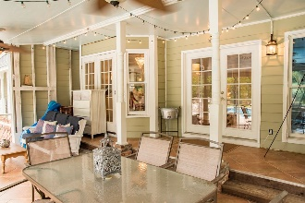
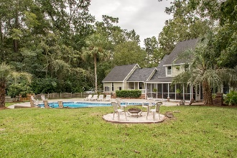
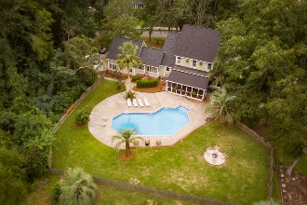
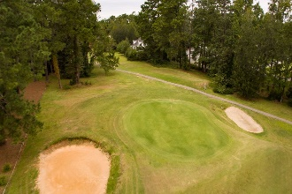


Back on the Market in Summerville!
Back on the Market!
SWIMMING POOL...ON THE GOLF COURSE… NO HOA!
415 Country Club Blvd Country Club Estates · Summerville, SC 29483 · MLS# 18017510 · $549,000 5 Bedrooms | 5 Baths | 4,290 Sq Ft
BACK ON THE MARKET!! NO HOA...SWIMMING POOL...ON THE GOLF COURSE!
Between Miler Country Club and Tea Farm, a Golf Course Lot situated on HOLE #4. The perfect balance that will make you feel right at home and awesome for hosting parties. Starting with the UPGRADES; New Hardwood Flooring, New Architectural Shingled Roof, 2 new HVAC units and duct replacement, new Hardiplank Siding, total KITCHEN REMODEL/EXPANSION with double ovens that every kitchen desires, New Appliances, Granite Counter Tops, beautiful Island, drawers and cabinets galore, not to forget the Huge Pantry and added wine/beverage nook. This kitchen was designed with love for style and convenience. The Family Room features a large Charleston Brick Fireplace, French Doors and a Showcase Window for lots of lighting. The Master Bedroom is Epic with a Large Sitting Area, a Huge WALK-IN CLOSET and an additional smaller closet with shelving and hang-ups. The 2017 UPGRADE of the MASTER BATH accents the DUAL SHOWER SYSTEMS, separate oversized Garden Tub and Double Sinks for him and her. All upstairs bedrooms have WALK-IN CLOSETS with their own Attic Door Access for plenty of STORAGE. The Mother-in-Law Suite includes Kitchen, Bedroom, Full Bath and Living Area. Not to leave out the Ample space in the FROG that includes another FULL BATH. Third story could be used as office space, a playroom, MORE STORAGE or a bedroom complete with more attic space. This magnificent home with its established natural landscape features a LARGE IN-GROUND POOL for fun and exercise at home. To top it off, you have that getaway area on quiet nights sitting out on your Large Screened-in Back Porch by the Pool. The location is perfect for walking and bike rides with access to the Sawmill Trail. House is located on a dead end street with no thru traffic. It's convenient to what you need and has everything you could possibly want. CHARM!
JACKIE LAWSON, REALTOR®
(843) 568-1250 · jlawsonhomes@gmail.com · CharlestonHomesByJackie.com
AgentOwned Realty Co. Premier Group, Inc. · 141 A N. Main Street · Summerville, SC 29483

