Slide 1
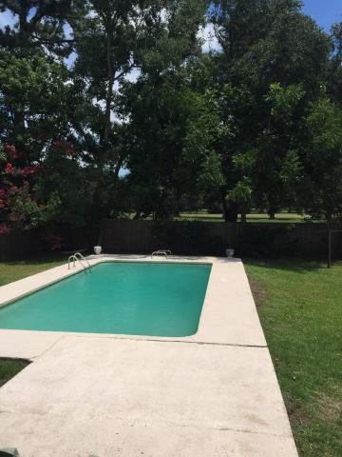
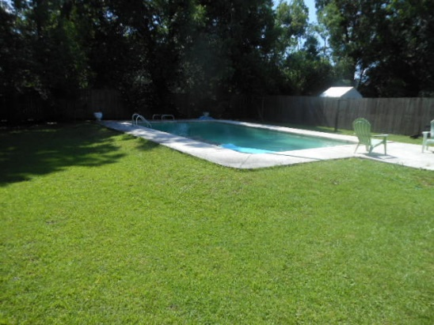
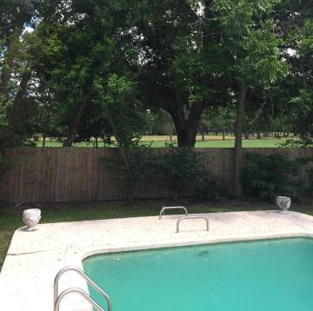
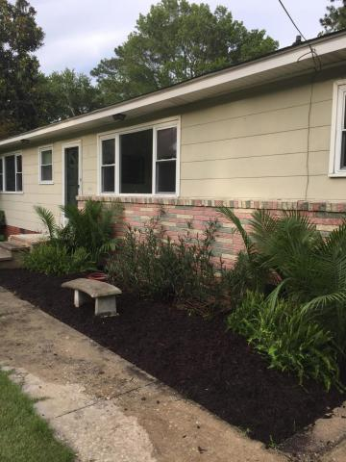
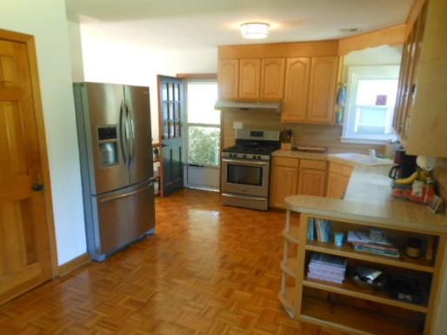
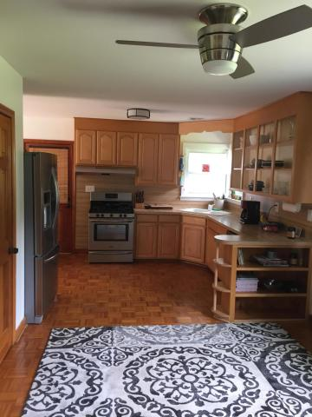
JAMES ISLAND GOLF COURSE LOT + POOL!!
415 Limbaker Street MLS# 17016472 $310,000
$40,000
Price Reduction!
Gorgeous spot on The Golf Course! Amazing location, In-Ground pool, Recently remodeled roof, windows, wiring, air conditioner, kitchen remodeled/appliances...REAL hardwood floors throughout....Just 7 minutes to downtown and less than 15 minutes to Folly Beach. Peaceful and quiet and no covenants or restrictions. There are two living rooms and part of 1 could be a third bedroom. Perfect private part of the neighborhood with no drive through traffic.
Rick Willis
843-327-3017 Rick@RickWillis.com The Group, LLC

