Slide 1
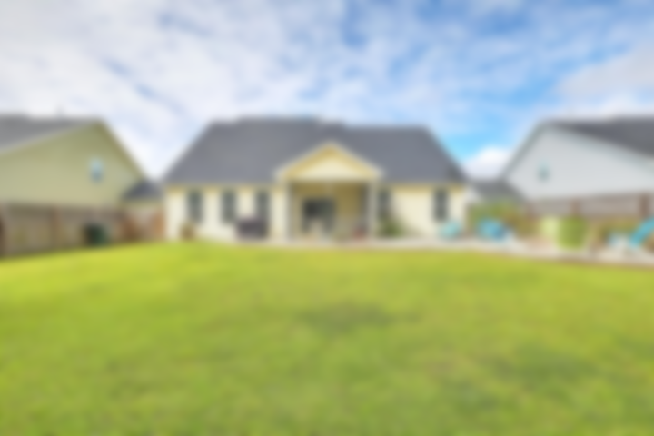
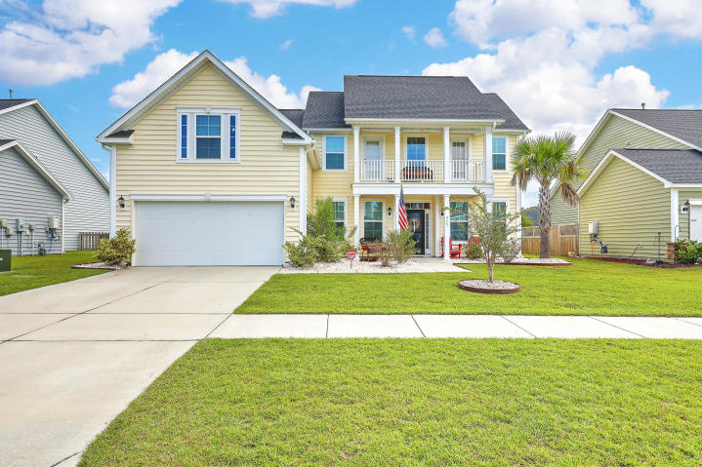
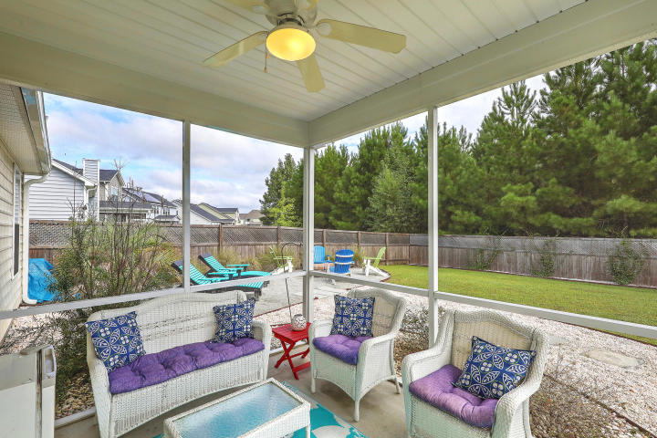
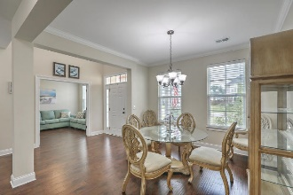
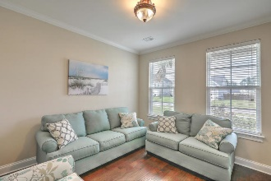
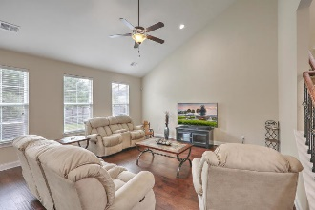
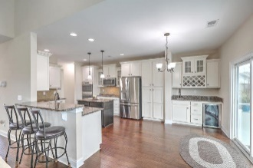
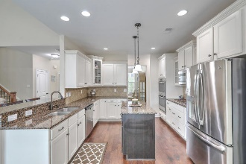
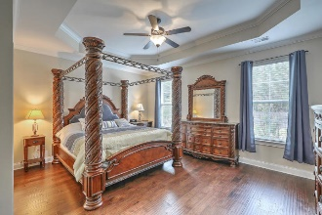
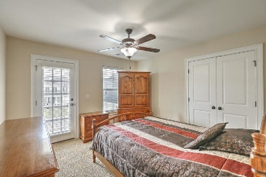
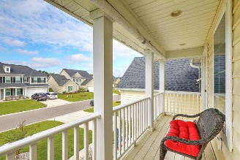
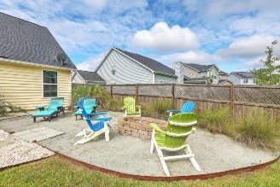
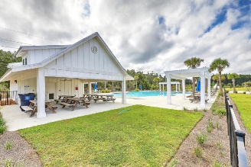


JUST LISTED IN CANE BAY! Open House Saturday 11a-3p
415 Spectrum Road
Cane Bay Plantation | Summerville, SC 29486 | MLS# 18026488 | $339,975
WOW! No need to wait for new construction with this GORGEOUS, LIKE-NEW home which is situated on a premium WOODED lot, offering plenty of privacy for years to come! Features of this desirable Marion floor plan include**HUGE DOWNSTAIRS MASTER EN SUITE with deluxe closet organizer and upgraded bathroom**DREAM KITCHEN with all the bells & whistles including wet bar with built in wine rack, granite, island, high end cabinets, double ovens, soft close drawers and so much more, flowing into the breakfast nook and into the spacious, open family room with vaulted ceilings**Gleaming hardwood floors throughout first floor**Study with French doors, ideal for playroom or 5th bedroom**Separate dining room with crown moldings**Upstairs features include loft which walks out to 2nd floor porch, 3 add'l bedrooms, one of which is presently used as a game room with access to the 3rd full bathroom**
Outside offers your own private oasis with plenty of space to entertain and enjoy an awesome seating area and fire pit! Other features to round out this incredible home include hard wiring for generator, outside coax for TV, LED lights throughout - and, of course, wonderful amenities and an easy ride to schools, shopping and dining. Don't miss out on this incredible opportunity!
Desiree Maurer Office - (843) 416-2000
Mobile - (843) 327-9010 desiree.maurer1@gmail.com
www.yourcharlestonhousesearch.com
Keller Williams Realty 496 Bramson Ct Ste 200 Mt. Pleasant, SC 29464

