Slide 1
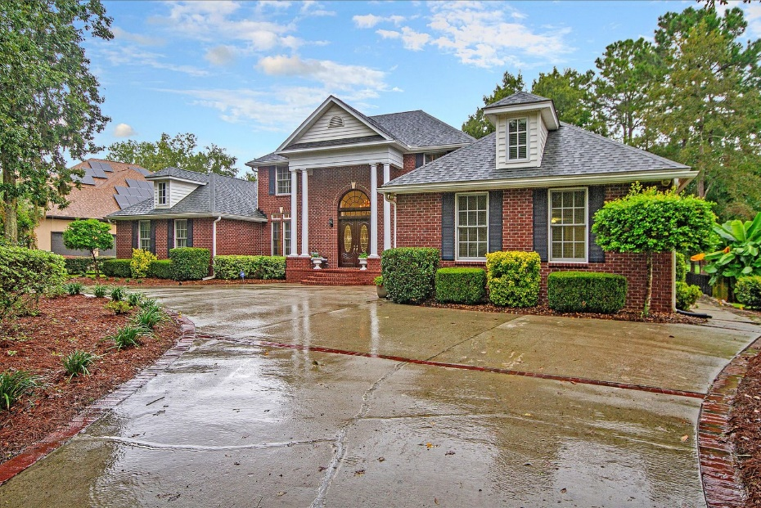
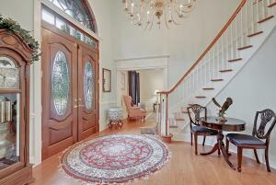
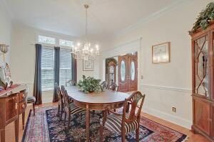
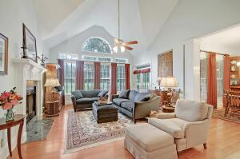
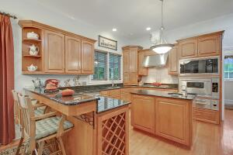
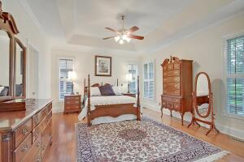
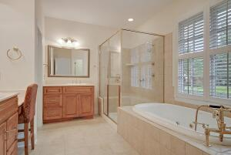
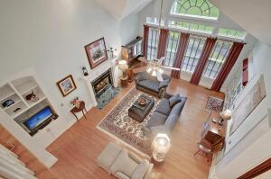
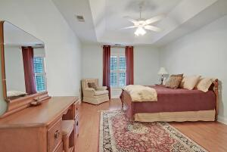
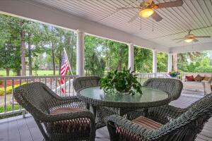
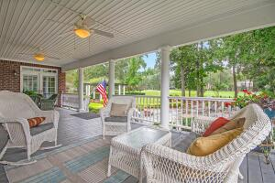
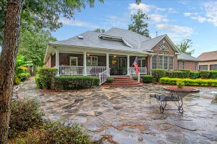
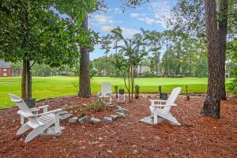
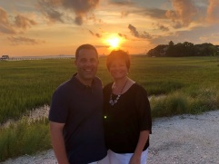

Stunning Golf Course Home in Gated Community!
4164 Club Course Drive
Coosaw Creek Country Club
North Charleston, SC 29420
MLS# 21025946
$649,900
4 Bedrooms | 4½ Baths | 3,892 sf
Stunning golf course home located in the gated community of Coosaw Creek! Get ready to be wowed the moment you arrive at this stately home with its circular drive and gorgeous setting. Upon entering, you'll be awed at the two story foyer and the natural light. To your left is the formal living room and to your right is the dining room. Both rooms have extensive trim work and transom windows. An arched doorway leads you from the dining room in to the kitchen. This kitchen is a chef's dream with its top of line appliances, granite countertops, island with vegetable sink and tons of cabinetry. Off the kitchen is a home office, laundry room, half bath and a flex space that could be another home office if needed. Back out to the kitchen, the breakfast bar overlooks the eat in area and family room. The family room has a gas fireplace, some built in cabinetry and large windows with great views of the backyard and golf course. Down the hall, head into the master suite. This master suite is stunning with a seating area and fireplace, large master bath with oversized shower and shower seat, separate jetted tub, two walk in closets and dual vanities. Also on the first floor is another bedroom with two huge walk in closets perfect for a mother in law suite as it also has a full bathroom. Head up the grand staircase and you'll find two identical rooms in either direction, both very large each with their own walk in closets and full baths. Off of one of the bedrooms is a walk in attic. So much storage in this house! Head out back to your own backyard paradise! The huge back porch has two ceiling fans and room for a seating area as well as a dining area all overlooking the stunning stone patio. There is extensive landscaping and a beautiful pathway that leads to a gazebo with seating. This house has been well maintained including crawlspace encapsulation. Wood floors throughout the home, oversized two car garage that is the cleanest garage you'll ever see which also has pull down attic storage. Newer roof and HVAC units means no big expenses anytime soon for the new owners! This house will truly impress you! The neighborhood has 24 hour 7 day a week gated security, unlimited golf for all household members, and the location, wow...close to it all! Boeing, Bosch, AFB, Mercedes are all a short drive away. Come live the good life in a golf course community that has tons of activities and events, great food in the restaurant, great community pool with an award winning swim team, and the most beautiful golf course you'll ever play on!
Larry & Kathy Mazalatis
Larry Cell 843-693-0529
Kathy Cell 843-693-0159
Office 843-871-9133
AGENTOWNED PREMIERE GROUP | 1800 TROLLEY RD | SUMMERVILLE, SC 29485

