Slide 1
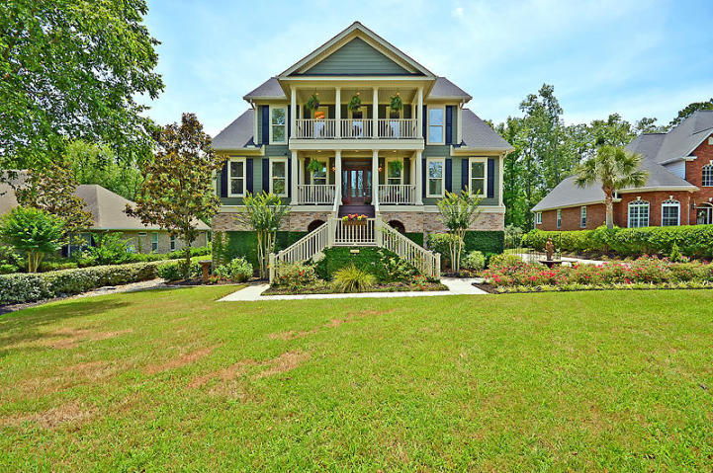
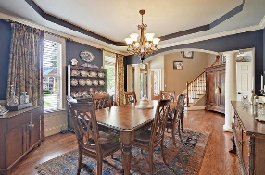
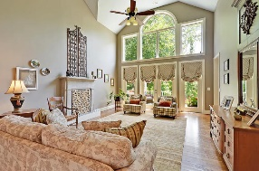
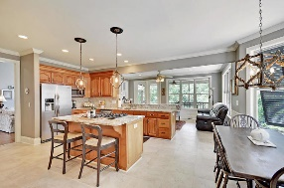
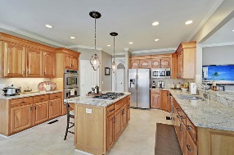
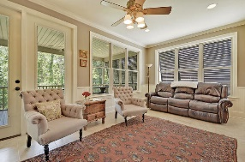
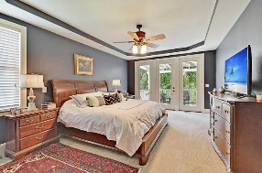
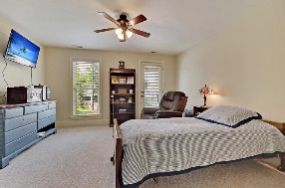
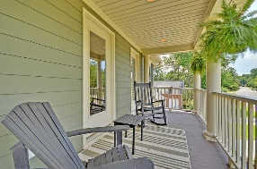
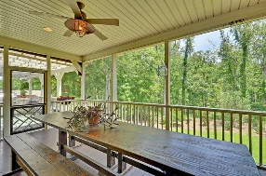
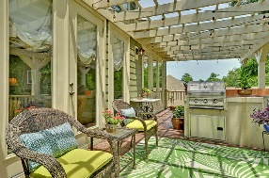
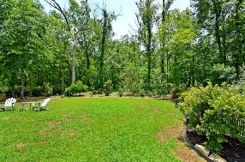
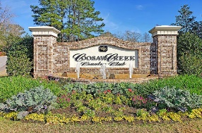
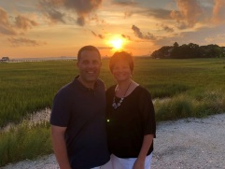

Mother-in-law Suite ~ Elevator ~ Gated Golf Course Community
4165 Club Course Drive
Coosaw Creek Country Club
North Charleston, SC 29420
MLS# 20016927
$679,000
5 Bedrooms | 4½ Baths | 4,537 sf
This custom built Lowcountry home is in EXCELLENT, move-in condition and a must see! Upon entering this stately home, you are greeted by soaring ceilings, a grand staircase, and beautiful hardwood floors. Floor to ceiling windows provide unparalleled beauty with its wooded, wetland views. The gourmet kitchen features stainless appliances, abundant counter and cabinet space, a five burner gas stove in a large center island. Also includes double ovens! Separate area being used as office nook could also function as butlers pantry or wine bar. There are dual masters in this home. Main floor master features french doors, leading to pergola covered deck, large Jacuzzi tub, and dual sinks and closets. Enjoy an elevator ride to the 3rd story where you will find additional master and 2 other rooms.
Additional Features:
Finished elevator with access to all three floors
Full first floor apartment with separate entrance, full kitchen, and separate laundry room (perfect for in-laws, guests, or grown children)
Central Vac system
Decorative Fireplace in Great Room
Custom Roman shades (which will convey)
Nadeau mirrors in bathrooms convey
Bermuda shutters
Professionally landscaped yard by Flowertown Garden Center
Irrigation system
Large walk in closets in every room
Multi level deck with half screened in on each level.
Gas grill connections on both decks, perfect for entertaining
Located on wetlands with abundant wildlife
Gated Community
Arthur Hills designed, award winning golf course
Junior Olympic size 25 meter pool
City Champion swim team
Third Floor Features:
Master with claw foot tub, separate shower, dual sinks, access to third floor front porch
Another room with access to third floor porch
Larry & Kathy Mazalatis
Larry Cell 843-693-0529
Kathy Cell 843-693-0159
Office 843-871-9133
AGENTOWNED PREMIERE GROUP | 1800 TROLLEY RD | SUMMERVILLE, SC 29485

