Slide 1
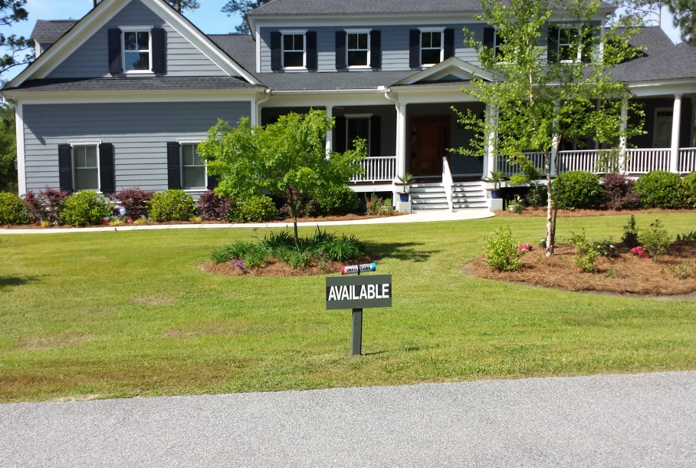
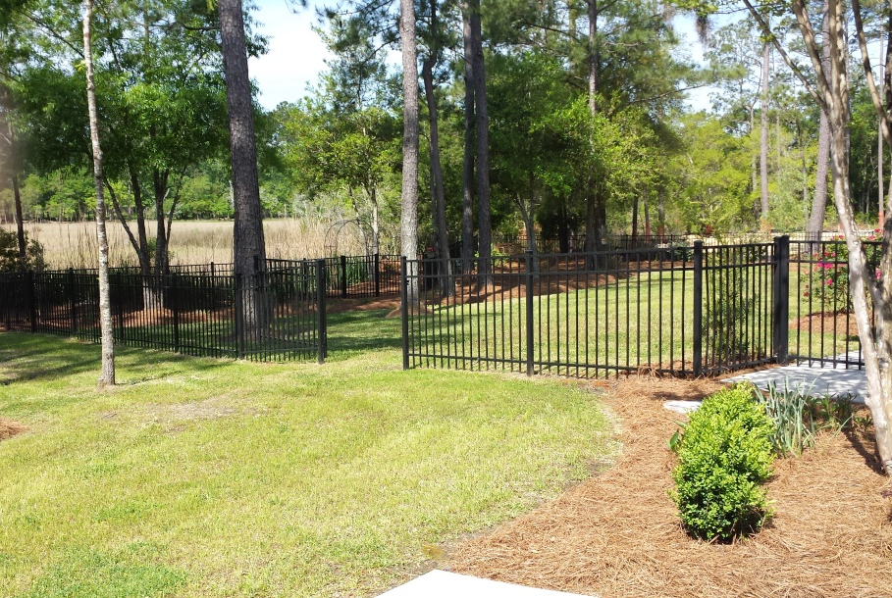
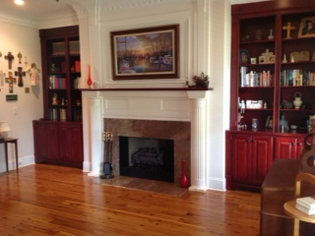
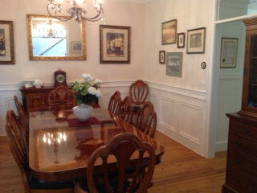
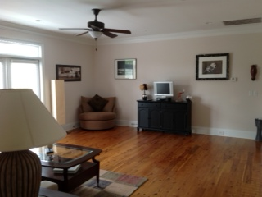
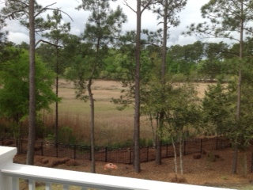
4165 Duck Club Rd
Poplar Grove ~ Ravenel ~ MLS# 1410384 ~ $768,500
Country Living Yet Close to Charleston
Priced to sell and move-in condition. Beautiful 4 bedroom, 3 full baths, 2 half bath located on large marsh front lot. 2 full master suites, 1 upstairs and 1 downstairs. Both master baths have separate walk in showers and jetted tubs and granite vanity tops. Interior of home features central vacuum system, crown moldings, Australian cypress hardwood floors in living areas, kitchen, library, master bedroom and stairs. Tile floor in all bathrooms. Family room has a beautiful granite fireplace surround and fireplace also in living room. The gourmet kitchen has granite counter tops. Exterior features include architectural shingles, Hardi-Plank siding, 3 car garage, Enclosed metal fence and invisible fence, deck, porch, screen porch. Poplar Grove is a gated community with boat ramp, dock facilities and club house.
Jack Bennett
Mobile - (843) 708-8300
jockbennet@gmail.com
Harbourtowne Real Estate | 672 Marina Drive, Ste 110 | Daniel Island, SC 29492

