Slide 1
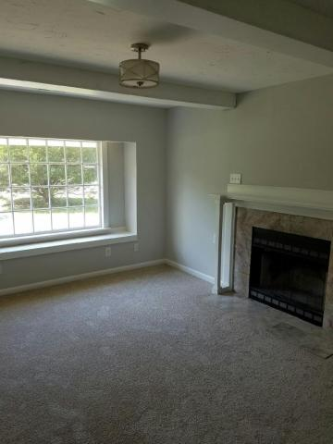
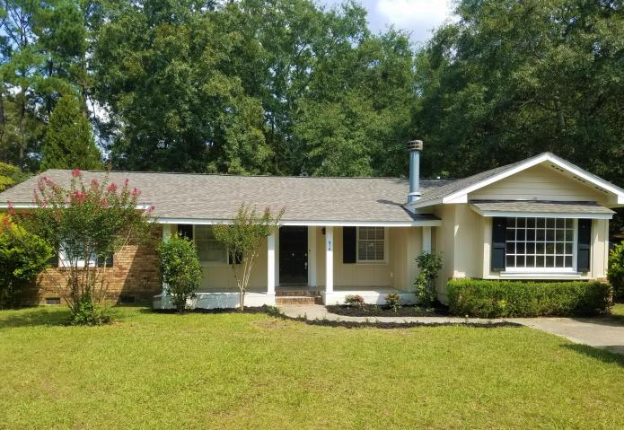
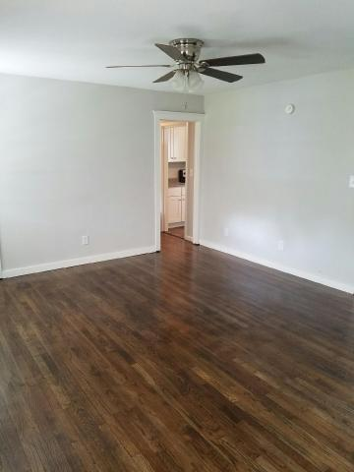
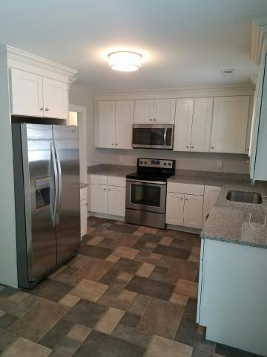
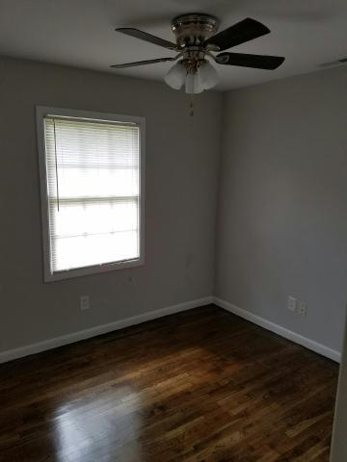
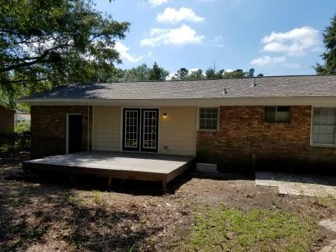
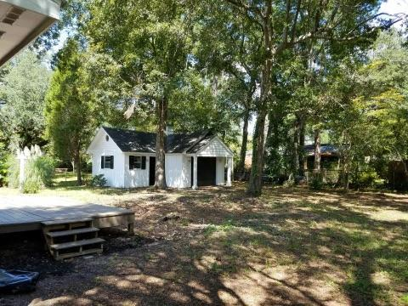
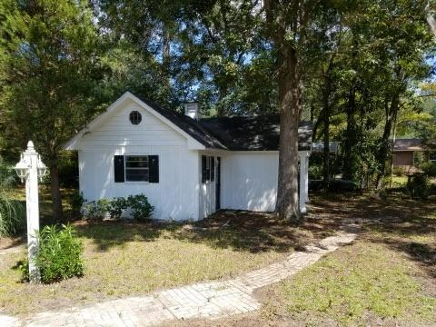


Available
Nov 1st!
$10k Price Reduction!
416 Forest Circle
Oakdale Estates · Summerville
MLS# 16024547 · $199,900
Do not miss this fully renovated, practically brand new home.
Home has New Water Heater, New HVAC, New Roof, New Kitchen with Granite, Refinished Hardwood Flooring, New Carpet, and Stainless Steel Appliances, Brand New Bathrooms, Fenced in Backyard, Detached Two Car Garage or Shop in Backyard, with Mature Trees.
Carly Jent
(843) 642-6057
carly@scpmx.info
www.scpmx.info
SC Property Services | 1514 Mathis Ferry, Suite 202 | Mt. Pleasant, SC 29464

