Slide 1
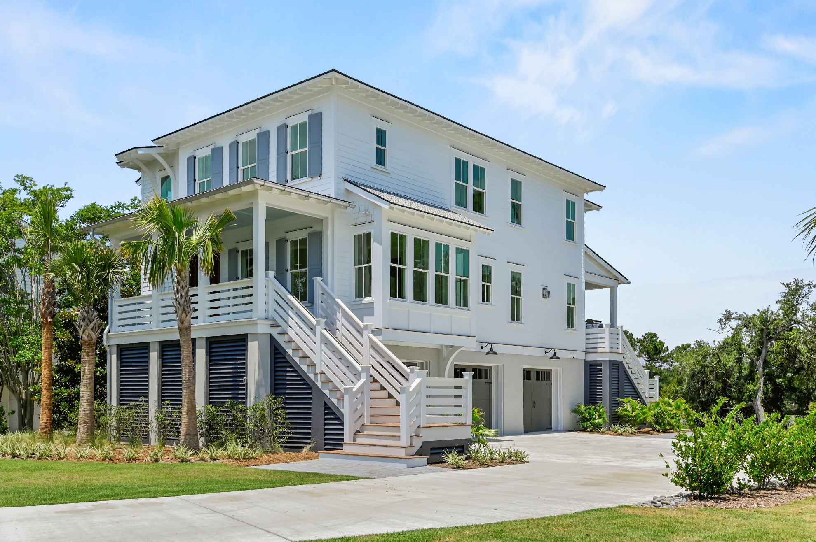
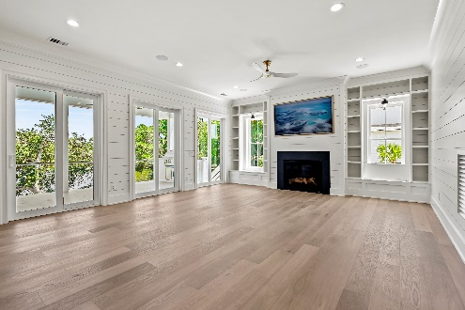
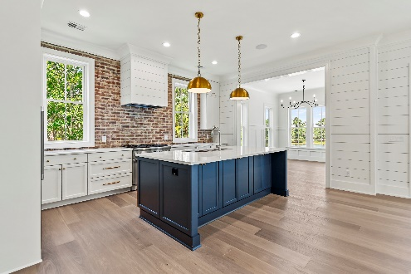
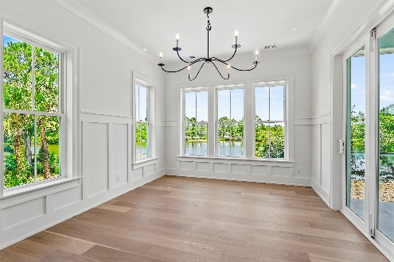


4176 Victory Pointe Drive
Victory Pointe | Mt Pleasant | MLS# 24000984 | $2,950,000
FINISHED NEW CONSTRUCTION!!!
Agent Open House
Thursday, June 6th
10:30 - 1:00
Take a look
at this listing!
Located in Victory Pointe, an exclusive gated community, on the banks of a picturesque lake overlooking lush marsh and the rolling fairways of Charleston National Golf Course, this home is truly a work of art! Entering the Foyer, you will be captivated by the floating antique wooden beams reclaimed from the1920's Prohibition Era, setting the tone for the exquisite craftsmanship throughout this home. The Kitchen features Thermador Professional Series appliances, custom cabinetry, a large island, and a walk-in Pantry with an additional refrigerator/freezer and antique reclaimed circle-sewn countertops. Off the Kitchen is a separate Dining Room offering a panoramic view! The Family Room is highlighted by a gas fireplace accented by a 75" Frame TV, and flanked by custom built-in bookshelves. 3 sets of Glass Doors open from the Living Room to the back porch that features a built-in Broilmaster Grill and overlooks a custom patio with built-in firepit and seating! Completing the main level is an elegant Powder Room with floating vanity and a Bedroom with ensuite Bathroom. Whether you take the stairs or the 3-stop elevator, the Primary Suite is sure to impress! With breathtaking views of the lake and fairways, it also features a covered walkout deck. The Bath includes dual vanities, a beautiful soaking tub, an oversized walk-in shower, a wall of custom cabinetry, and an exceedingly large Closet. The 3rd and 4th Bedrooms each have ensuite Baths. The 3-car garage level is spacious enough for a workshop, extra storage, or golf cart.
Wendy Arnsdorff
843-364-8619
wendy.arnsdorff@carolinaone.com
www.wendyarnsdorff.com
Carolina One Real Estate :: Mt. Pleasant North Office :: 2713 N Highway 17 :: Mt. Pleasant, SC 29466

