Slide 1
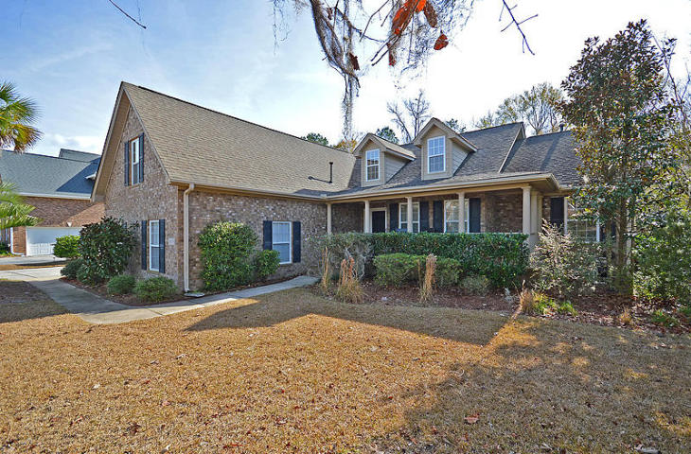
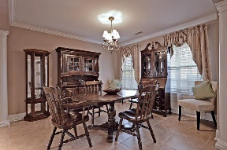
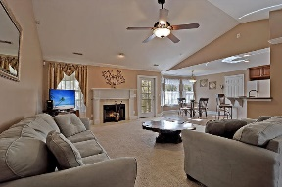
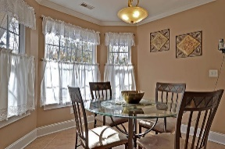
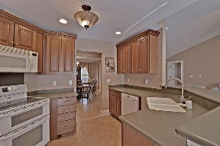
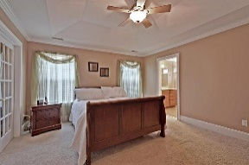
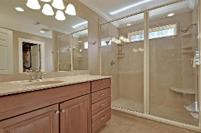
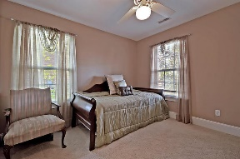
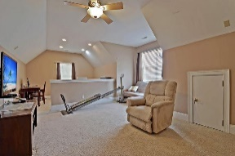
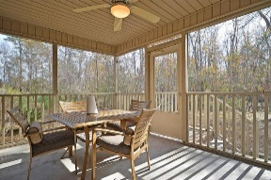
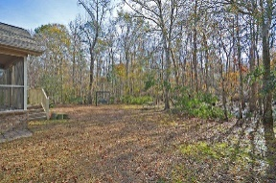
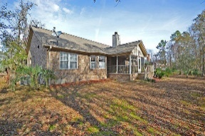



One-story In Gated Golf Course Community
4179 Club Course Drive
Coosaw Creek Country Club
North Charleston, SC 29420
MLS# 17001091
$329,000
4 Bedrooms | 2 Baths | 2,500 sf
This beautiful, custom, brick, one-story home is in immaculate, move-in condition and offers 3 bedrooms on the ground floor and a FROG / bonus room or 4th bedroom is the only room upstairs! Walking inside, buyers will notice elegant, custom tile floors in the foyer and large dining room. The family room is spacious and offers a gas fireplace and is open to the kitchen breakfast bar. The kitchen also has tile floors, pantry and an eat-in kitchen area. The large master bedroom is on the left side of the home and offers an attached sitting room / exercise room / nursery or office as well as a master bathroom with dual vanities and a huge shower and a walk-in closet. Two more bedrooms are on the opposite side of the home and share a full bathroom. The screened porch overlooks a PRIVATE, wooded backyard. Upstairs buyers will find the FROG which can be a 4th bedroom, playroom or used for practically anything! With beautiful landscaping, curb appeal and a price in the low 300's, this home will not last long! Come see it today! Coosaw Creek also offers excellent amenities such as golf, tennis, community pool and a clubhouse with a full restaurant and bar and all in a gated golf course community close to the airport, Boeing and Bosch!
Larry & Kathy Mazalatis
Larry Cell 843-693-0529
Kathy Cell 843-693-0159
Office 843-871-9133
AGENTOWNED PREMIERE GROUP | 1800 TROLLEY RD | SUMMERVILLE, SC 29485

