Slide 1

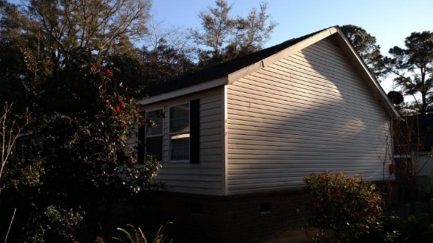
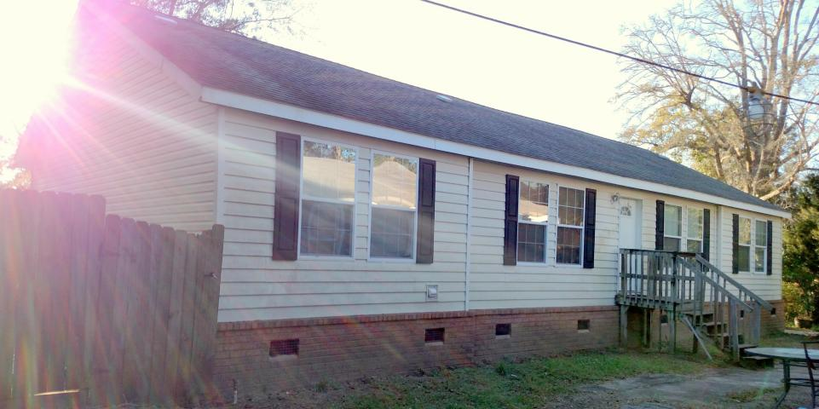
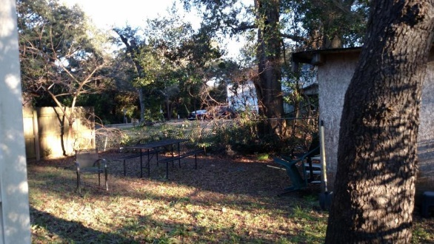
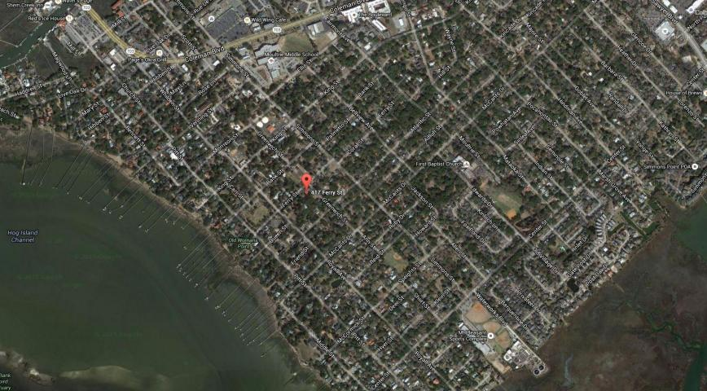
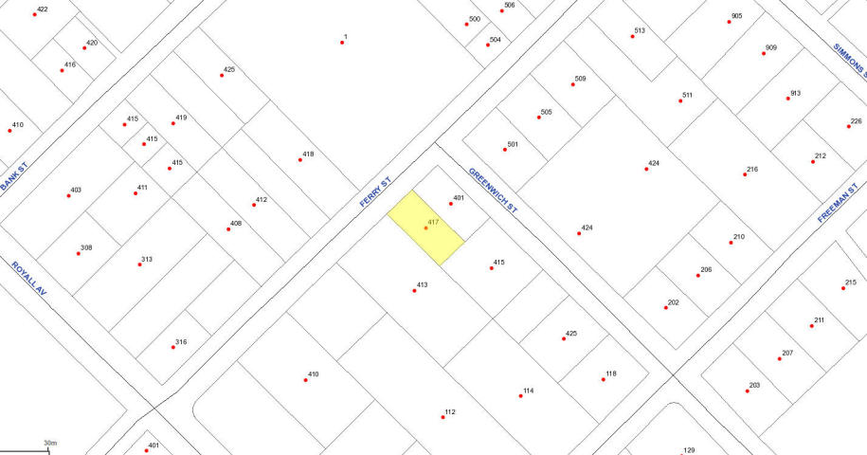
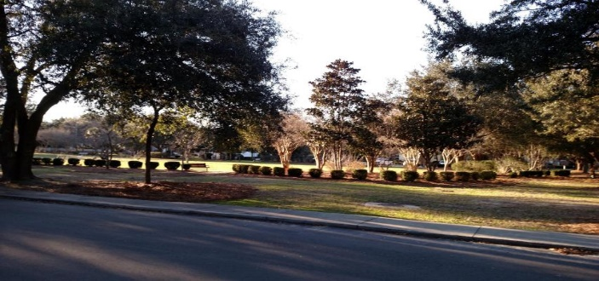
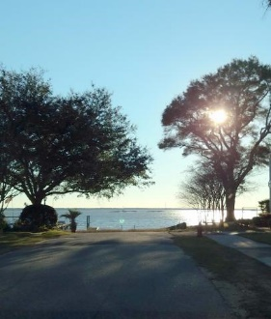
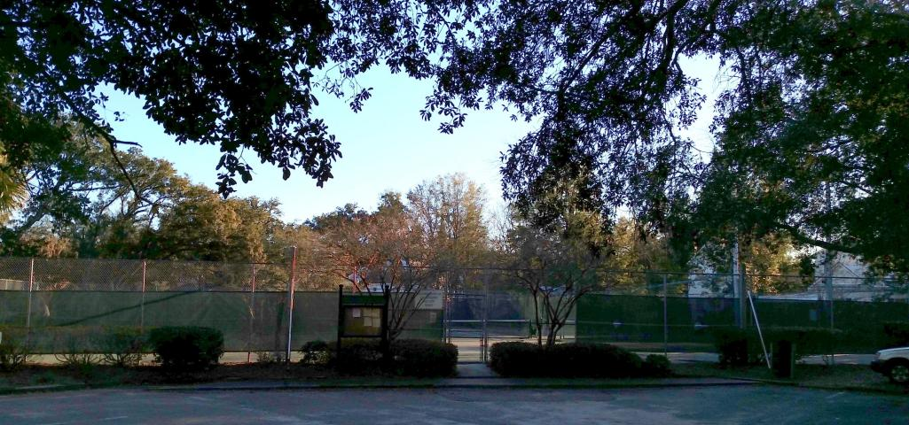

Great Old Village Lot
Drastically Reduced …Motivated Seller!
Penelope Hayes
O - 843-856-0021
C - 843-605-7099
phayes@century21properties.com
417 Ferry Street | Mount Pleasant | MLS# 16001375 | $295,000
GREAT OLD VILLAGE LOT w/ modular home. PRICED TO SELL! MOTIVATED SELLER ALL OFFERS WILL be CONSIDERED Keep the modular home or move it to another location and build your dream home! Walking distance or a short bike ride to the best parks, schools, and restaurants. Surrounded by new construction, renovated dwellings and older homes. A waterfront neighborhood, The Old Village is one of the area’s most coveted neighborhoods for families, retirees and young professionals. A true neighborhood, with a commitment to keep its history in the forefront! Conveniently located on the eastern side of the Charleston Harbor.
Just a short walk to dog park, boat landing, and tennis courts
Century 21 Properties Plus | 3301 Salterbeck Ct Suite 100 | Mt. Pleasant, SC 29466

