Slide 1
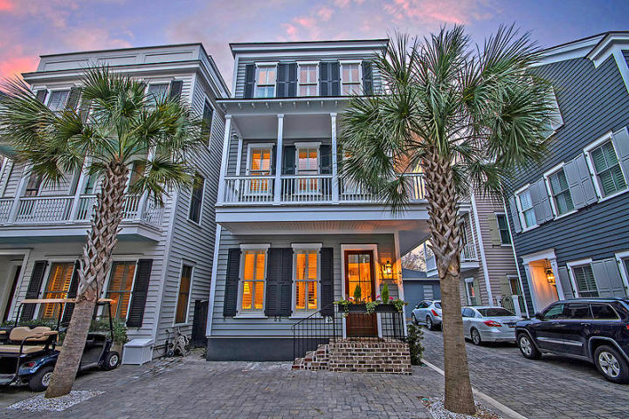
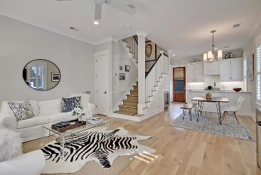
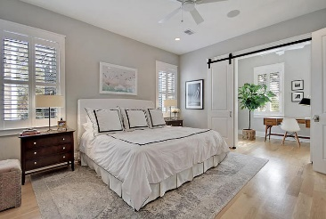
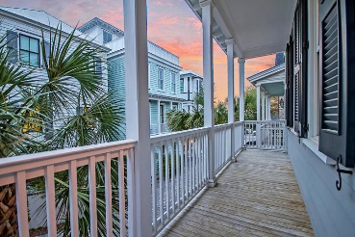
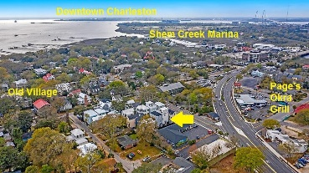


417 Rose Wilder Lane
Earls Court :: Mount Pleasant, SC 29464
MLS# 20008063 :: $774,900
Luxury Single Home in Mt Pleasant's Old Village
Just Reduced!
Home is vacant, sanitized, and ready to show without agent interaction. Call ahead and the lights can be turned on as well.
This Charleston "Single House" takes style to the next level and is just footsteps from fine dining, shopping and recreation opportunities in and around the Mount Pleasant's historic Old Village and it's picturesque shrimp fleet marina at Shem Creek. This property can be a dream primary residence, investment and/or second home. The low maintenance exterior includes a privacy fenced back yard with a paver patio. Multiple interior upgrades have been added such as custom closet organizers and additional cabinetry. The floor plan is bright and open with over-sized windows, plantation shutters, thoughtful coastal color selections, extensive mill work 10ft ceilings and 8ft doors. All this comes with easy access to downtown Charleston, the beaches, top-rated schools, parks and much more.
1874 Sq ft, 3bd, 2.5ba
7-minute walk to the restaurants, parks, marina and more around Mt Pleasant's historic Old Village and iconic Shem Creek
Corner lot
Seller is original owner
Two designated off-street parking spots
X flood zone (flood insurance is not required by lender)
5-inch lightly stained white oak flooring
Bertazonni duel fuel range
Leibherr bottom-freezer refrigerator
Bosch dishwasher
Subway tile kitchen backsplash
Marble counters in all baths and kitchen
Solid wood shelving in all closets
Upgraded master bath with frameless glass shower door and Carrera marble shower
Subsequent to purchase, added $38,000 of improvements:
Custom Closets & Laundry Room Cabinetry
Plantation Shutters and Custom Blinds
Bath Cabinetry
Carpet Runner on Stairs
Four 4K/HD Smart TVs
Added a custom-fit Kitchen Aid Refrigerator
High Efficiency Washer & Dryer
Multi-directional Swing-arm TV mount
Closet and Laundry Room hardware
Interior paint
Under Cabinet lights
* Earl's Court homeowners' association does allow short-term rentals.
Steve Kaul, REALTOR
(843) 817-5547 · skaul@carolinaone.com
www.charlestonhousehunt.com
Carolina One Real Estate · 195 W Coleman Blvd · Mt Pleasant, SC 29464-3495

