Slide 1
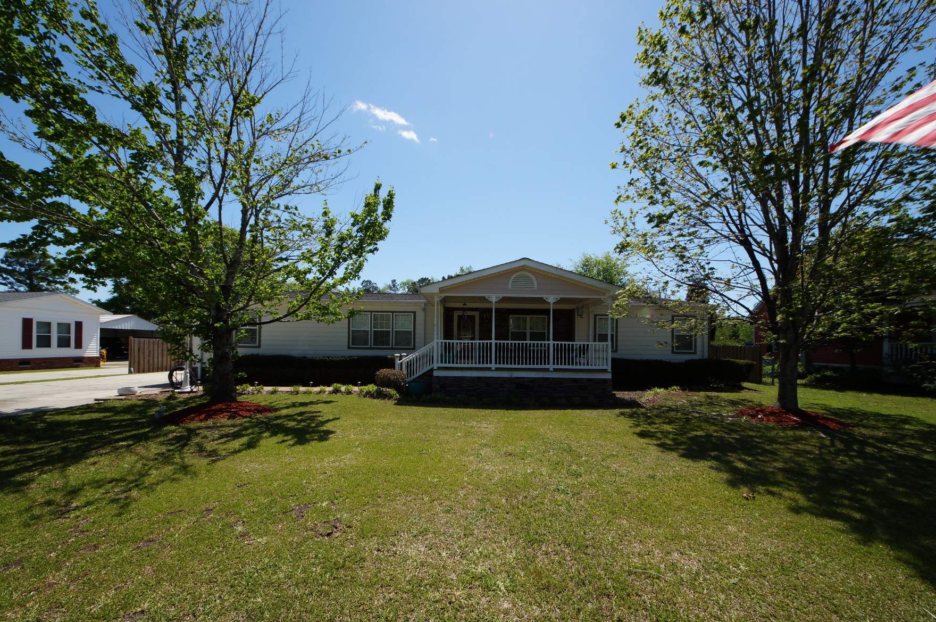
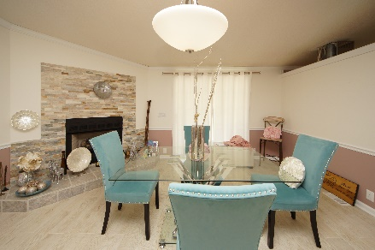
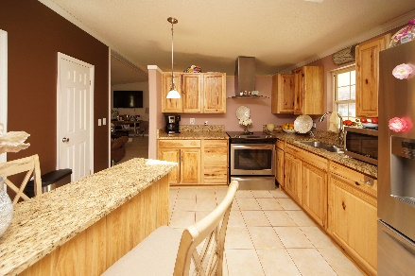
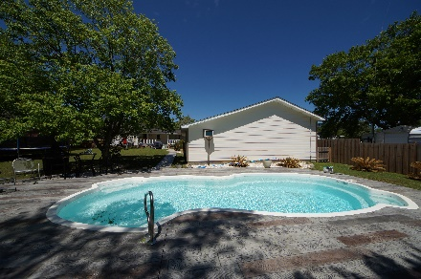


417 Treeline Drive
Springhill :: Moncks Corner, SC 29461
MLS# 18010644 :: $216,000
3 Bed / 2 Bath
Complete Remodel
Just Reduced!
$210,000
Complete Remodel to include New Roof, Hardie Plank siding, Tile Flooring, Sheet Rock & Crown Molding, Front Porch, Back Porch, Upgraded fixtures, 2 Car garage with mother-in-law suite/kitchen, decorative concrete and new in ground swimming pool and outside outhouse with shower!
Seller will also leave wall mount flat screen TV in living room. Not your average manufactured home. Please view our photos. This home is amazing!
Connie White, Broker
843-532-3356
conniesyouragent@gmail.com
Charleston Homes · 597 Old Mt. Holly Road · Suite 301 · Goose Creek, SC 29445

