Slide 1
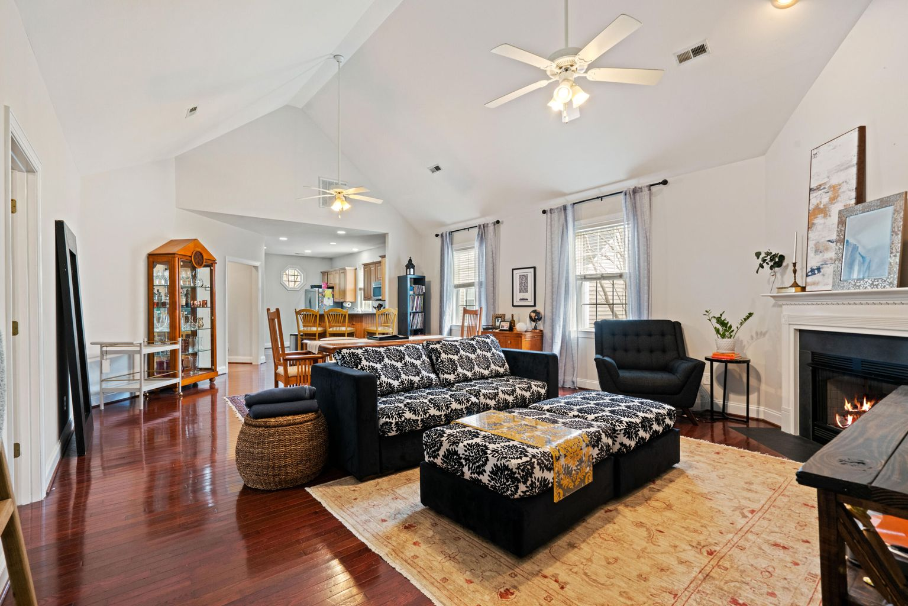
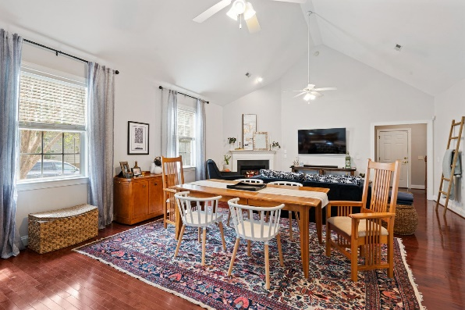
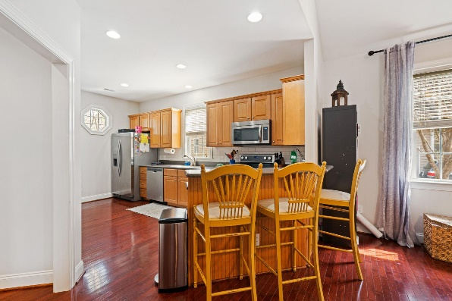
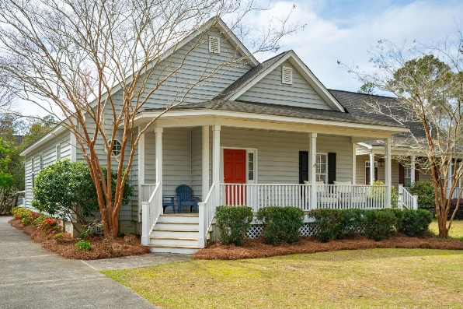
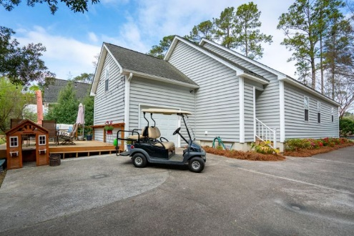


Price Drop!
Immaculate and well cared for home in the heart of Summerville. Open floor plan downstairs, oversized master suite with his and hers closets and en suite bathroom, with new granite recently installed. Two additional bedrooms with a bathroom right off main living area. Good sized FROG and a nice deck off the back of the house. Stainless steel appliances in the open kitchen with a bar top for easy living and plenty of cabinet space. The best part is your proximity to Historic downtown Summerville. It is an easy golf cart ride to all the shops, dining, and attractions this area has to offer. This is a very well cared for home and it shows.
417 Waring Street
Cottages at Shepard Place | Summerville, SC 29483
MLS# 21007680 | $327,656
$11,000 price drop on this fantastic home a golf cart away from historic downtown Summerville!
There is nothing else priced like it this close to historic downtown.
Updated master bath, hardwoods throughout main living areas, stainless appliances, and a true bargain at $327,656!
Justin Natale
843-437-9739 | jnatale1982@gmail.com
www.theblvdcompany.com
The Boulevard Company, LLC | 806 Johnnie Dodds Blvd Ste 100 | Mt Pleasant, SC 29464

