Slide 1
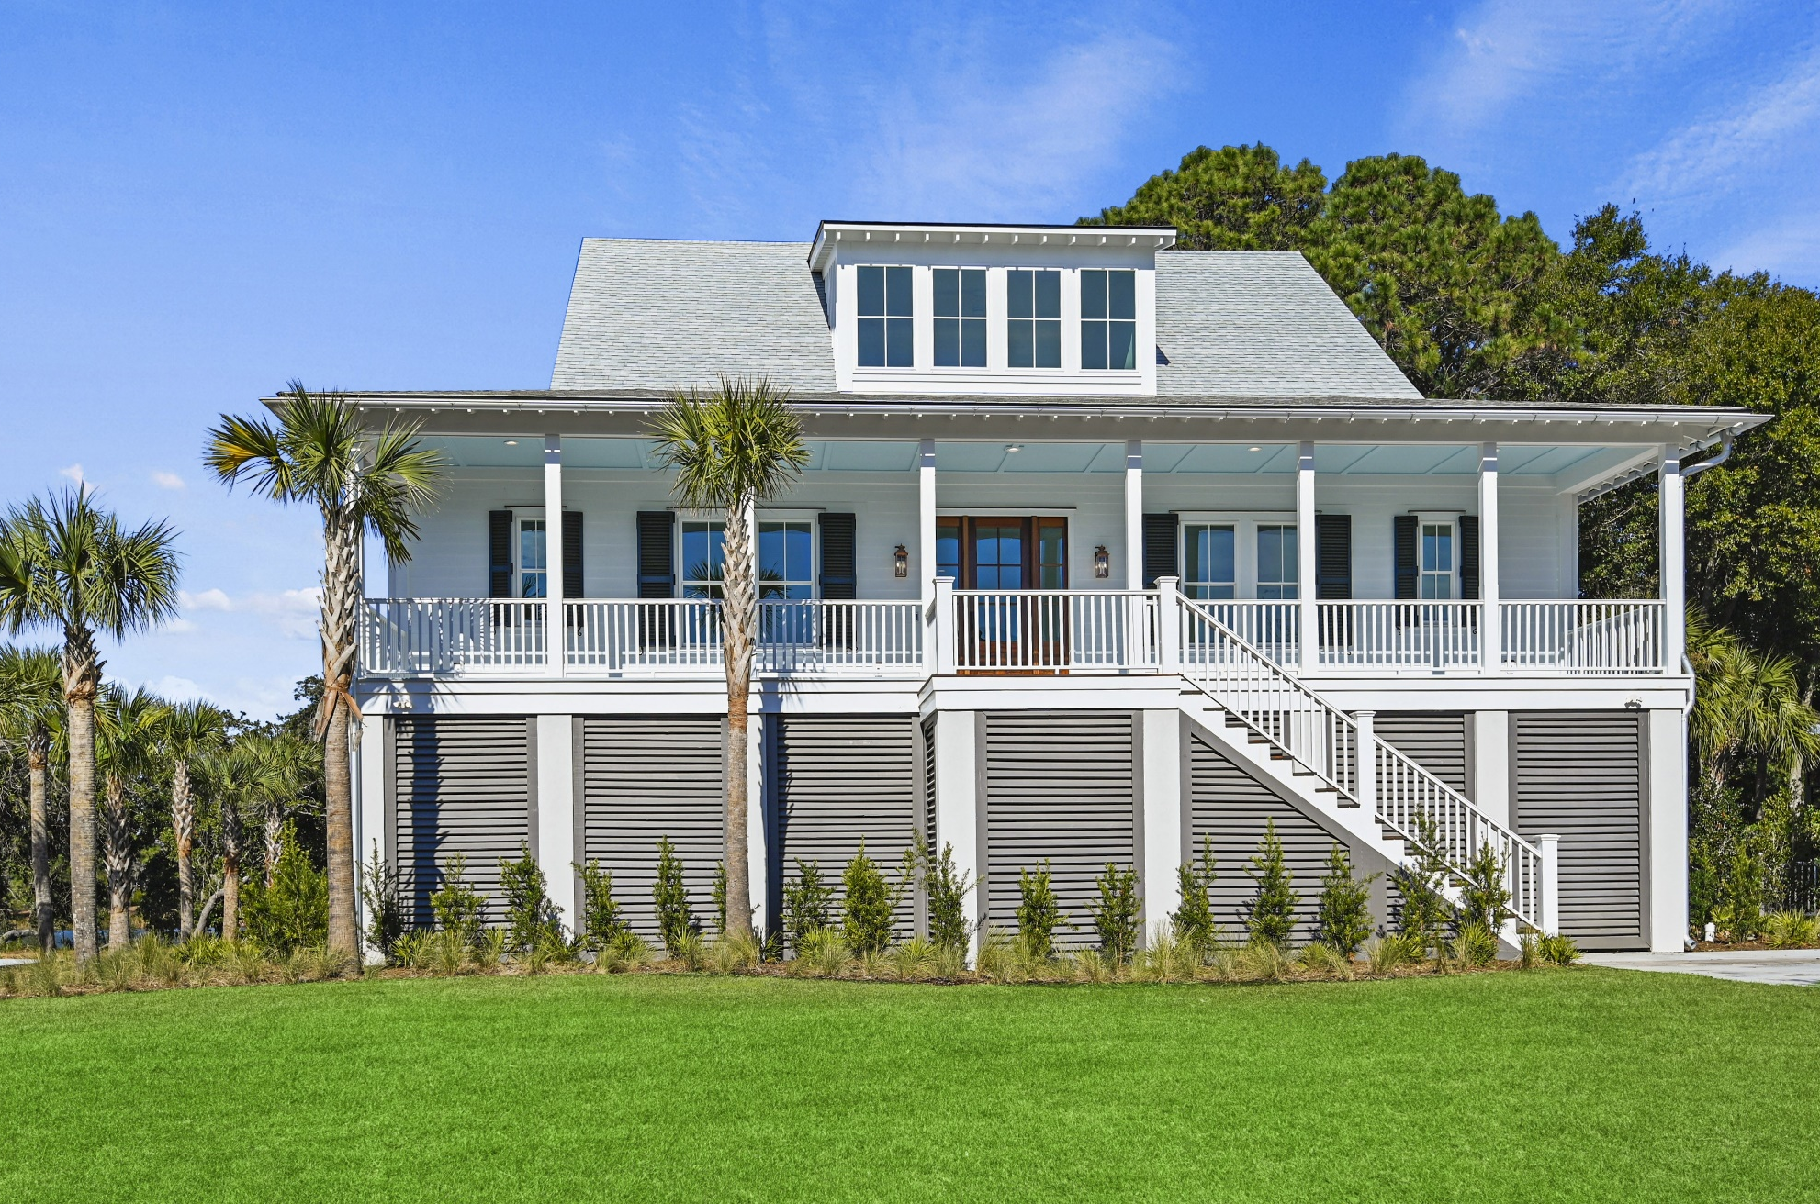
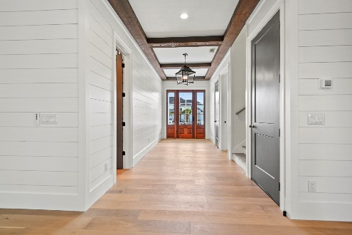
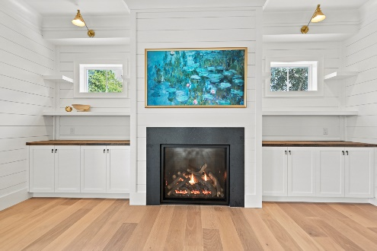
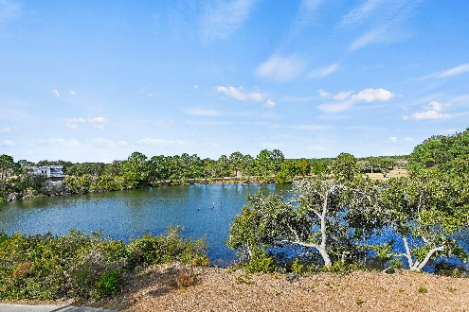


4180 Victory Pointe Drive Victory Pointe | Mt Pleasant | MLS# 23028422 | $2,799,000
Luxury New Construction
Open House Jan 28th ~ 1-3p
Open House
Jan 4th ~ 10a-12p
Be the first to view this gorgeous new construction home located in the private, gated community of Victory Pointe, overlooking a lake brimming with wildlife, the rolling hills of Charleston National golf course, and a glistening marsh!
DESIGN FEATURES
Constructed 2023
Expected Delivery February 2024
4 Bedrooms | 4.5 Baths
Master suites on the main and Upstairs
Open Floor Plan
10' Ceilings on the main, 9' upstairs
Full Front and Rear Porches
Thermador Professional Series Appliances
Reclaimed Wood Accents
Hurricane Impact Resistant Windows and Doors
Wendy Arnsdorff
843-364-8619
wendy.arnsdorff@carolinaone.com www.wendyarnsdorff.com
Carolina One Real Estate :: Mt. Pleasant North Office :: 2713 N Highway 17 :: Mt. Pleasant, SC 29466

