Slide 1
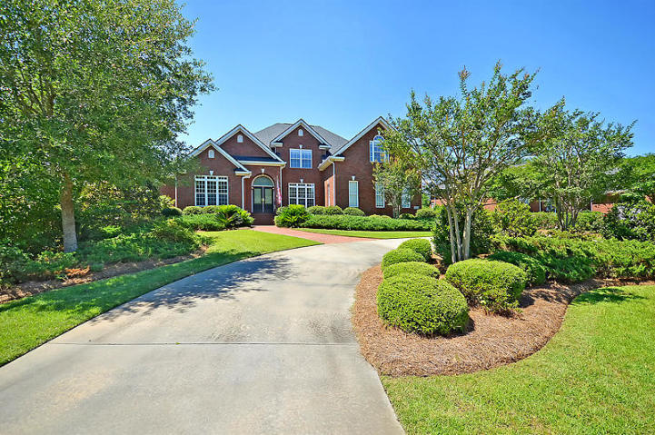
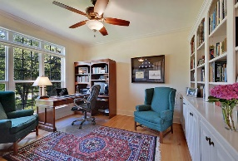
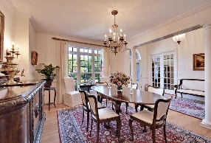
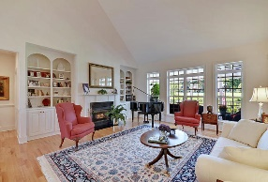
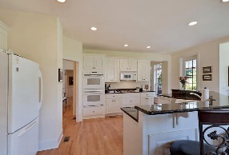
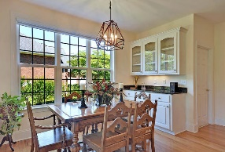
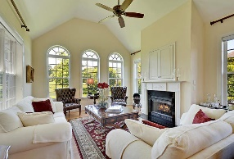
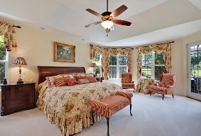
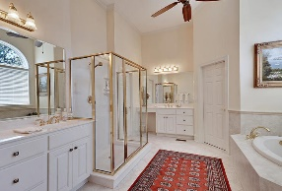
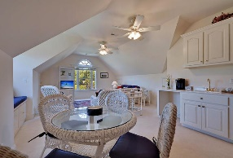
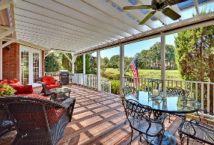
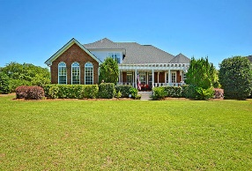



Stunning Home on Golf Course in Gated Community
4182 Club Course Drive
Coosaw Creek Country Club
North Charleston, SC 29420
MLS# 19017998
$599,000
4 Bedrooms | 3/2 Baths | 4,000 sf
This custom built, brick, golf course and pond site home is in IMMACULATE, move-in condition! This home offers 4,000 Sq. Ft., 4BR, 3BA, 2 half BA with the master bedroom downstairs and awesome pond and golf course views from the family room, kitchen and keeping room. Please view other Coosaw Creek homes and you will find this executive home stands out in terms of custom construction quality, upgrades and also condition of the home! Upon entering buyers will notice beautiful hardwood floors and will find an office to the left with custom built-in cabinetry and glass French doors. To the right buyers will find a dining room with chair rail and crown molding. The family room has vaulted ceilings, gas fireplace, custom cabinetry and opens to the gourmet kitchen with huge island / sitting bar, granite counters, dual ovens, gas cooktop, large walk-in pantry and custom cabinetry. Attached to the kitchen is a keeping room with gas fireplace, vaulted ceilings and awesome golf course and pond views! Buyers will also find an eat-in kitchen area and laundry room downstairs along with an entrance to the large back deck with sunsetter screens for privacy / shade and great views! The master bedroom is downstairs and offers tray ceilings, great golf course views and a master bathroom with jetted tub, separate shower, dual walk-in closets and dual vanities. Upstairs buyers will find 3 bedrooms with walk-in closets, 2 full bathrooms and a large FROG with a wet bar and window seats. The FROG could be a 5th bedroom or could be used as an entertainment / gameroom, exercise room or upstairs family room. The property is professionally landscaped with a circular drive and a large 3 car garage with extra cabinetry. Roof replaced in 2017 and main HVAC unit replaced in 2018. This home is a MUST SEE! The neighborhood has 24 hour 7 day a week gated security, unlimited golf for all household members, and the location, wow...close to it all! Boeing, Bosch, AFB, Mercedes are all a short drive away. Come live the good life in a golf course community that has tons of activities and events, great food in the restaurant, great community pool with an award winning swim team, and the most beautiful golf course you'll ever play on!
Larry & Kathy Mazalatis
Larry Cell 843-693-0529
Kathy Cell 843-693-0159
Office 843-871-9133
AGENTOWNED PREMIERE GROUP | 1800 TROLLEY RD | SUMMERVILLE, SC 29485

