Slide 1
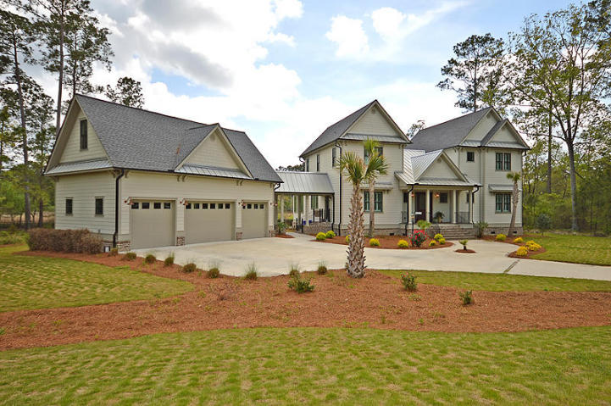


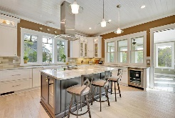
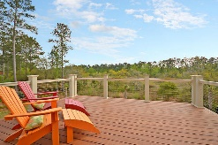

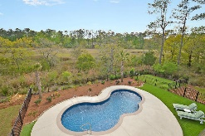

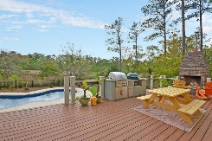

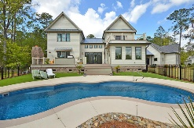
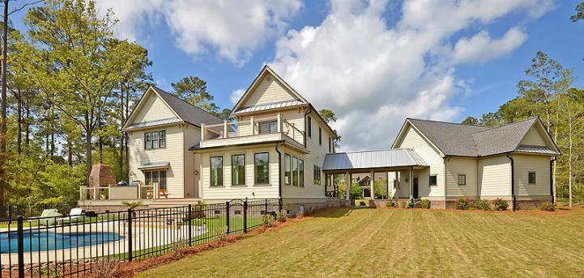



4185 Duck Club Road
Poplar Grove ~ Ravenel, SC 29470
1.3 Acres On The Marsh ~ Gated Community
Poplar Grove is over 5 thousand Acres of low country paradise. Enjoy fishing, crabbing, kayaking, paddle boarding along 5 miles of waterfront on the Deep Water Rantowles Creek. Enjoy our community Boathouse with Deep Water Dock, Kayaking outpost, boat landing, and boat storage available. Miles of walking, biking, and equestrian trails make this neighborhood sought after for the outdoor lifestyle with nature preserved all around. Poplar Grove's awarding winning amenity center has a Salt Water Pool, Fitness Center, and Marsh Observation Deck overlooking Deep Water expansive views. Poplar Grove is convenient to downtown, 526 and 17 along with all Charleston has to offer. If you want the feel of a NEW DREAM home without waiting to build, here it is!!!
Asking $929,000
MLS# 18012916
3,343 SqFt
4 Beds / 3 Baths
Marshfront water views
Custom Contemporary
Deborah Wingard
(843) 458-0827
deborah.wingard@southeastern.company
Elyssa Wingard
(843) 458-2214
elyssa.wingard@southeastern.company
www.southeastern.company
Southeastern • 4245 Ten Shillings Way • Ravenel, SC 29470

