Slide 1

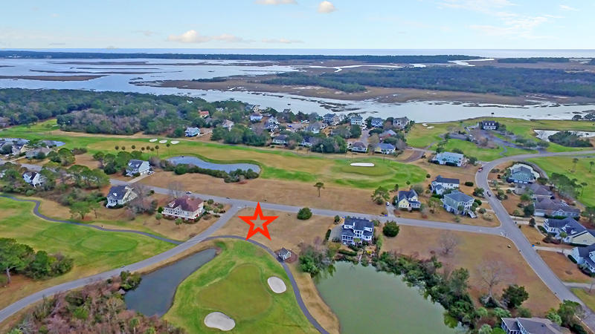
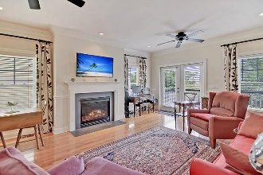

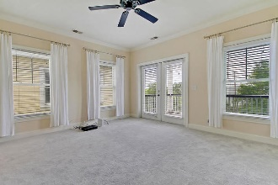
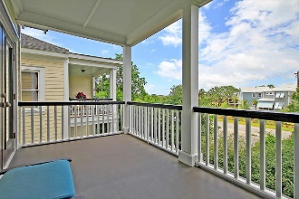
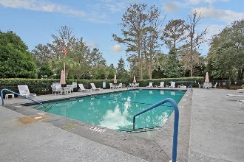
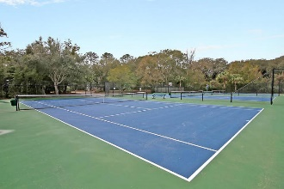
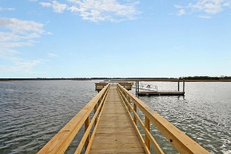
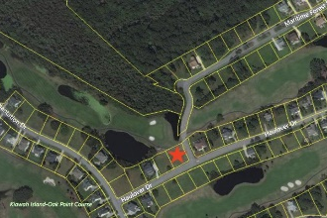


Build Your Dream Home in Kiawah River Estates
4189 Haulover Drive
Kiawah River Estates | Johns Island, SC 29455 | MLS# 19027089 | $118,000
Wonderful corner homesite on Kiawah Island Golf Resort's Oak Point Golf Course in the lovely, gated community of Kiawah River Estates. Cleared and level, this high homesite has long golf course views of the fourth and fifth fairways. On the back side of the property you have views of the fourth green, a peaceful lagoon, and undevelopable woods. Enjoy all that Kiawah River Estates has to offer including golf, tennis, basketball, a clubhouse with pool and fitness room/classes, library, book club, social events, and a community dock and park. Club membership opportunities are available in the Kiawah Island Governor's Club and the Seabrook Island Club. Kiawah River Estates is located approximately 5 minutes from Seabrook Island, Kiawah Island, Beachwalker County Park, Bohicket Marina, and Freshfields Village shopping and dining. It is a lovely 30 minute ride to downtown Charleston. House plans available.
Lee Lindler
Cell (843) 637-0803 | lee@akersellis.com
Akers Ellis Real Estate LLC | 3730 Bohicket Road, Suite 5 | Johns Island, SC 29455
akersellis.com

