Slide 1

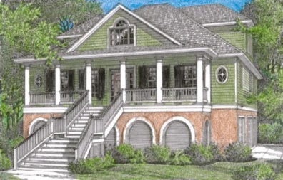
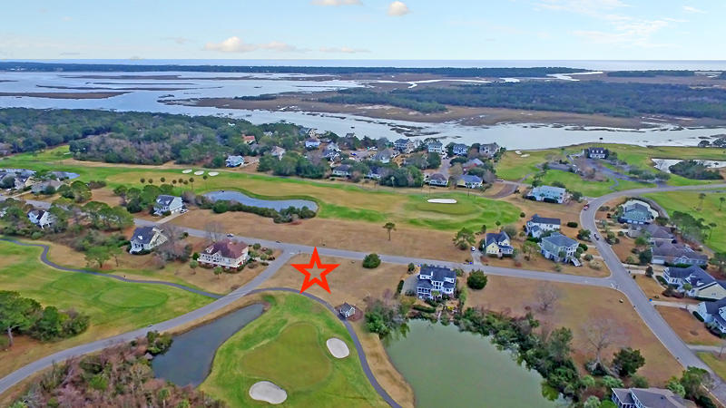
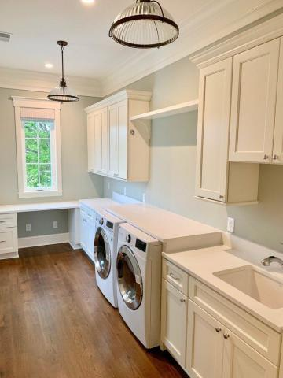
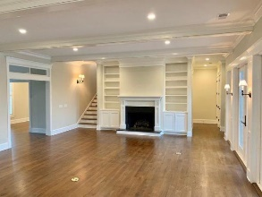

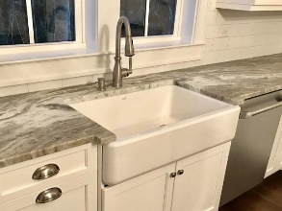
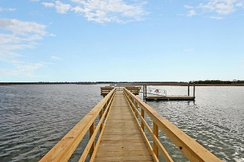
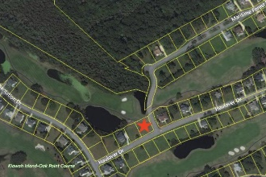


Kiawah River Estates Proposed Construction
4189 Haulover Drive
Johns Island, SC 29455 | MLS# 19027088 | $791,100
Elevated construction and high-end finishes!
Build your dream home on this cleared corner lot overlooking Kiawah Island Golf Resort's Oak Point Golf Course, a tranquil lagoon, and undevelopable land across the fairway. This amazing proposed construction has a wonderful builder in place, and the lot price is included in the package. High-end finishes featuring 5'' oak flooring and crown molding throughout, tiled bathrooms, 8'' baseboard, elevator shaft with optional elevator, granite countertops, cement fiber siding, gas fireplace, tabby driveway, and a Mahagony front door.
Enjoy all that Kiawah River Estates has to offer including golf, tennis, basketball, a clubhouse with pool and fitness room/classes, library, book club, social events, and a community dock and park. Memberships are available in the Kiawah Island Governor's Club or Seabrook Island Club. Kiawah River Estates is located approximately 5 minutes from Seabrook Island, Kiawah Island, Beachwalker County Park, Bohicket Marina, and Freshfields Village shopping and dining. It is a lovely 30 minute ride to downtown Charleston. Other house plans are available.
Lee Lindler
Cell (843) 637-0803 | lee@akersellis.com
Akers Ellis Real Estate LLC | 3730 Bohicket Road, Suite 5 | Johns Island, SC 29455
akersellis.com

