Slide 1
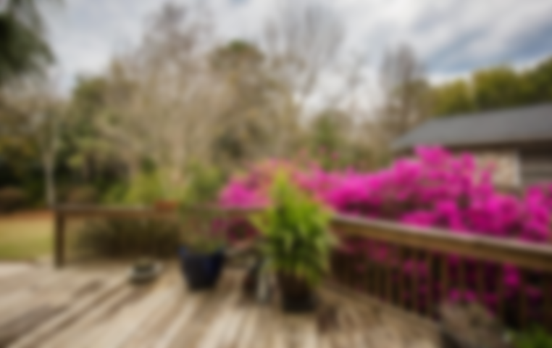
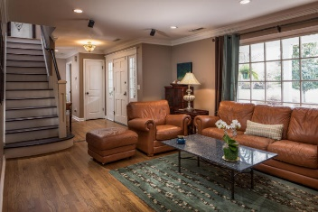
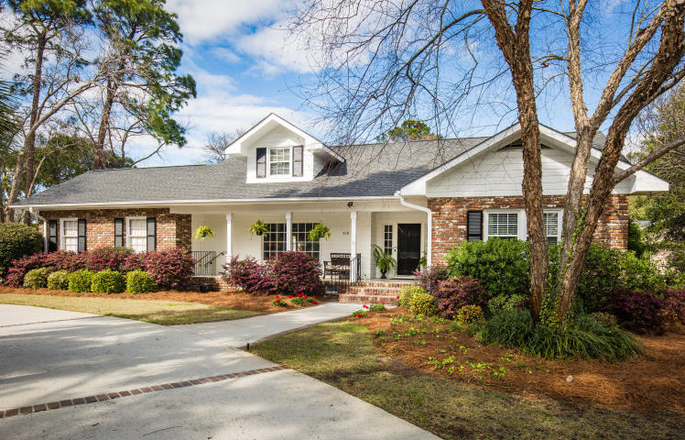
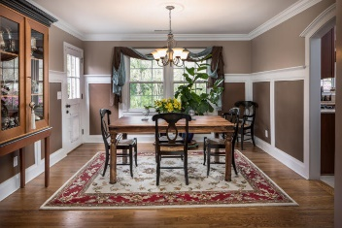
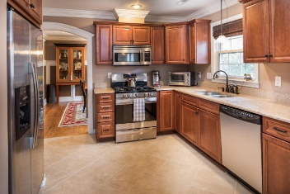
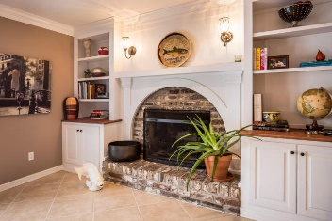
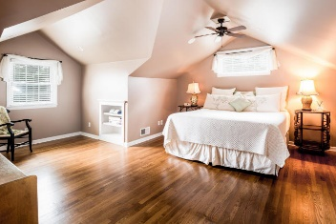
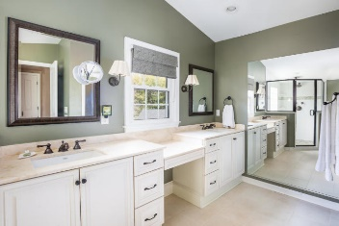
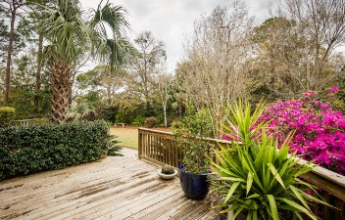

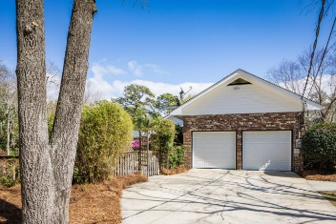
418 Palm Street
Mount Pleasant · MLS# 17007569 · $747,000
Immaculate Home in the Groves
Loaded with Updates
Beautiful home on nearly a half acre lot in highly sought after The Groves community in the heart of Mt Pleasant! Walking or biking distance to Shem Creek shopping and dining, Waterfront Park, Ravenel Bridge, and much more! This 1960s brick ranch has been completely, stylishly renovated in recent years but maintains its original southern charm with its old Charleston brick exterior and beautiful millwork finishes. Enter the home through the foyer and note the site-finished oak floors with inlaid accent and the crown molding, which carry on throughout most of the house. The foyer opens to the family room on the left and from here a double-cased opening leads to the dining room, which features gorgeous trimwork. Off of the dining room are the open concept kitchen and den with tile flooring.
A fireplace featuring a hand-crafted decorative mantle and raised brick hearth and with built-in cabinets on either side is the focal point of the family room. The kitchen features stainless steel appliances, granite countertops, and custom wood cabinetry. French doors lead from the den to a large deck overlooking the beautiful back yard with plenty of room for a pool. The original master suite is on the main level and features hardwood floors and two closets in the bedroom and tile floors and double sink vanity in the bathroom. The main floor also has a guest powder room. The second floor master features double vanities with stone countertops and separate dressing table between, tile floors, tile shower, and soaking tub with tile surround. There is an additional bedroom and full bath on the second floor. The attached two-car garage has plenty of room for expansion into a full in-law suite, office, bonus room, or kids play room. This is a beautiful home in a prime location. If you know the Mount Pleasant market then you know this property will go fast!
Jill Marcacci
843-297-5590
jill@agentowned.com
Andrea Rogers
(843) 532-3010
andrearogers1@gmail.com
www.andrearogersrealtor.com
www.agentownedrealty.com
AgentOwned Preferred Group | 1400-G Palm Blvd | Isle Of Palms, SC 29451

