Slide 1
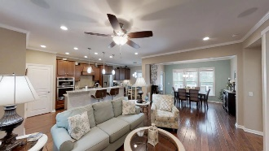
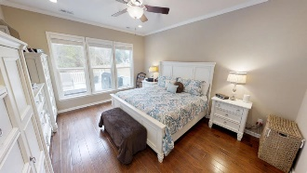
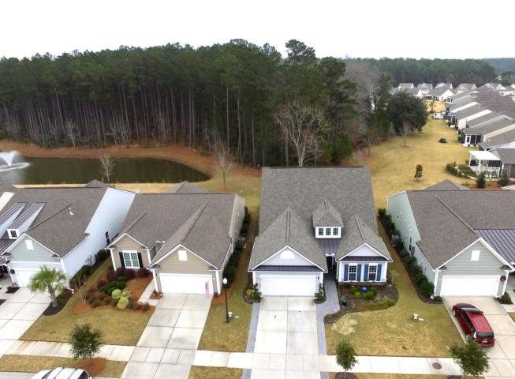
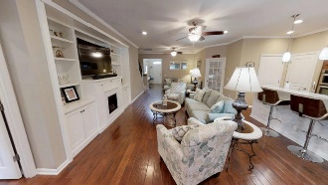
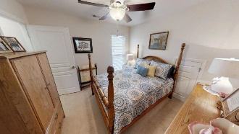
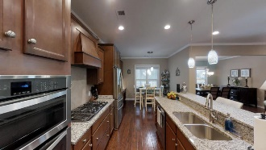
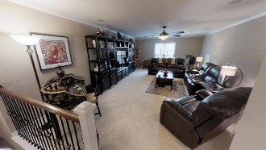
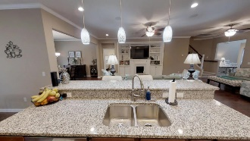
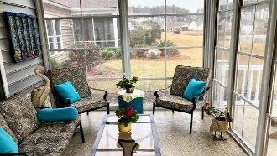
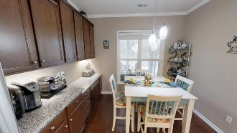
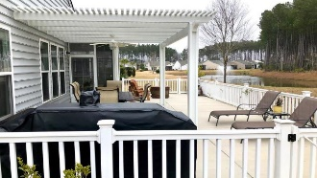
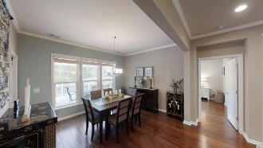
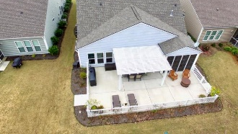


419 Eastern Isle Avenue Cane Bay Plantation Summerville, SC 29486 MLS# 18033540 | $410,000
Back on Market.
Financing fell through!
Del Webb 55+ Community
Beautiful pristine 4 bedroom 3 bath home located in the Gated 55 plus Del Webb community in the Cane Bay subdivision. This fully upgraded home is built on a premier lot with a pond view and overlooking woodlands. As you walk into the foyer you are greeted with beautiful hardwood floors. The well designed open floor plan allows you to enjoy the spacious feel. The upgraded Gourmet Kitchen has ample cabinet space, granite counter-tops and upgraded stainless steel appliances, that create a culinary experience for the chef in the family. Both the up and down stairs has amazing surround sound for a unique audio experience.
The spacious master bedroom is located on the first floor with a large master bath that includes a separate garden tub, large walk-in tile shower and a water closet for your privacy. Enjoy being organized with the custom wardrobe cabinetry in the master closet. The very spacious loft area is perfect for a theater/game room or just another large family room. Adjacent to the loft is a large bedroom and full bathroom. The dining room could be used as a sun-room if you do not entertain often. Located near the dining room is a large all season room with vinyl windows and screens. The over-sized enclosed patio includes vinyl railing and a Lanai to add enjoyment to your outdoor living space. To add to the list of extras is the irrigation system, gutters, well designed landscaping with hardscape included, a walk-up storage space above the large two car garage, beautiful crown molding, tank-less water heater and much more. Make this beautiful must see home your home. Call and make your appointment today.
Kathy Ashmen
(843) 261-7123 O | (843) 991-7218 M kathy.ashmen@agentownedrealty.com
kathyashmensouthernhomes.com
AgentOwned Realty Co. Premier Group, Inc. | 141 A N. Main St | Summerville, SC 29483

