Slide 1
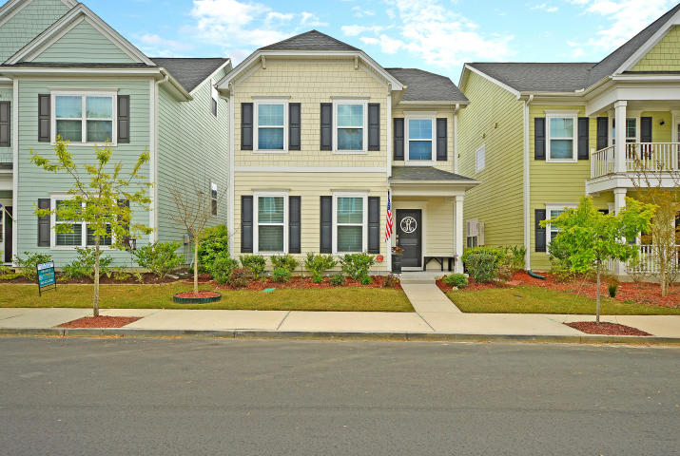
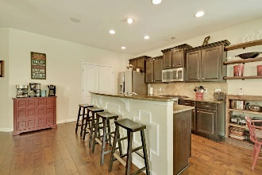
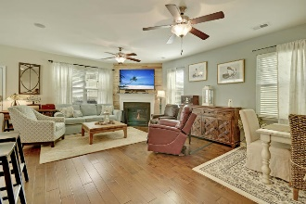
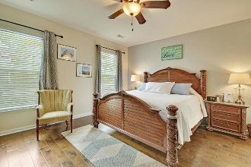
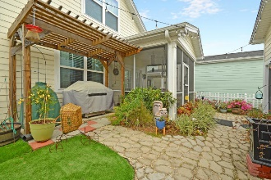
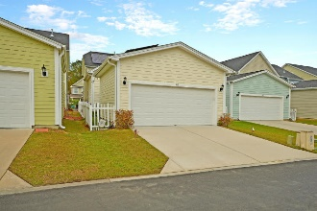


INCREDITIBLE OPPORTUNITY
$15,000 Agent Bonus
with ratified contract by 4/15/18
419 Forsythia Ave
White Gables
Summerville, SC 29483
MLS# 19009392
$269,900
$12,100 Under
Recent Appraised Value
An Amazing Fully detached two story home is situated on quiet street with sidewalks and is surrounded by a professionally landscaped Fenced yard. This Remarkable home offers 9 ft smooth ceilings, priceless lighting & ceiling fans , has 2 spacious bedrooms with plush w/w carpet, and a loft upstairs. There are several large rooms with distinctive wood flooring on the first floor including the Stylish great room with a cozy fireplace & a music port w/ 2 speakers. The Stunning dining area is perfect for formal dining. The Grand master bedroom suite includes beautiful wood flooring, a huge walk-in closet, a unique holly-wood style master bathroom with exclusive lighting & mirrors, a soaking tub and a separate walk-in shower, selected wood cabinets, and a double vanity granite counter tops. The modern kitchen offer genuine crafted wood cabinets, rare granite counter tops, tile back splash, upgraded stainless built-in appliances and distinctive wood flooring. The light filled breakfast area is perfectly situated for informal meals, snacks or morning coffee. There is a walk-out to a Popular ceramic floor Screened-in porch and the professionally laid stone patio, landscaped fenced yard with atrium. Cook outs anyone?
Whole house gutters included at no additional cost. For the energy conscience Buyer, the seller has installed a solar system that has reduced the monthly electricity cost to less than approximately $20.00 monthly. The current Solar System offers an assumable Financing Plan for the purchaser of this home. Information will be provided upon request. Homes like this Beauty are rarely available for sale, so don't procrastinate. BRING YOUR CHECK BOOK! Age, sqft, taxes, acreage, HOA dues, and schools are approximate buyer to verify any and all information deemed necessary.
William R Everett, Jr
(843) 693-8539– C
(843) 576-2701 – O
bill@theeverettgroup.net
RE/MAX Pro Realty, 9209 University Blvd, Charleston, SC 29406

