Slide 1
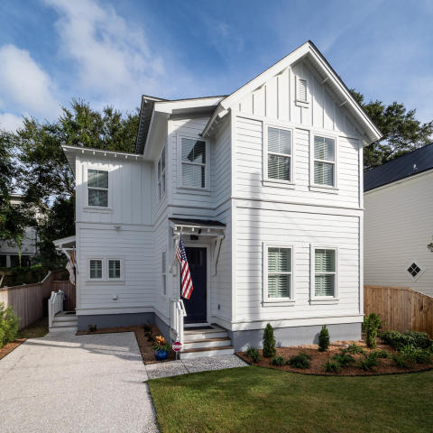
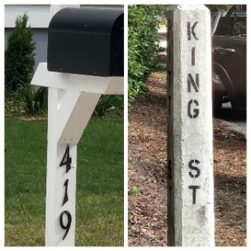
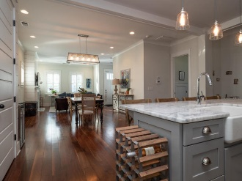
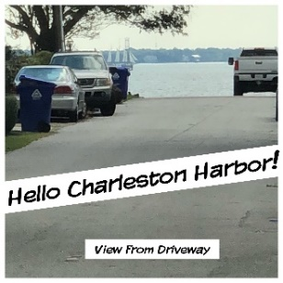


716 Lawton Harbor Drive
419 King Street
Old Mt Pleasant
Mount Pleasant, SC 29464
MLS# 18025098
$849,000
Open House
Sat & Sun
11a-2p
2,450 SF
4 Bedrooms
3½ Baths
Open floor plan
Wood floors throughout
Motivated Seller!
Donna Landry (225) 921-2111
donna.landry@cbcarolinas.com
Walk or golf cart the kids to Moultrie Middle School or Mt. Pleasant Academy. Walk or bike to all that Old Village has to offer. Only minutes to downtown historic Charleston, Shem Creek, Pitt St. Bridge and Sullivan's Island. Bring your buyers!

