Slide 1
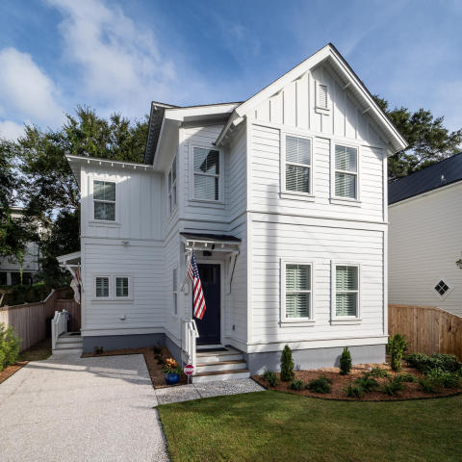
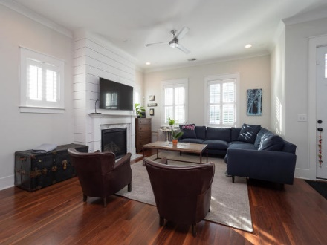
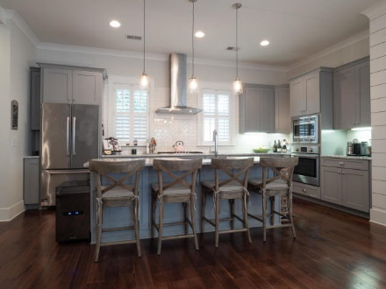
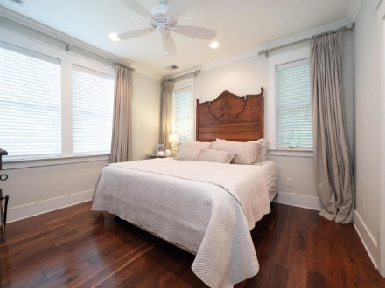


716 Lawton Harbor Drive
Open House
Sat & Sun
12-3
419 King Street
Old Mt Pleasant
Mount Pleasant, SC 29464
MLS# 18025098
$849,000
2,450 SF
4 Bedrooms
3½ Baths
Open floor plan
Wood floors throughout
2 blocks from Charleston Harbor
Donna Landry
(225) 921-2111
donna.landry@cbcarolinas.com
Walk or golf cart the kids to Moultrie Middle School or
Mt. Pleasant Academy. Walk or bike to all that Old Village has to offer. Only minutes to downtown historic Charleston, Shem Creek, Pitt St. Bridge and Sullivan's Island. Bring your buyers!

