Slide 1
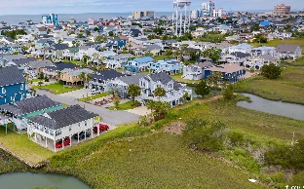
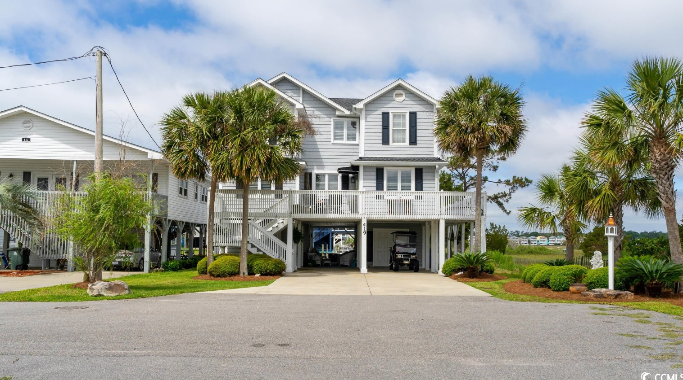
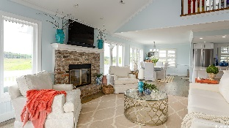
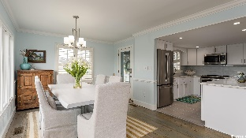
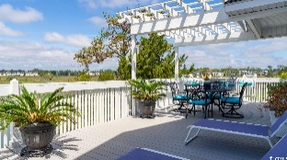
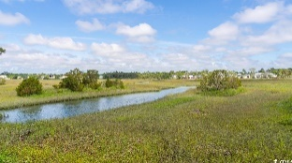
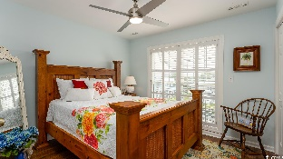
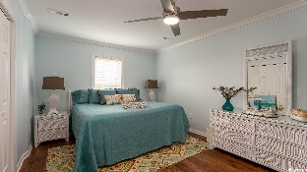
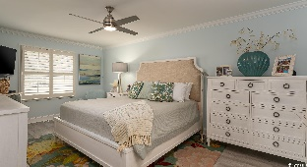
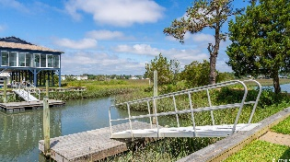
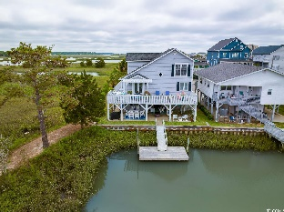



Singular, Historic, Beautiful Raised Beach Home
New On The Market For The First Time!
419 34th Ave N
Cherry Grove | North Myrtle Beach SC 29582 | MLS# 2310620 | $1,190,000
This custom-built channel home is astounding. The marsh-front rare find has been continuously occupied and well-loved since 1984 by the original builder and owner. Now it can be your dream home with new renovations and being sold furnished. The location is incomparable, magnificently situated on a beautiful marsh-front property with private access to a small peninsula. Boasting a floating dock with channel access, the house is only three blocks from the ocean. Prepare to have your breath taken away by the array of wonderful wildlife, heron, egret, and even bald eagles. Binoculars are a must! The exterior is dramatic with spacious composite decking surrounding the home on three sides, serving up more extraordinary views of the channel with custom landscaping of palm trees and dramatic lighting and areas for relaxation, a party, or taking in the breathtaking natural vistas. The home is a raised beach house with cedar shake vinyl siding. Pull up to the drive and find the option of covered vehicle parking or activity areas including flex seating space and a fire pit. On this ground floor there is plentiful storage with easy access to the large dock providing viewing enjoyment of the marsh and channels from the French doors opening from the large, ground-level room onto the marsh with unlimited scenic beauty. This room is ideal for an art studio or man cave. In addition to storage on the ground level, this beautiful layout offers one of the three full baths featuring a stand-up, adjoining shower. Then, up the front exterior stairs through the front door covered by a beautiful canvas awning to the newly renovated main level. A portion of these exquisite renovations was due to a recent fire. Almost everything is state of the art and new: Cedar Shake Vinyl Siding; GE Stainless Steel Stove, Refrigerator, Microwave, and Dishwasher; Garbage Disposal; Seamless Quartz Counter Tops in Kitchen, including a Large Work-and-Breakfast Bar Island, and in Master Bathroom; GE Full-Size Stackable Washer/Dryer Fitted into a Perfect Laundry Nich at Back of Master Bedroom Closet; New HVAC System with Two Units, One for Each Level; New Hot Water Heater; New Tile Kitchen and Bathroom Floors; New Interior/Exterior SONOS Sound System; Three New Smart TVs; New ESEECLOUD Security System; New Ceiling Fans Throughout and More! The heart of the home is the main two-story level featuring simplicity and style. The main floor flows beautifully to the outside decks providing plentiful sunlight through a wall of windows on the marsh-side. Upon entry, there is formal dining with views and ease of access to the kitchen and main-living great room. The stars of that glamorous show are the seamless quartz counter tops, impressive vaulted ceiling, and the circa 1850's remarkable antique hardwood flooring from a Charleston warehouse. Don't miss the beachy coral accent color finished into the wood, genius! Likewise, the brick fireplace is from the same Charleston warehouse and time period. The fireplace is ready for the new owners' operating choice. The master bedroom is delightfully oversized with a sitting area and charming upscale furnishings. The laundry niche is included in the huge walk-in master closet, while the master bath has a beautifully tiled walk-in shower and linen closet. Note that all bedrooms have hardwood flooring. Travel up the staircase to the top level where there are three more bedrooms. One bedroom is currently used as a study and has an adjoining welcoming loft-lounge. The other two upstairs bedrooms are serviced by a Jack-n-Jill bathroom. Closets and storage are plentiful. The area under the stairs can serve as storage or pantry. There has been little intrusion to the home due to flooding, although some water has entered ground level during major hurricanes, which issues the owner has mitigated. See this treasure today and create your own memories for the next 40 years!
Video Tour: https://youtu.be/NTUv8bw-tjc | Virtual Tour: https://my.matterport.com/show/?m=9ZT1AX2aFAL
Connie Ross-Karl
702-306-2643
conniesross@aol.com
Ronnie Nichols
Realtor / BIC
ronnienichols8@aol.com
NEW WAY PROPERTIES MYRTLE BEACH

