Slide 1
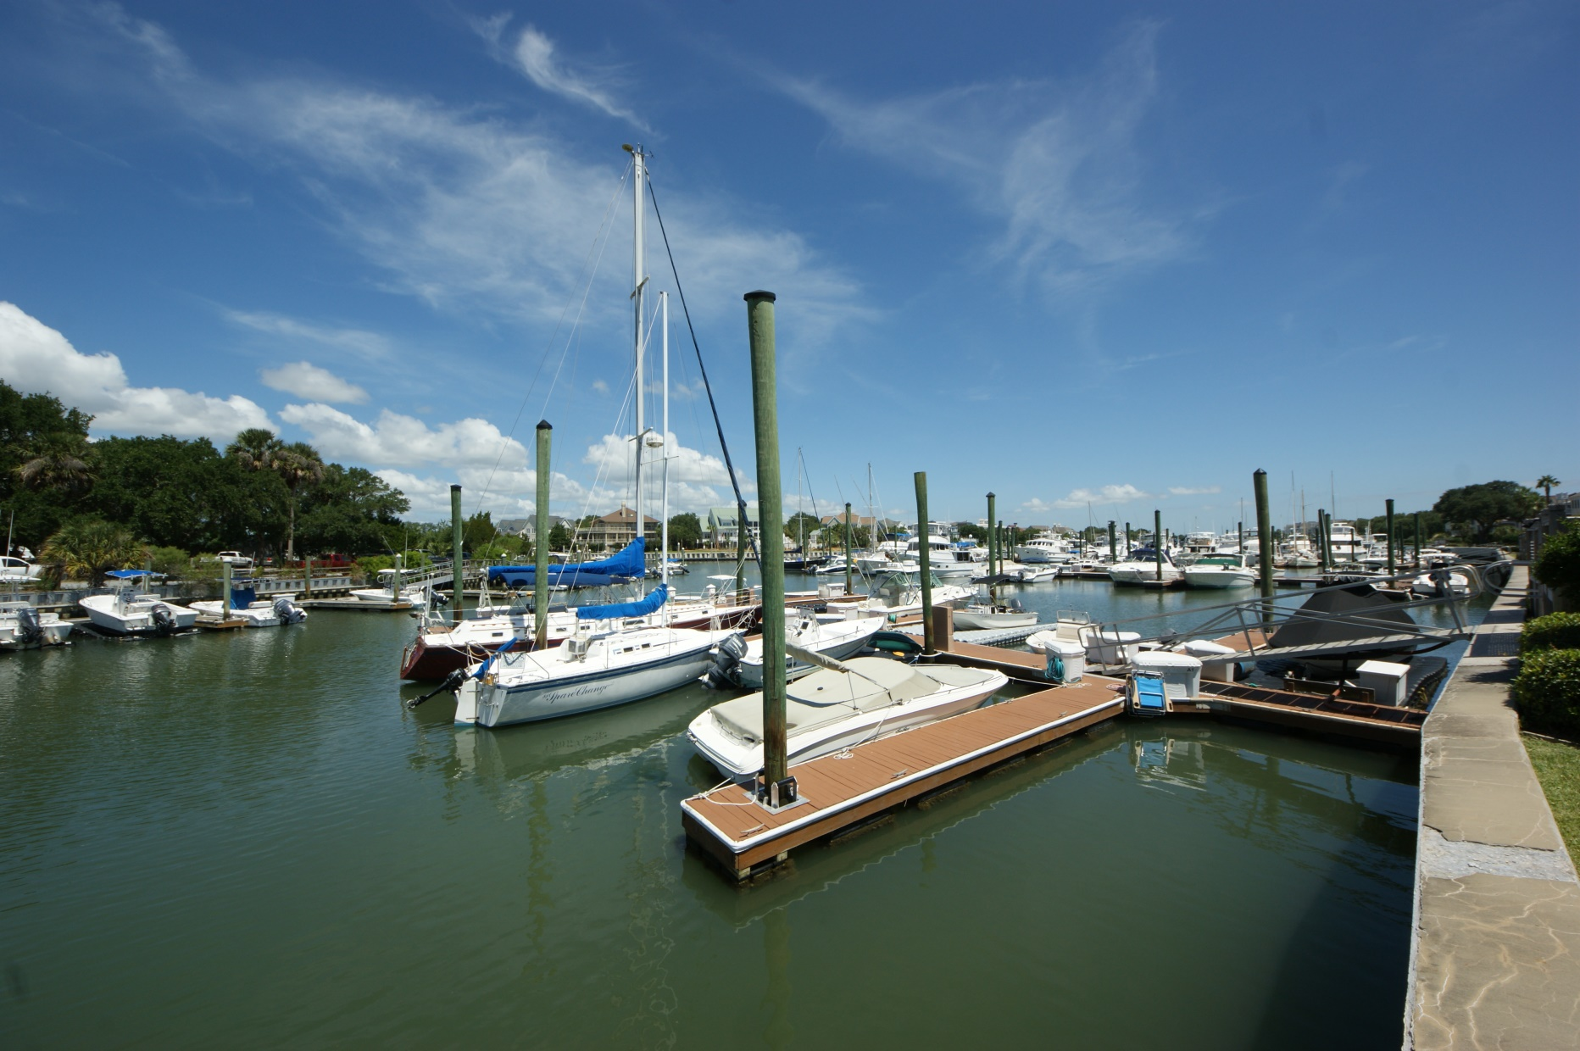
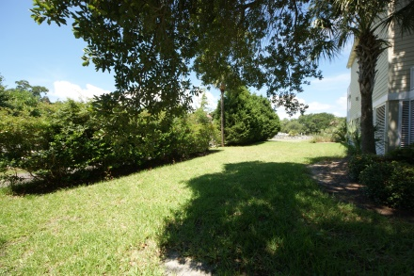
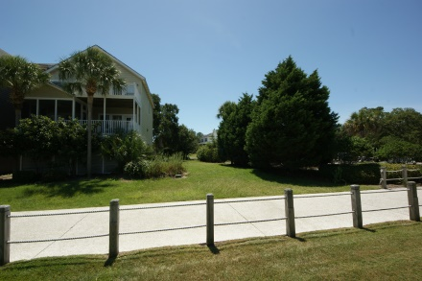
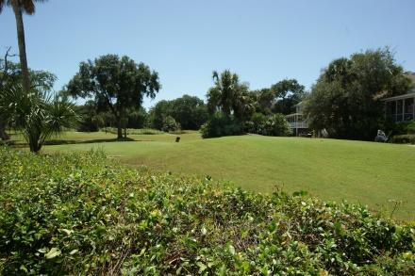
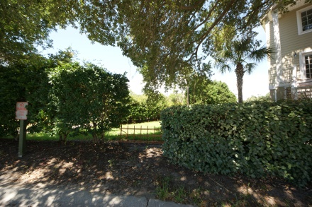
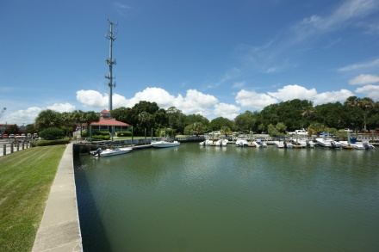
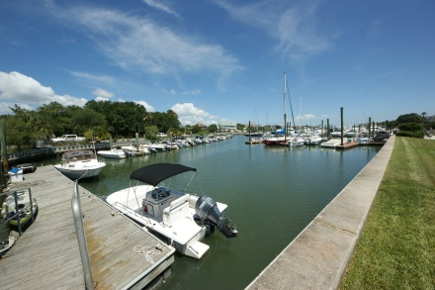
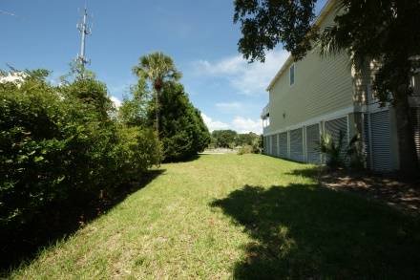
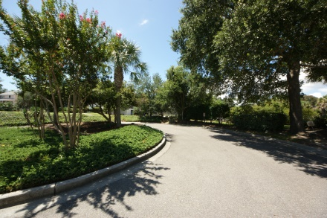


READY TO BUILD!
On The Yacht Harbor At Wild Dunes
41 Morgans Cove Drive, Isle of Palms, SC 29451
MLS# 15022206 | $395,000
$5,000 Buyer's Agent Bonus at Closing!
Exquisite home site on the water in Wild Dunes with amazing views!
Lot overlooks the marina that can be right outside your door.... imagine the wonderful home you can build to enjoy the views of the waterways! Wild Dunes is a 1600 acre gated community with two famous golf courses designed by Tom Fazio. Also, a nationally ranked tennis complex including 17 clay courts. Located on the north end of Isle of Palms, the exclusive community offers a lifestyle that is incomparable to anywhere else. Near shopping, restaurants, historic Downtown Charleston and just steps from the ocean....this property is a rare offering in a place that feels like paradise!
Susan Weeks
(843) 813-0495
susanweeksdesign@gmail.com
www.agentownedrealty.com
AgentOwned Charleston Group
902 Savannah Hwy
Charleston, SC 29407-7802

