Slide 1
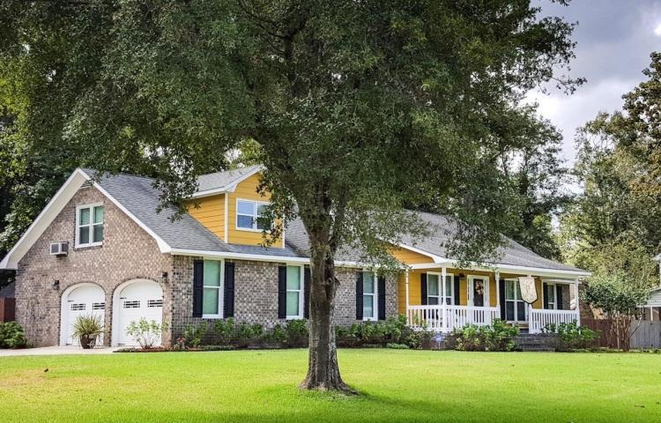

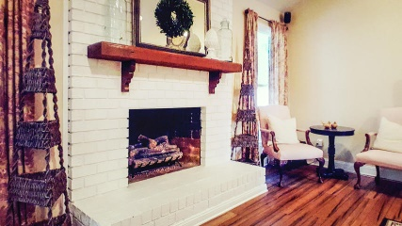
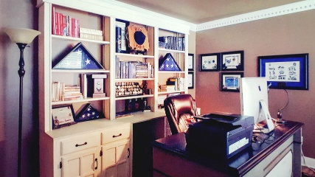
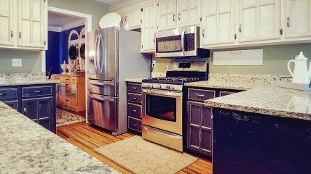
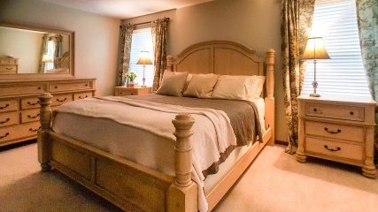
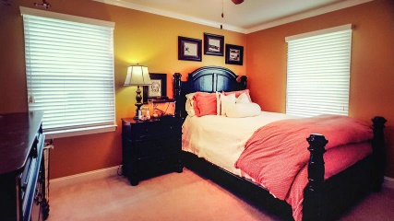
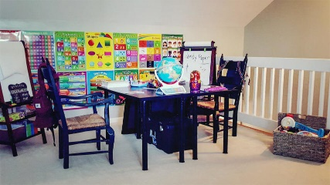
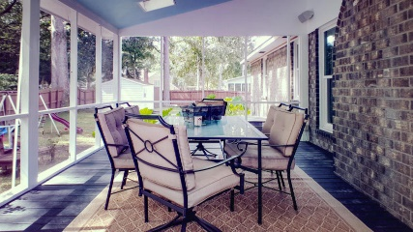
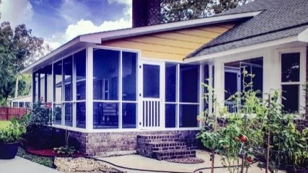



Check Out This Shadowmoss Showstopper!!!
41 Shadowmoss Parkway
Shadowmoss
Charleston, SC 29414
MLS# 18026884
$385,000
2,422 SF
3 Bedrooms :: 2 Bath
This beautifully renovated home sits on a large (.38 acres) corner lot with manicured mature landscaping. At just over 2400sqft this home offer 3 bedrooms and 2 bathrooms with a large flex space over the garage. This home offers highly sought single level living in a wonderful neighborhood and golf community. This home boasts: NEW antique hand scraped bamboo floors, New Hurricane rated windows, New Levolor Blinds, New lighting, New 5'' baseboards, New crown molding, New HVAC, New ceiling fans, New hot water heater, New insulated garage doors with Craftsman door openers, New exterior doors, New bathroom fixtures, New Paint, New touch screen thermostats, New bathroom counter tops. The kitchen is AMAZING with granite counter tops, stainless appliances, and the gorgeous chalk painted distressed cabinets (black on top and white on the bottom).
Enjoy dining Al Fresco on the over sized screened in porch that has been totally refurbished, with new paint, new trim, new screening and surround sound speaker system.
The backyard is fully fenced and has double gates from driveway. The storage shed and large box gardens will convey.
Parking will never be an issue with the extra driveway with extended concrete pad.
NO HOA!!! So bring your BOAT or RV.
Lizzie Ray
(843) 452-9298
lizzieray1122@gmail.com
Eric Draper
(843) 442-7118
eric.draper@gmail.com
www.charlestonrealestategroup.com
Charleston Real Estate Group | 443 Folly Rd | Charleston, SC 29412

