Slide 1
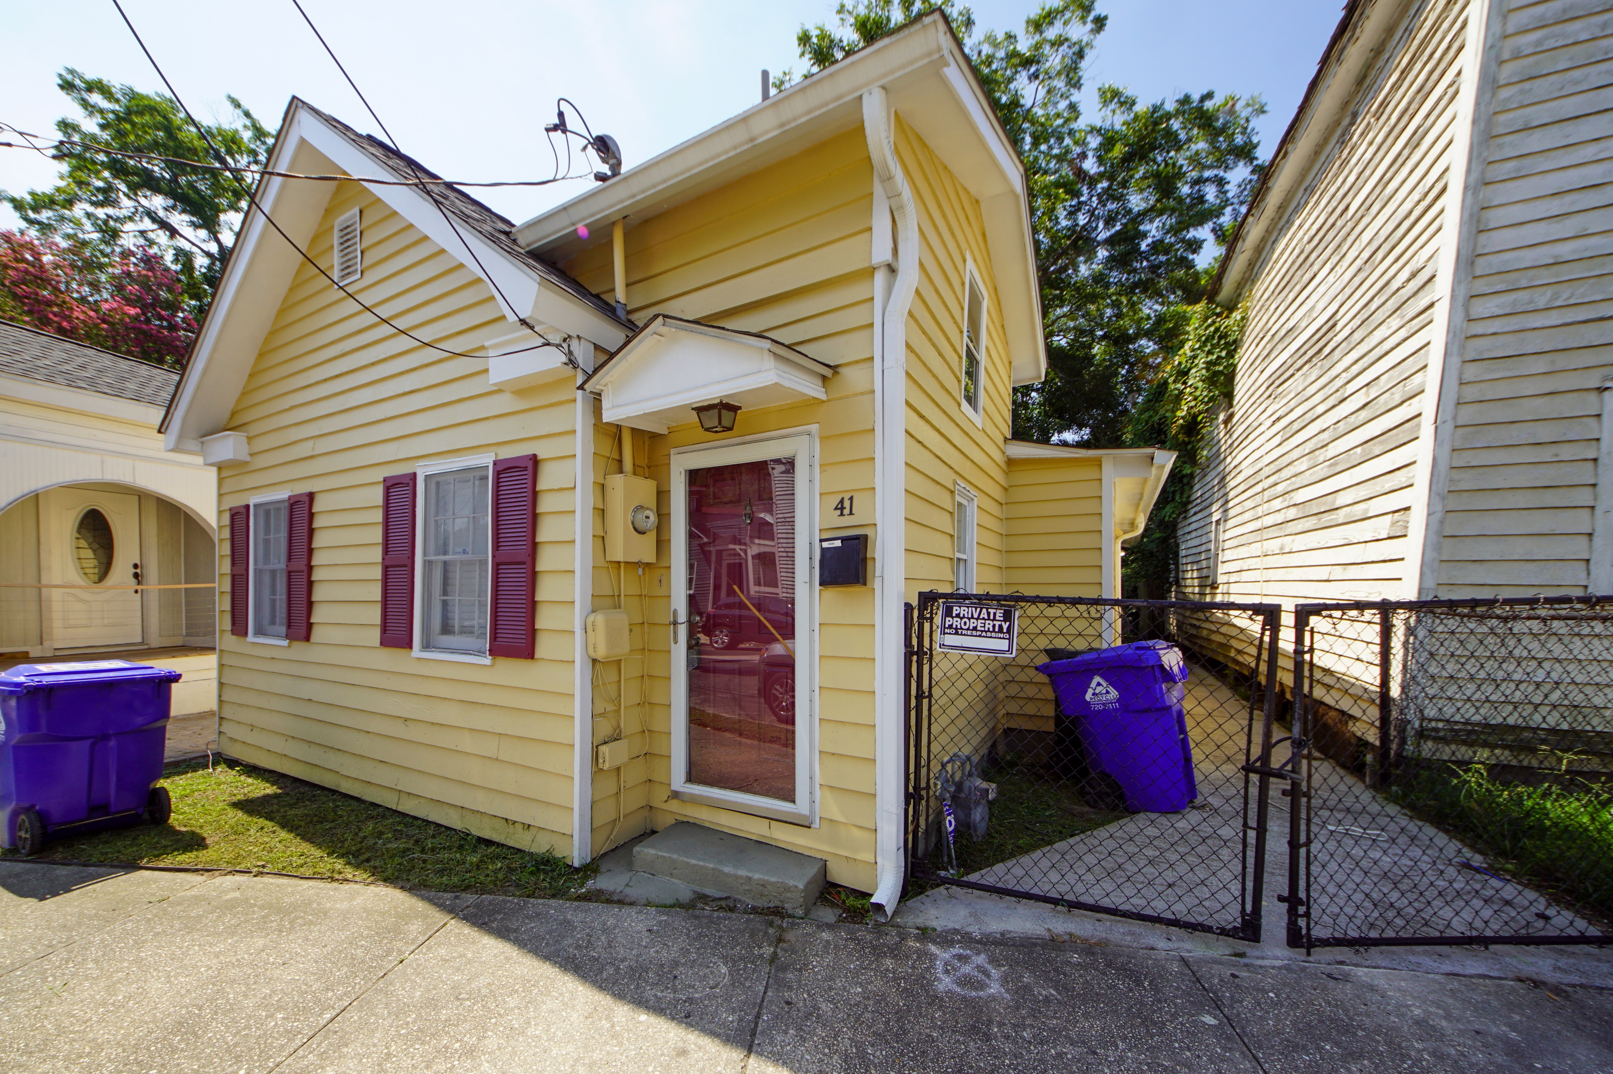
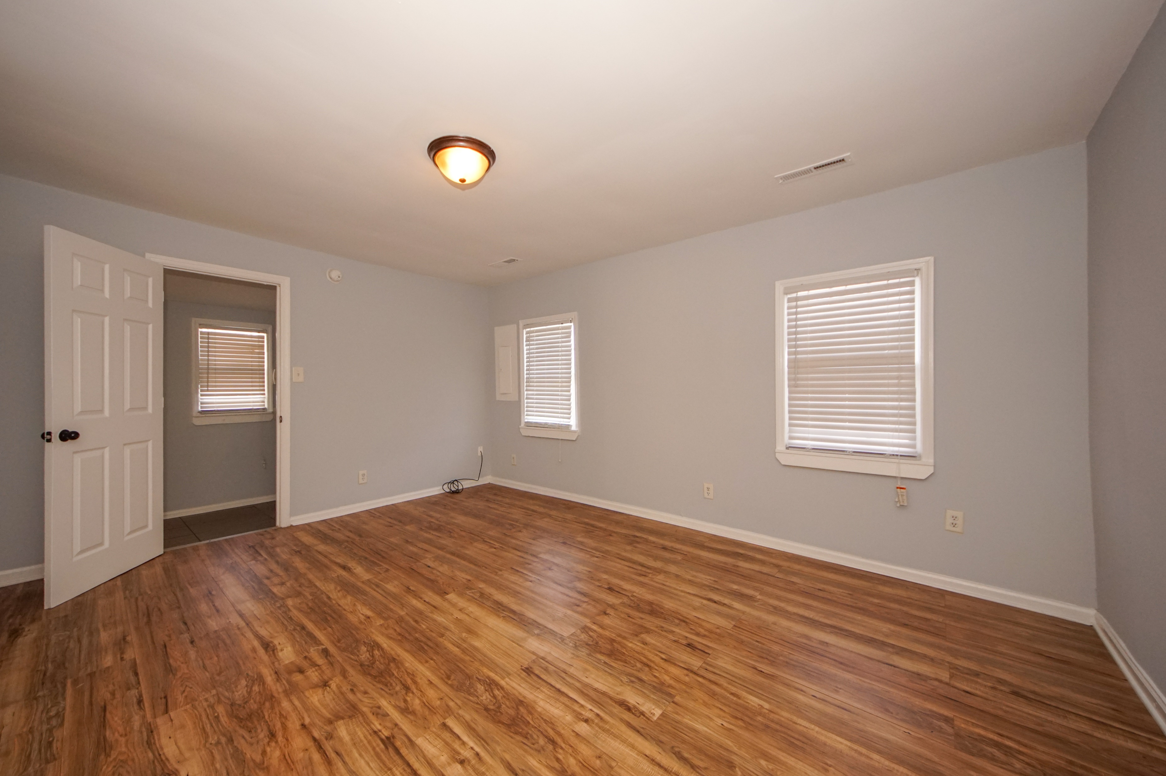
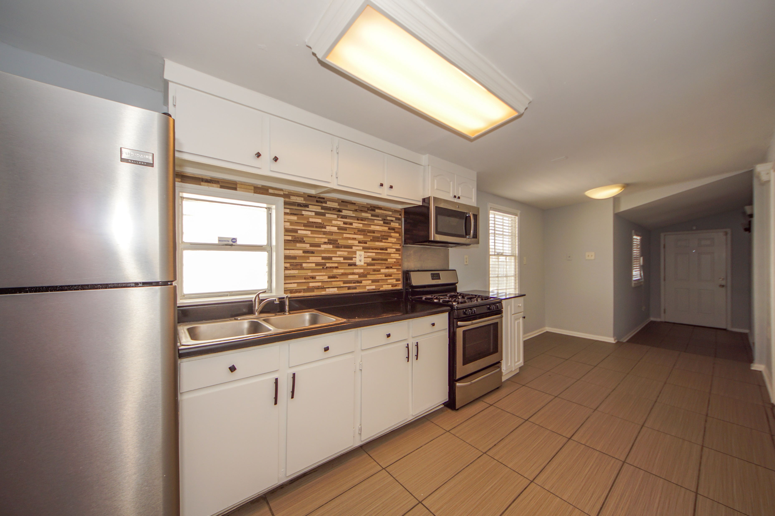
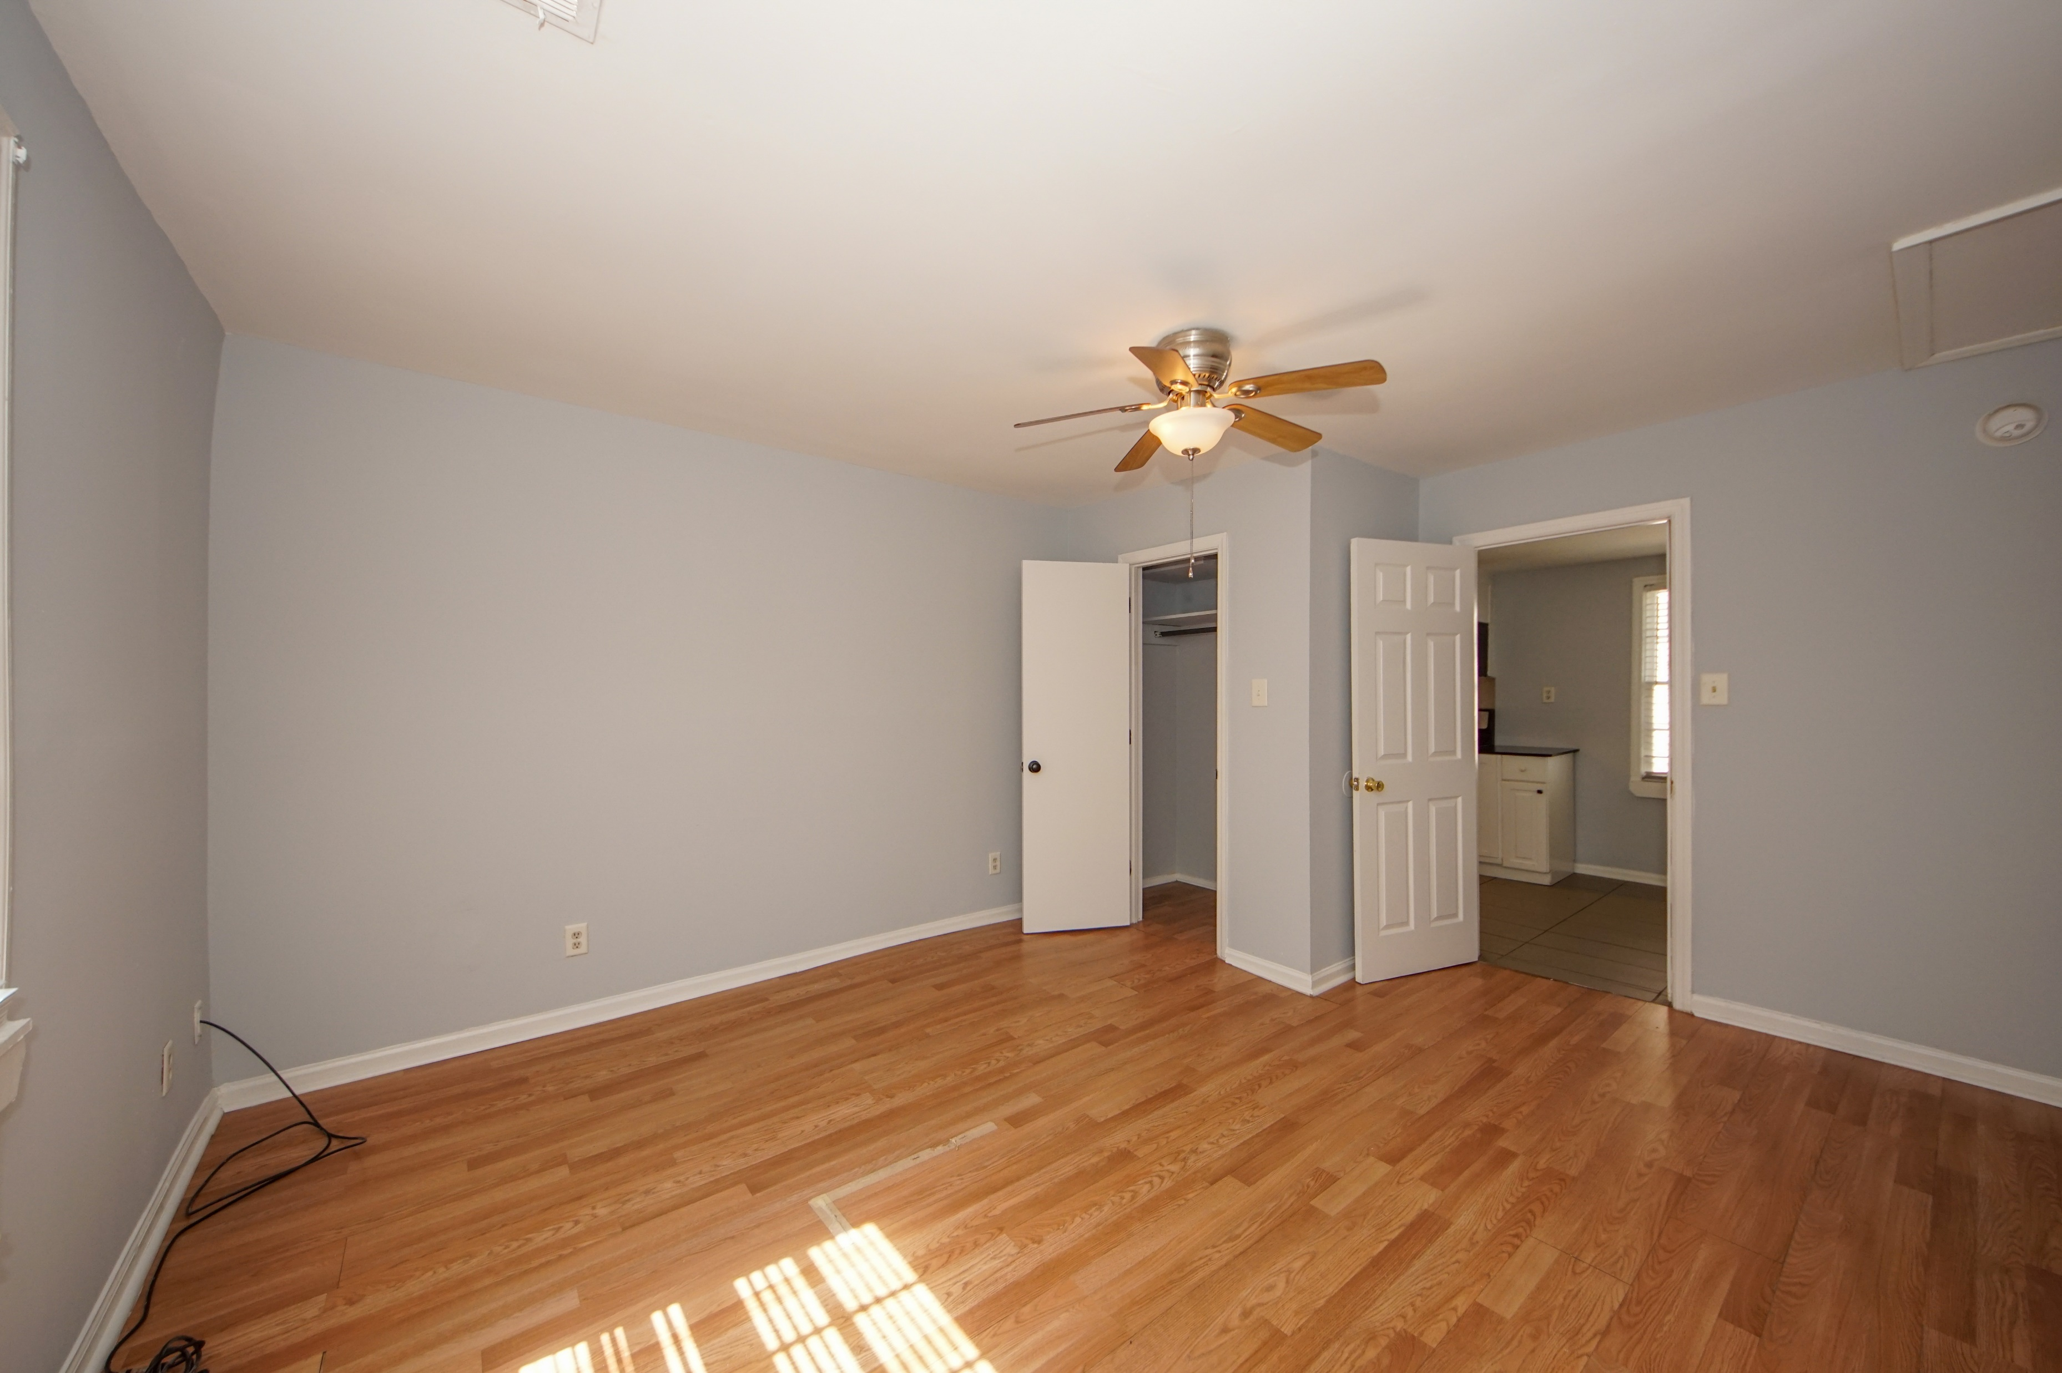
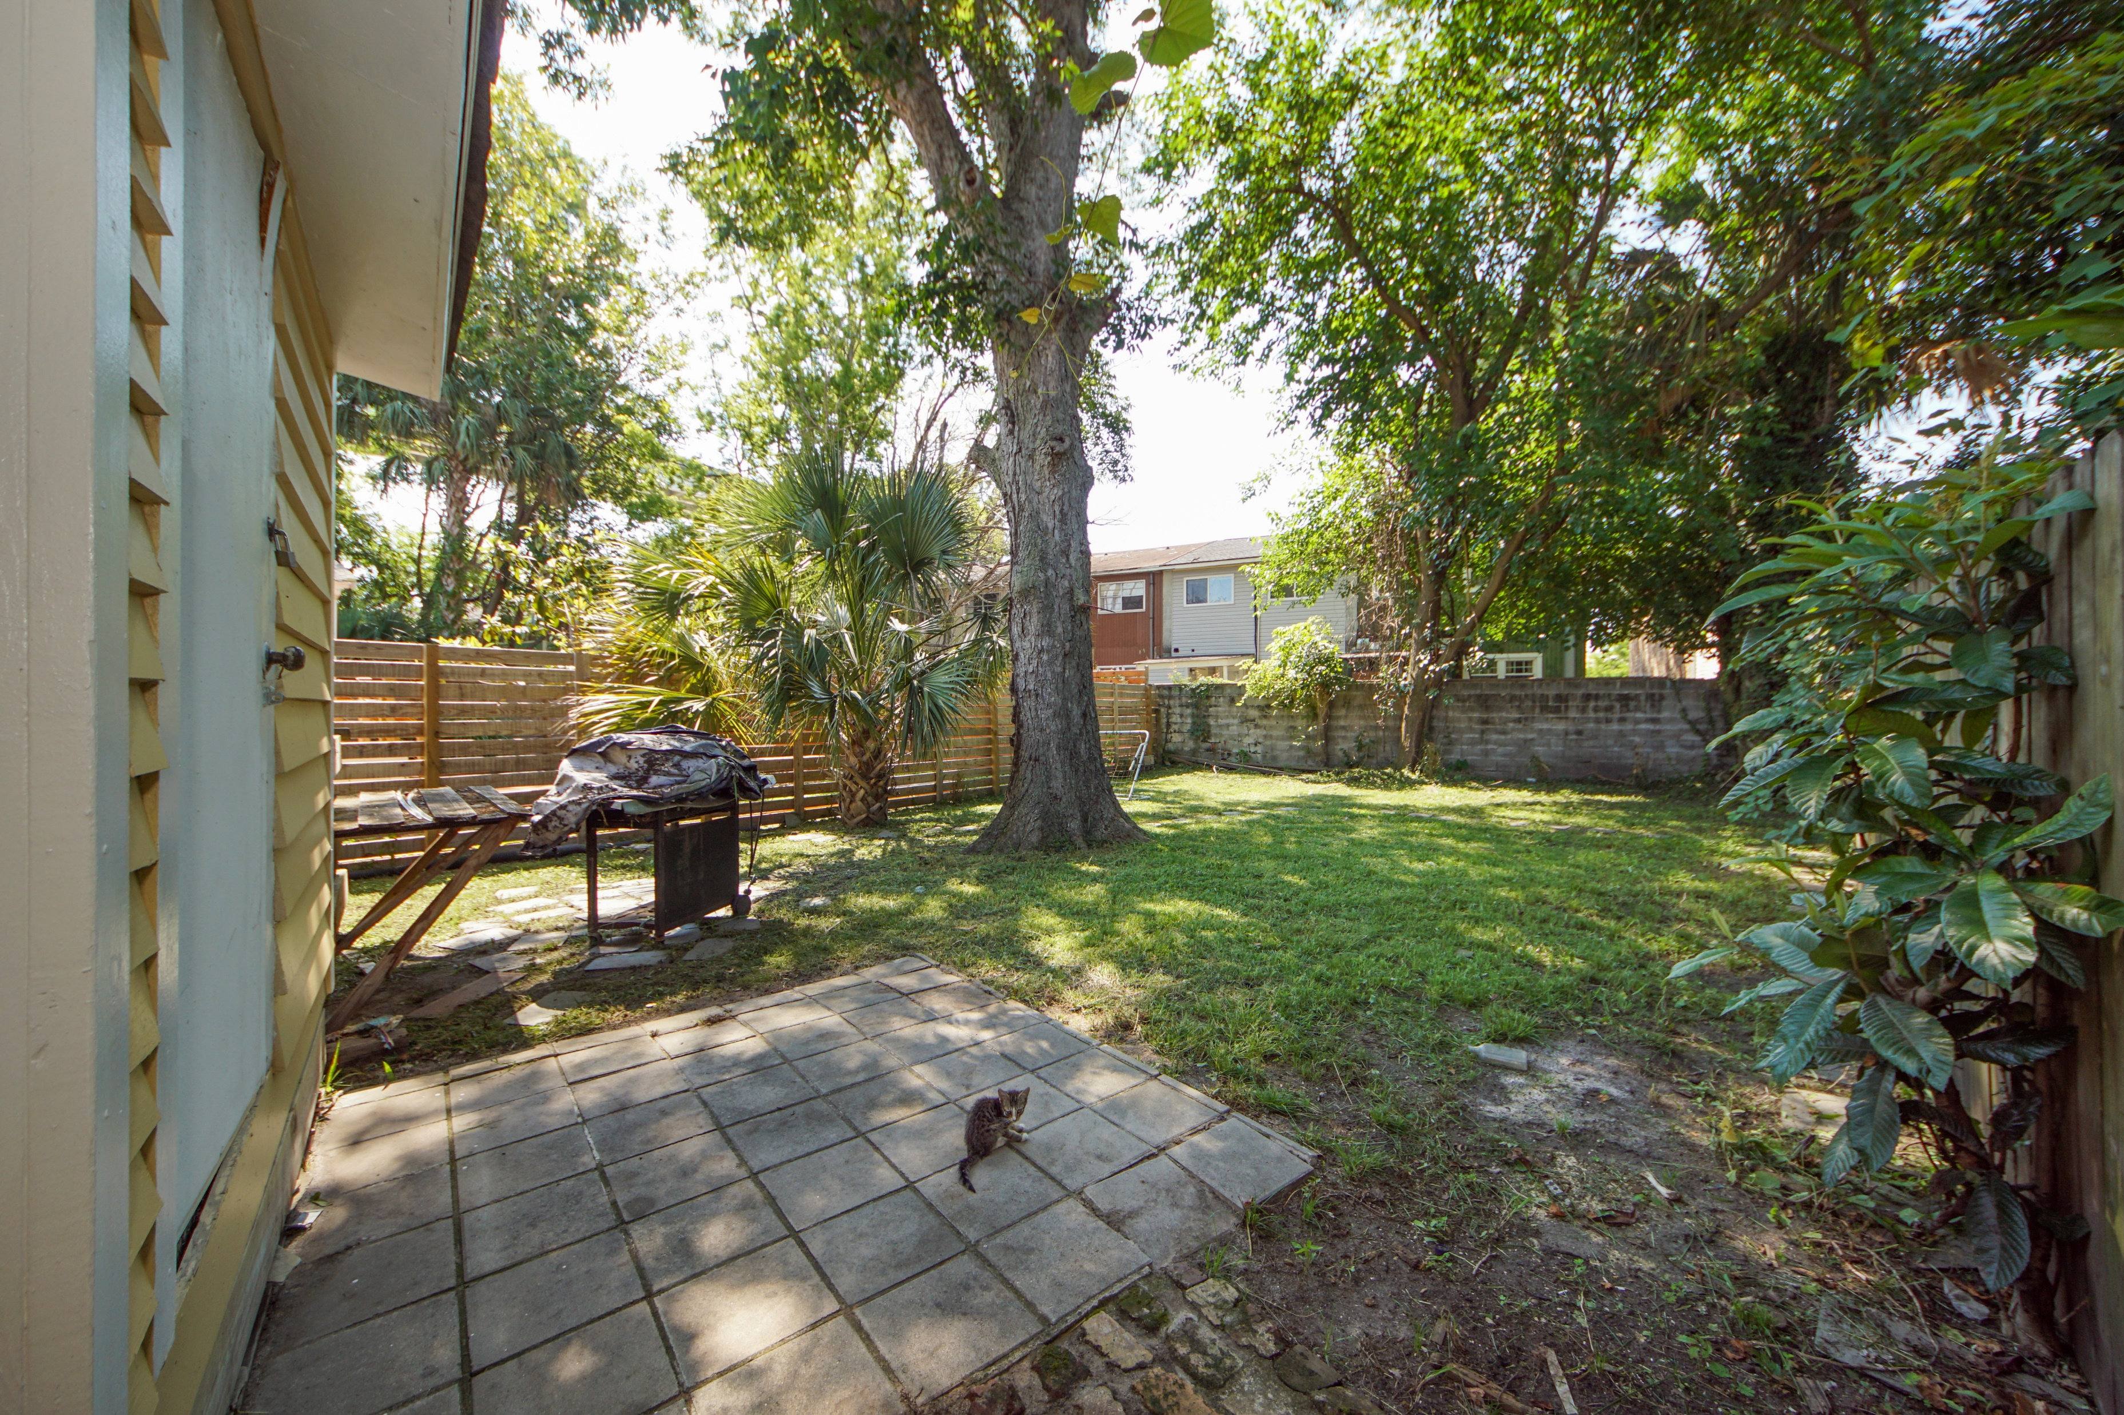
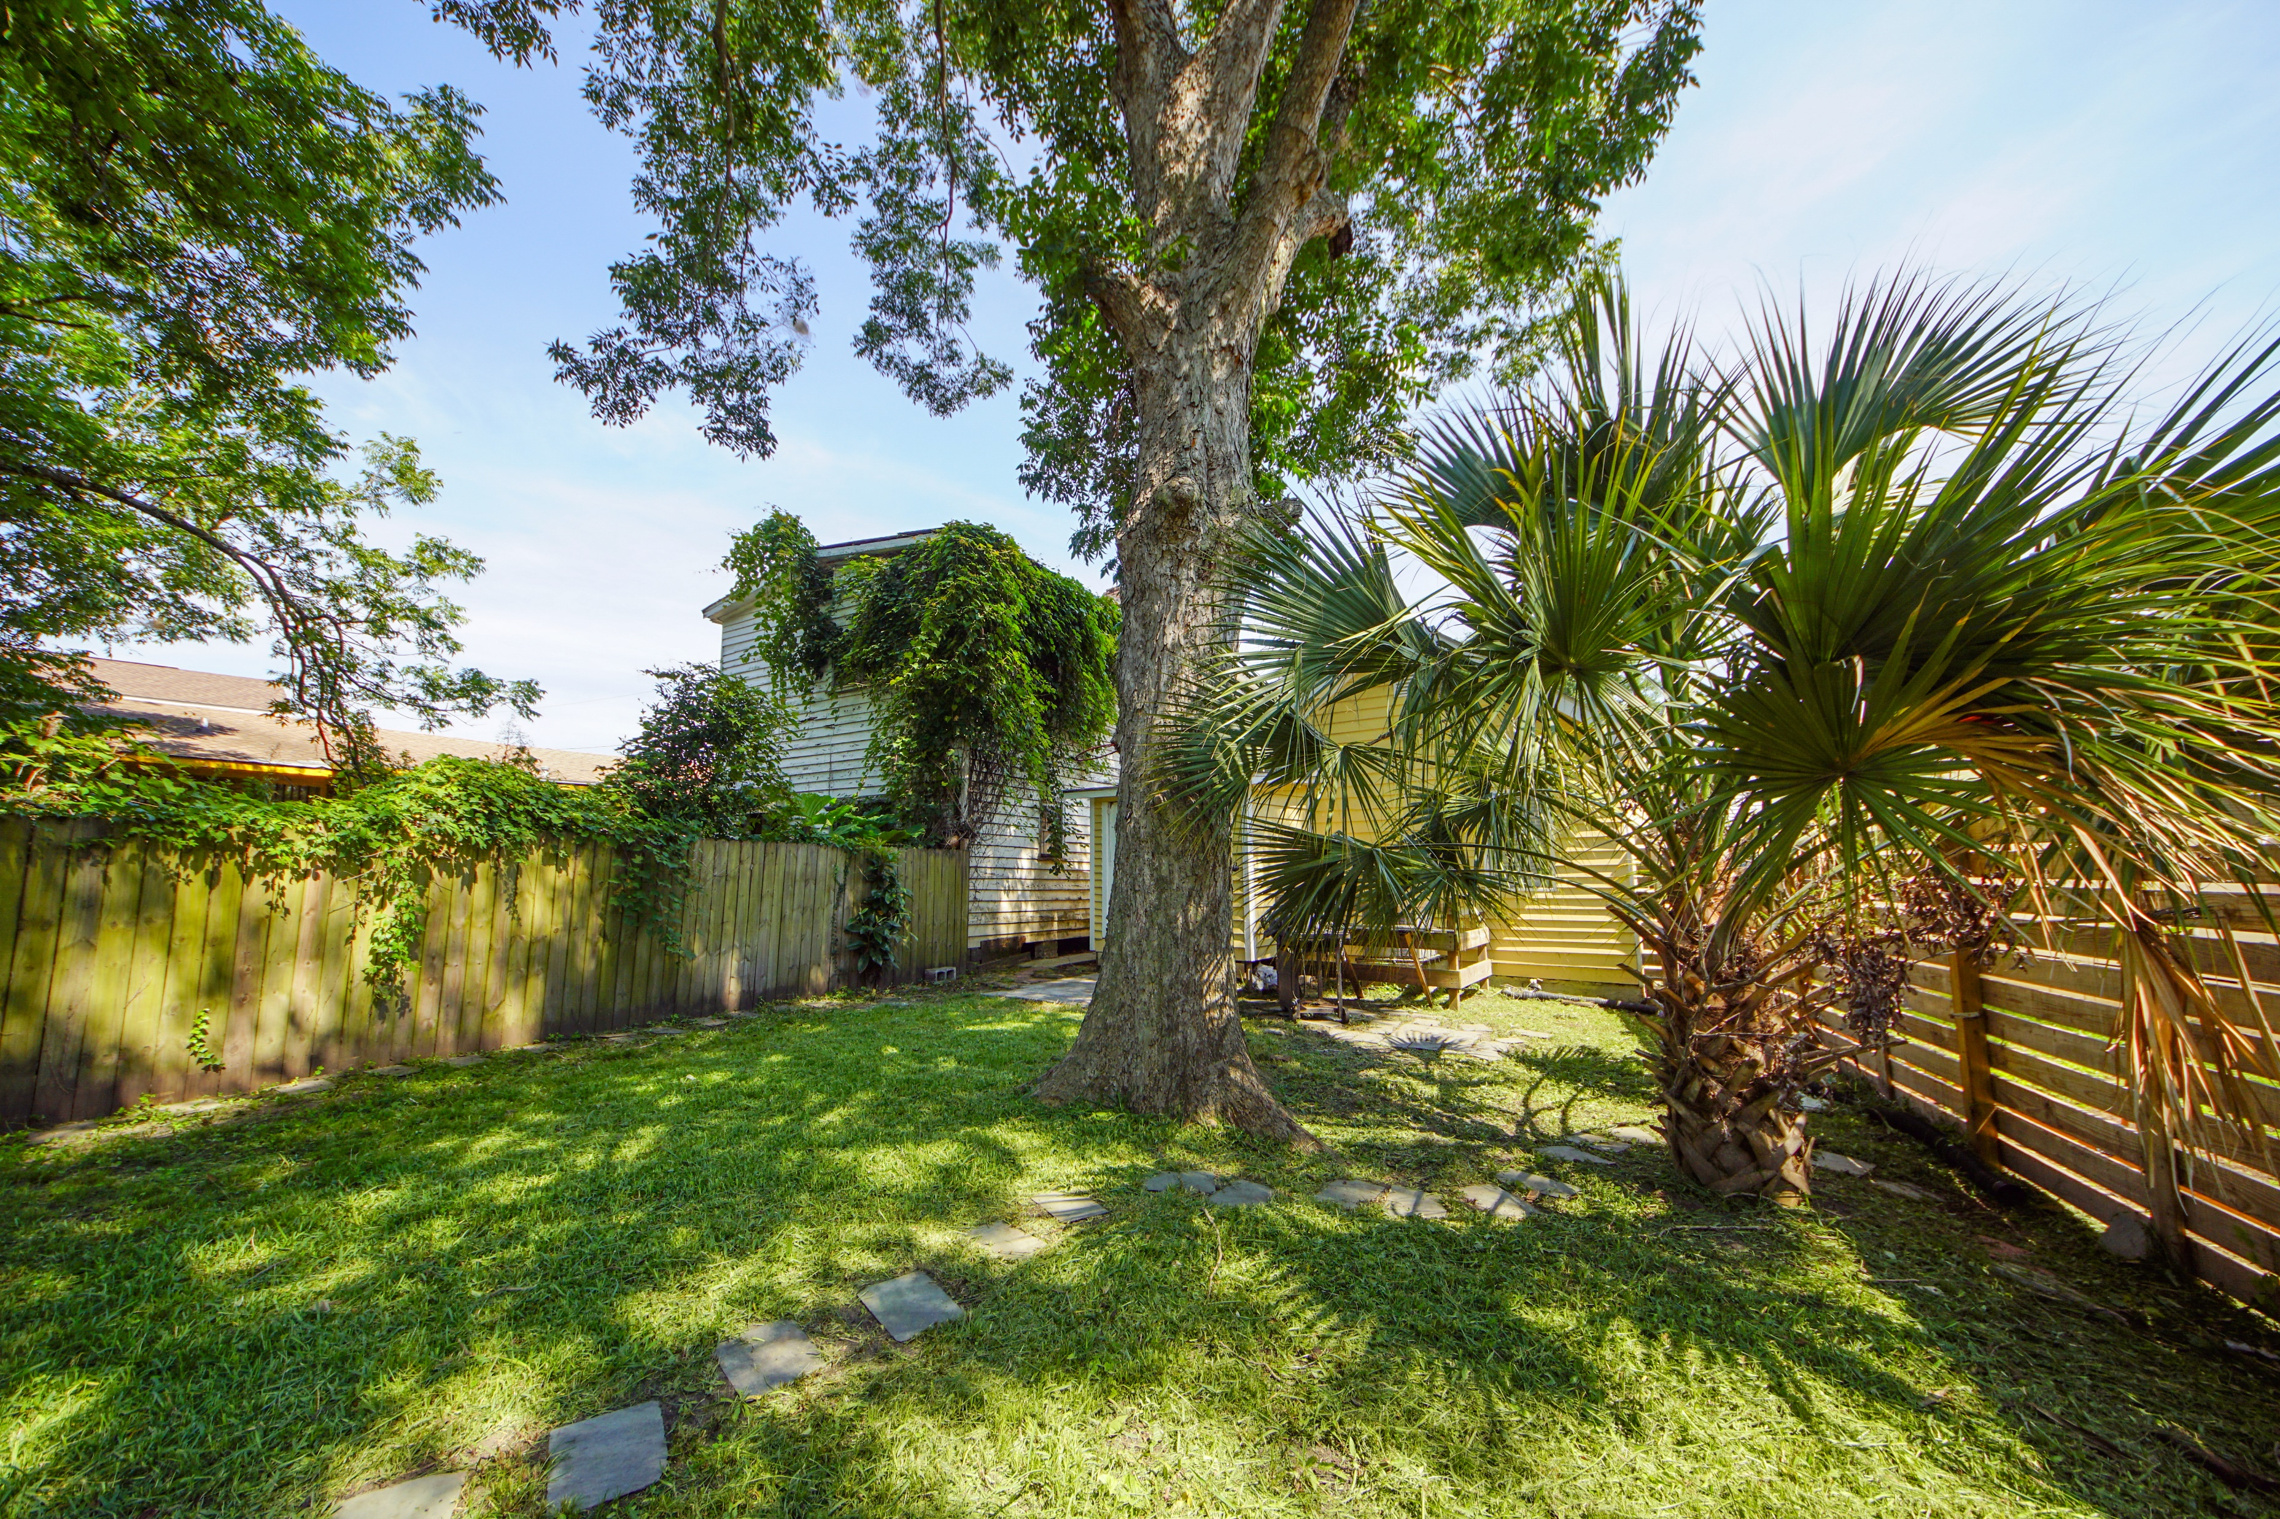

41 Poinsett Street
North Central ~ Charleston, SC 29403 ~ MLS# 20021305 ~ $350,000
MOVE IN READY COTTAGE ON QUIET STREET DOWNTOWN.
THIS THREE BEDROOM TWO BATHROOM HOME IS READY. PERFECT HOME FOR FIRST TIME BUYER OR INVESTOR. THIS HOME HAS LARGE REAR YARD PERFECT FOR POSSIBLY ADDING ADDITIONAL SQUARE FOOTAGE OR A NICE LARGE DECK. EASY TO SHOW.
Renata Smalls-Stinson
stinsonspace@bellsouth.net
www.thespacecompany.com
O 843-577-2676 | M 843-864-3990

