Slide 1
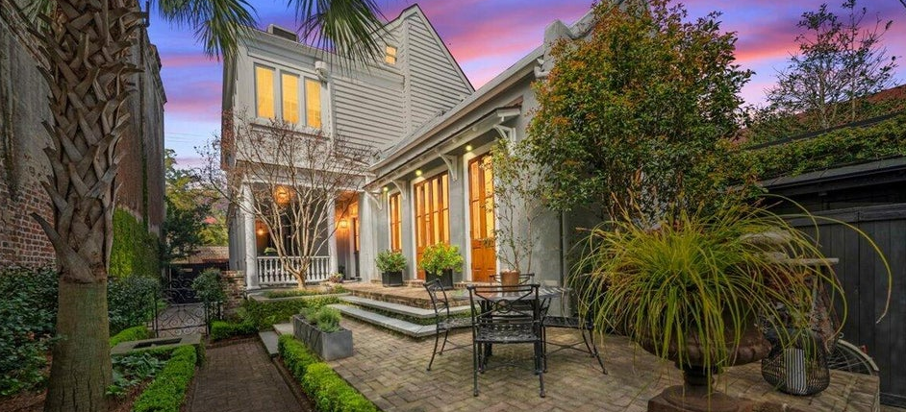
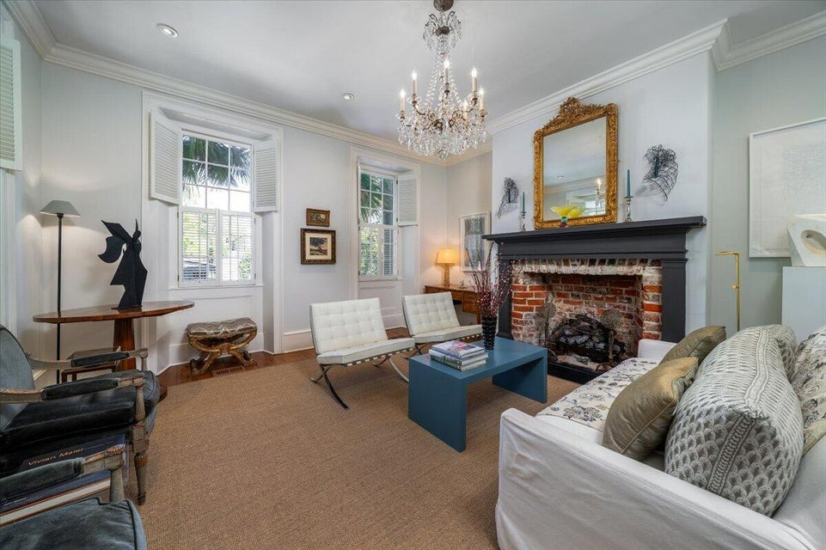
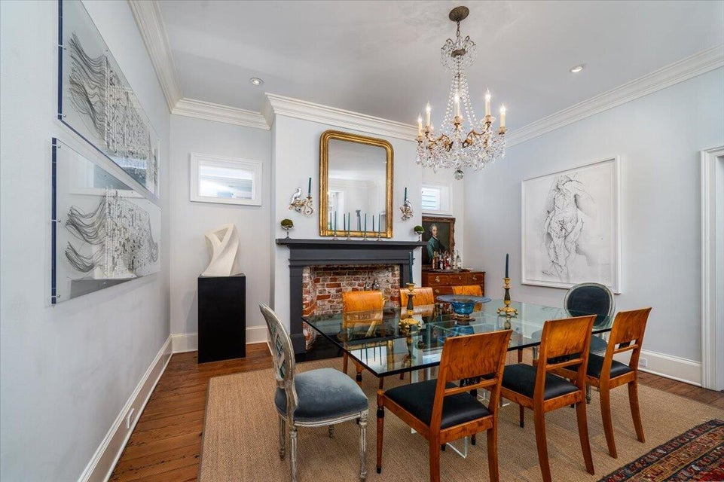
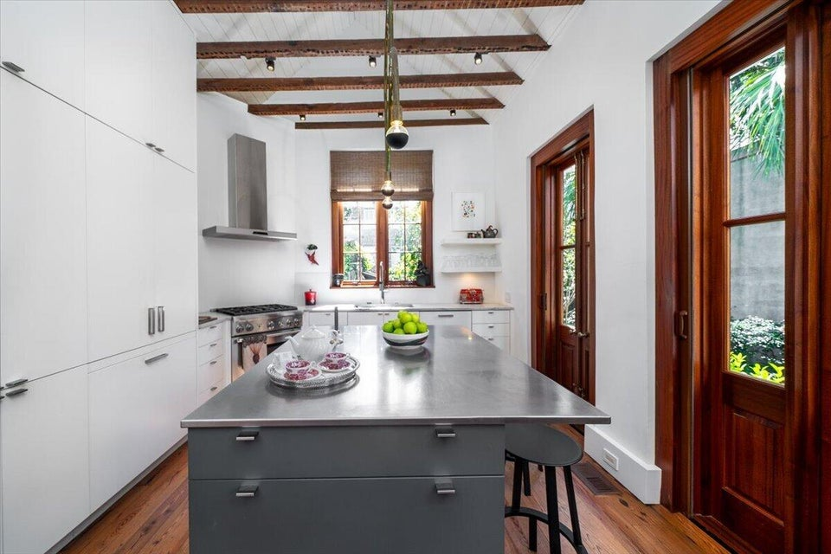
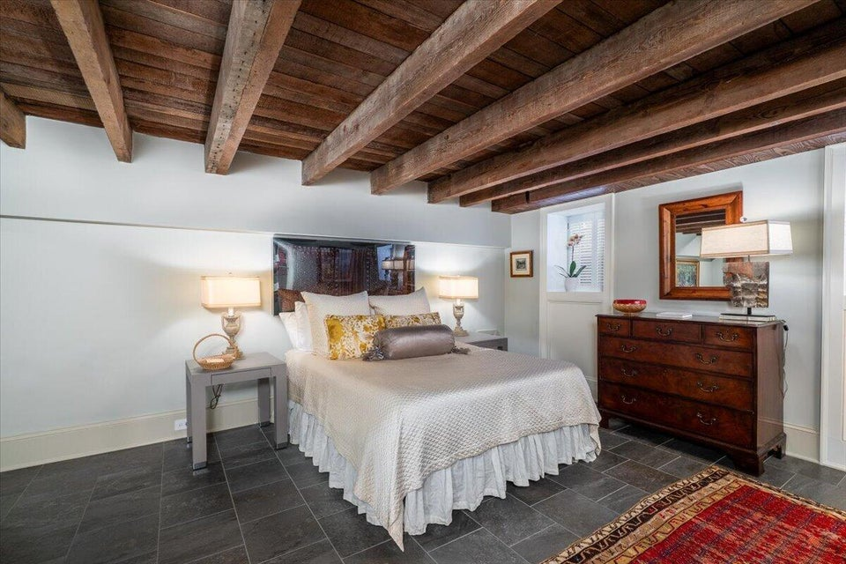
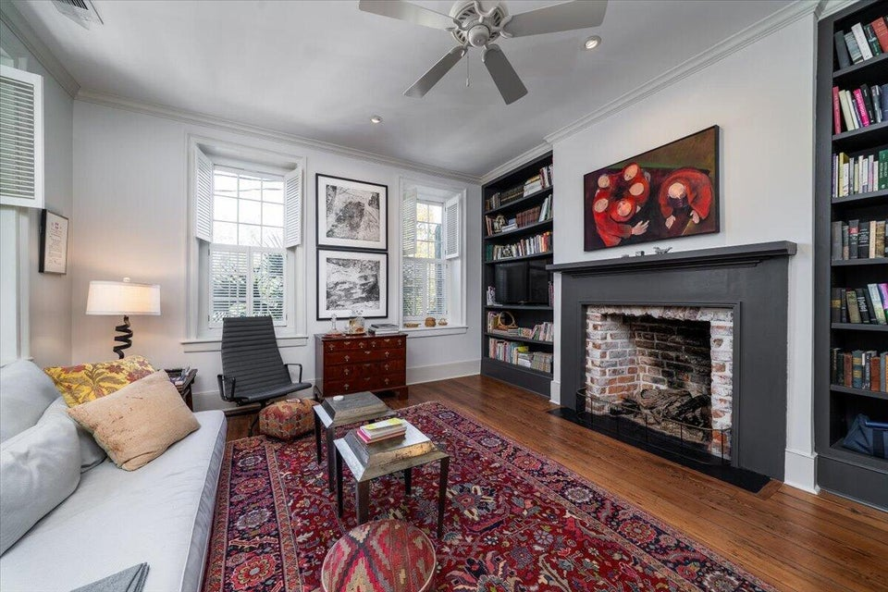
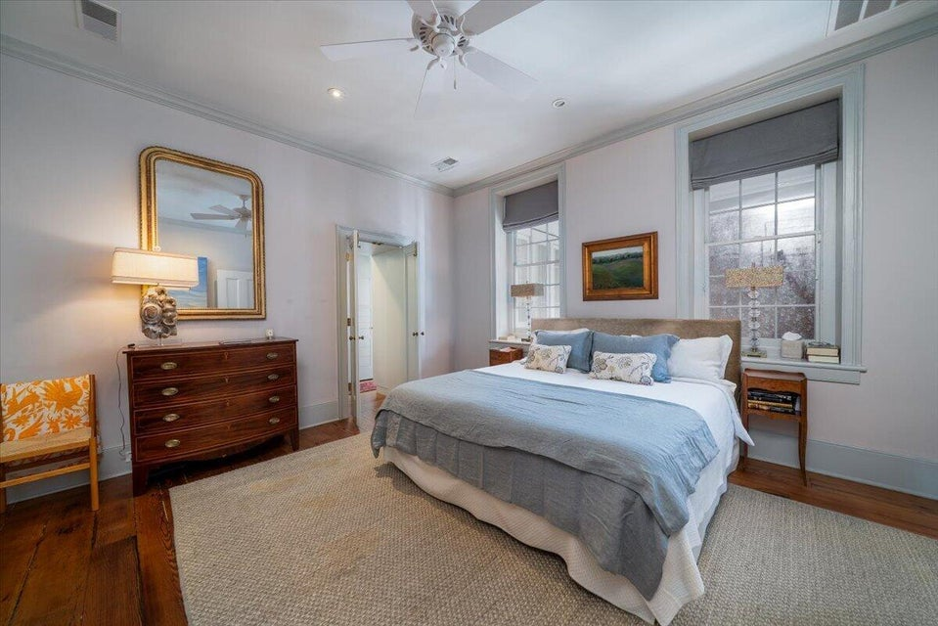
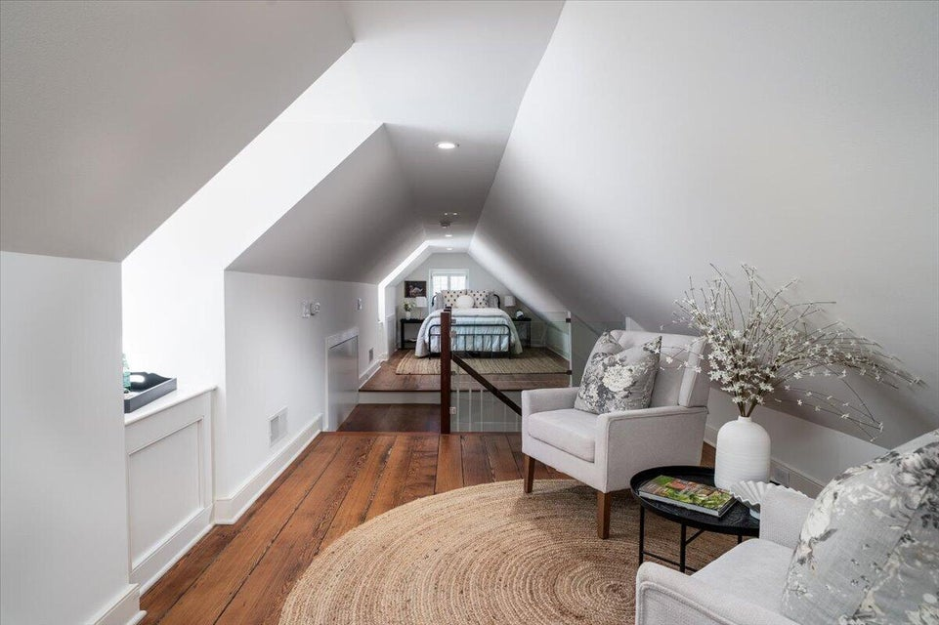
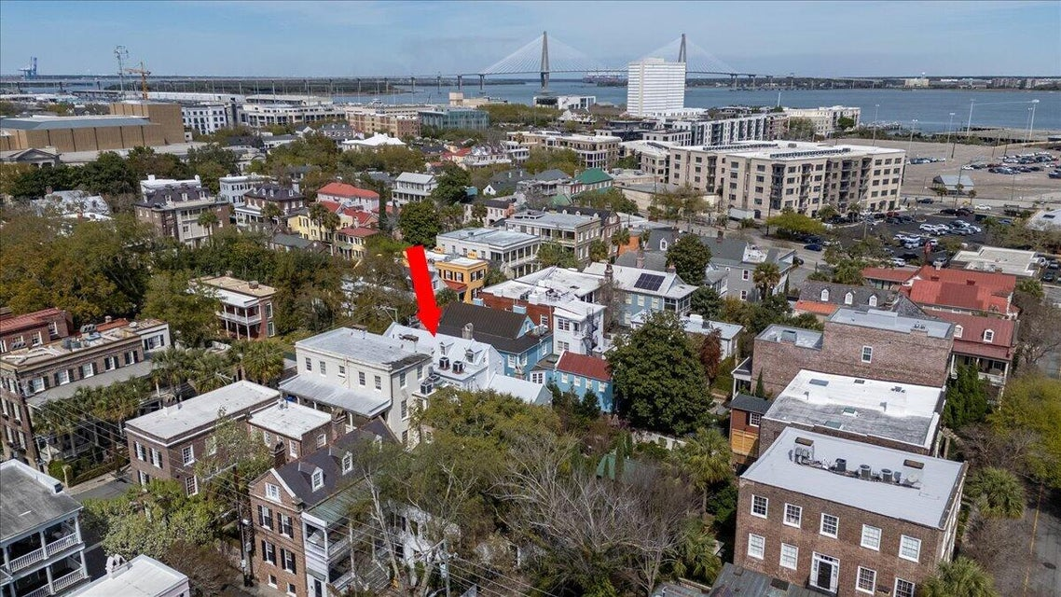

ANSONBOROUGH AT IT'S FINEST!
41 Society Street
ANSONBOROUGH · CHARLESTON, SC 29401 · MLS# 26007837 · $3,649,000
Steeped in history and meticulously maintained, this approximately 3,000-square-foot residence presents a rare opportunity to own a remarkable piece of Charleston's architectural legacy. Originally constructed in 1818 by prominent merchant and planter Robert Murrell Venning, the home served as his primary residence while he developed other properties throughout the area. Following the Great Fire of 1838, the house was carefully restored while preserving its original footprint. Today, the property retains its pre-fire 1818 brick foundations, chimneys, and original walls--offering an authentic connection to the historic Ansonborough neighborhood, one of downtown Charleston's most prestigious and desirable enclaves.
Just steps from the Charleston Gaillard Center and some of the city's finest restaurants, the location is ideal for sophisticated downtown living. Recent updates, including a newly resealed roof, ensure the home's structural integrity is as impressive as its rich history. Complete with off-street parking--an exceptional convenience in the historic district--41 Society Street represents a rare offering: a premier Charleston peninsula residence that seamlessly blends historic character with modern luxury.
Robyn Lane
843-222-5599
robynlane01@icloud.com
Bobby Shealy
843-442-7373
bobby@shealyrealestate.com
bobbyshealy.erawilderrealty.com
ERA Wilder Realty
1282 State Rd
Summerville, SC 29486

