Slide 1
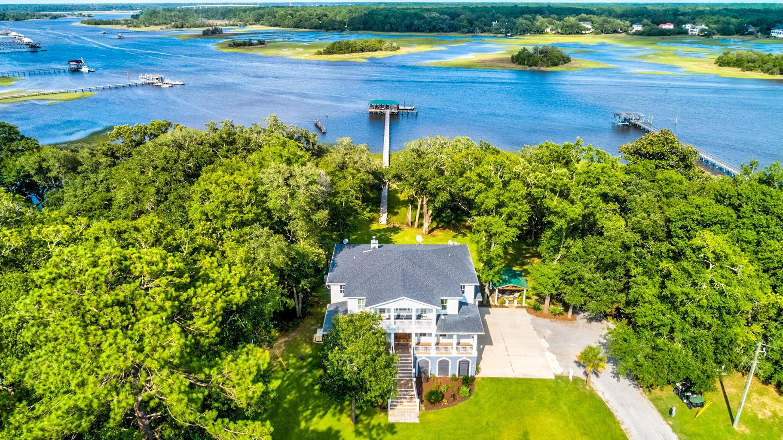
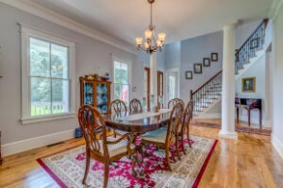
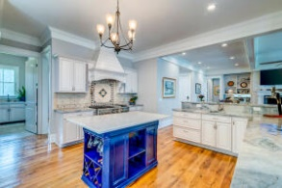
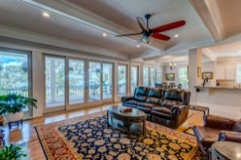
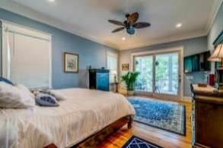
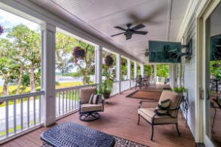
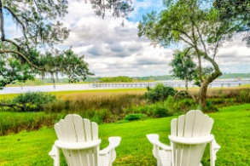
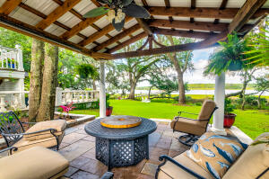
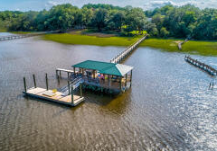

Charleston Area Deep Water Estate
New Price!
4200 El Cid Way
Hollywood, SC 29449 | MLS# 22020091 | $4,400,000
A luxury, 5385 sq. ft. deep water 3 acre estate on the Intracoastal Waterway with exquisite views. The house is elevated with 3 car garage underneath as well as an adjacent, fully equipped, mother in law suite. There is an elevator shaft that serves all 3 floors. The exquisitely designed interior boasts white oak flooring throughout with an open floor plan and master on main floor. Additionally on main floor are the great room-with fireplace, kitchen and formal dining room, which all lend themselves to the awesome views of the river. Upstairs are two additional master suites and media room- all with balconies. A large porch off the main floor leads down to the expansive patio designed with entertainment in mind. The area includes two gazebo's, covered cookout area, and outdoor fireplace, all on sandstone tile while also enjoying views of the Stono River. From back patio it is a short walk on walkway to the large pier head (25 X 20 ft)with an equally large floating dock ( 10 X 40 ft) where there is 6 ft of water at low tide, sink with running water, and mounted tv. Also on property is a stocked, freshwater pond, irrigation system, landscape lighting for entire site, a gutter system that feeds rainwater into the pond, and a powered work shop with running water. In case of any power outages there is an aux generator available with fuel provided by a 500 gallon propane tank. Imagine all the above and be only minutes from most your shopping needs and approx 25 min. from downtown Charleston. Flood insurance currently not required on property. Please take advantage of virtual tour provided.
Click for a Video Tour
Carey Budds
843-475-1505
cdft73@aol.com
Jerry Wise
843-442-7633
jerrywise03@gmail.com
Carey Budds
843-475-1505
careybudds@gmail.com
ERA Wilder Realty | 125 Wappoo Creek Ste F | Charleston, SC 29412

