Slide 1
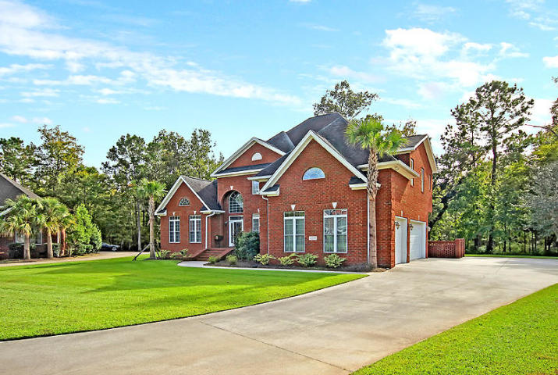
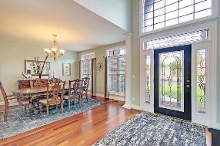
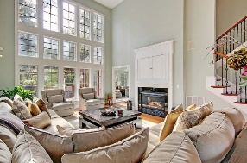
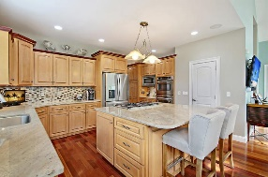
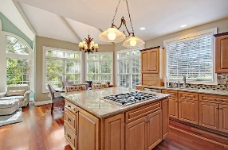
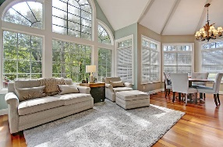
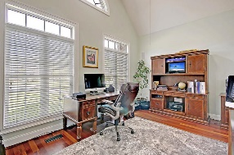
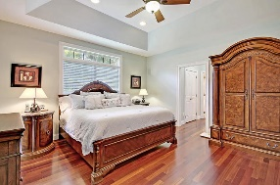
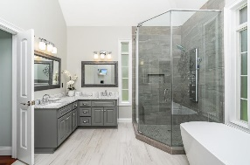
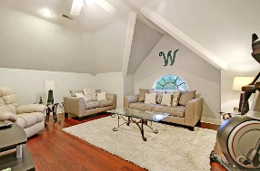
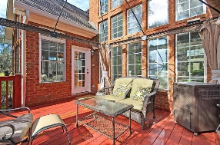
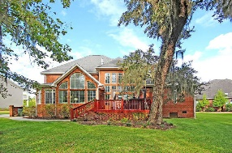



On Cul-de-sac in Gated Golf Community
4202 Magnolia Court
Coosaw Creek Country Club
North Charleston, SC 29420
MLS# 19013384
$481,900
4 Bedrooms | 3½ Baths | 3,707 sf
This beautiful, brick, custom built home is in excellent condition! The first floor features a gourmet kitchen with granite counters, island, double ovens, double dishwasher, custom cabinetry, gas range, stainless steel appliances, backsplash, pantry and an eat-in-kitchen area. This home offers beautiful Brazilian Cherry hardwood floors throughout! No carpet! On the 1st floor, buyers will also find an office attached to the master bedroom, separate dining room, a keeping room with porch access and a family room with vaulted ceilings and a gas fireplace. The large master bedroom is on the 1st floor and features tray ceilings, dual closets and a master bathroom with a newly renovated gorgeous master bath offering a large glass shower, jetted tub and dual vanities.
The 2 staircases (front and back access) have wrought iron railings. Buyers will also find a laundry room with cabinetry on the 1st floor. Upstairs, buyers will find a walk in attic for storage, three bedrooms with two full bathrooms. One bedrooms has its own bathroom and could be used for an upstairs master suite. The huge FROG can be used as a 5th bedroom, playroom, living area, entertainment room or practically anything a new owner may want / need! The home also features a 3 car garage, back deck overlooking private wooded backyard with pond views as well, central vacuum and many other custom upgrades! This home is an absolute MUST SEE within Coosaw Creek. The neighborhood has 24 hour 7 day a week gated security, unlimited golf for all household members, and the location, wow...close to it all! Boeing, Bosch, AFB, Mercedes are all a short drive away. Come live the good life in a golf course community that has tons of activities and events, great food in the restaurant, great community pool with an award winning swim team, and the most beautiful golf course you'll ever play on!
Larry & Kathy Mazalatis
Larry Cell 843-693-0529
Kathy Cell 843-693-0159
Office 843-871-9133
AGENTOWNED PREMIERE GROUP | 1800 TROLLEY RD | SUMMERVILLE, SC 29485

