Slide 1
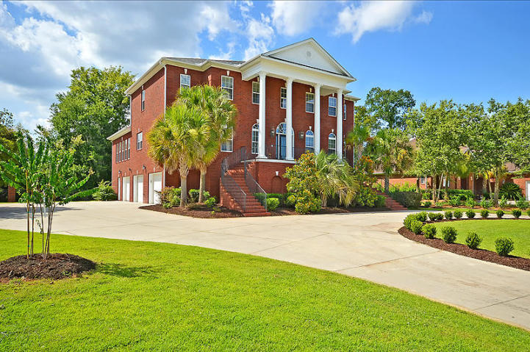
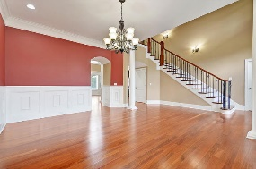
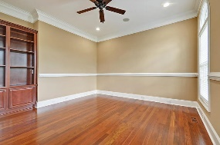
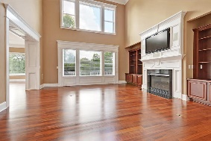
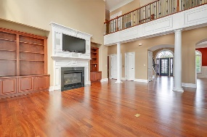
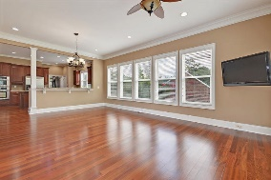
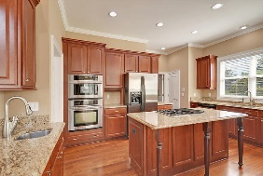
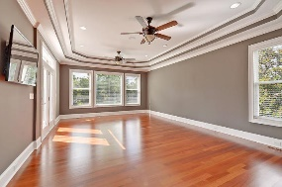
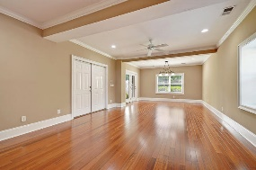
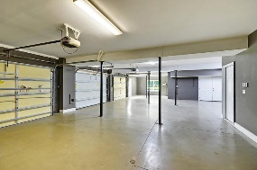
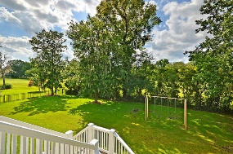
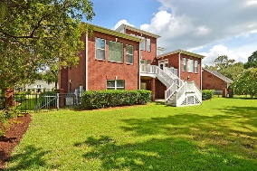
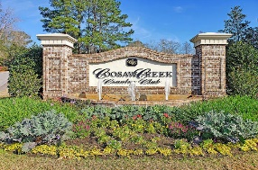
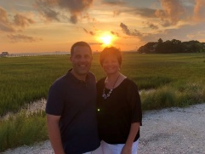

Stunning Three Car Garage Home On Golf Course!
4204 Club Course Drive
Coosaw Creek Country Club
North Charleston, SC 29420
MLS# 20018410
$799,000
6 Bedrooms | 4½ Baths | 5,550 sf
This 5,550 Sq. Ft. custom brick home built in 2008 may be the nicest home in the whole neighborhood and loaded with upgrades! Excellent condition with beautiful Brazilian Cherry hardwood floors throughout! Tired of climbing the beautiful custom staircases? No problem, just take the elevator from the ground floor to the 1st or 2nd floors - easy for getting groceries to the 1st floor kitchen. The kitchen offers a large island with gas stove top, large sitting bar overlooks the family or keeping room AND the great room in an open floor plan. All the kitchen counters / island are granite and the appliances are stainless steel including the double ovens, trash compactor, dishwasher, vegetable sink and more... Custom cabinetry everywhere with no expense spared, multiple sliding drawers, garbage can, gas cook top, and many recessed lights finish out this gourmet kitchen which is EXCELLENT for entertaining! On the main floor (1st floor), buyers will find a large separate dining room, separate home office, great room open to kitchen, family or keeping room also open to the kitchen, laundry room, eat in kitchen area, master bedroom and a large deck with gas grill hook-up overlooking the 7th fairway. Elegant trim work found throughout the house. The deck overlooks a large fenced-in backyard with the golf course beyond. The large master bedroom is on the 1st floor and offers a huge master bathroom with large shower, jetted tub, custom cabinetry and ample walk-in closet space. The master bedroom also opens to the deck outside and has its own sitting / reading area. The large flat screen LCD TV's in the master bedroom, family room and great room are negotiable and can convey with the home. The home also features an intercom system and security system. Surround sound w/ speakers in master bedroom, outside deck and great room may convey as well. The ground floor has a massive side load oversized 3 car garage which can fit 4 cars with extra storage space to spare! Also on the ground floor is a mother-in-law suite including a bedroom with full bathroom and living room previously used as a billiards room / playroom. A large circular driveway is in front of the grand entrance as well as lawn irrigation throughout the yard. Four more large bedrooms all with walk-in closets and two bathrooms are located upstairs. A few additional features include two tankless hot water heaters and an automatic stand-by generator for the 1st floor in case of emergency. This home is a must see within Coosaw Creek! COOSAW CREEK OFFERS AN EXCELLENT CLUBHOUSE WITH RESTAURANT AND BAR, NEIGHBORHOOD POOL, TENNIS COURTS AS WELL AS AN EXCELLENT GOLF COURSE. PLANNED EVENTS AND MEALS IN THE VERY ACTIVE CLUBHOUSE ARE COMMON AND GOLF MEMBERS ENJOY THE NUMEROUS MONTHLY GOLF EVENTS OFFERED WITHIN THIS PRIVATE GATED COMMUNITY....
Larry & Kathy Mazalatis
Larry Cell 843-693-0529
Kathy Cell 843-693-0159
Office 843-871-9133
AGENTOWNED PREMIERE GROUP | 1800 TROLLEY RD | SUMMERVILLE, SC 29485

