Slide 1
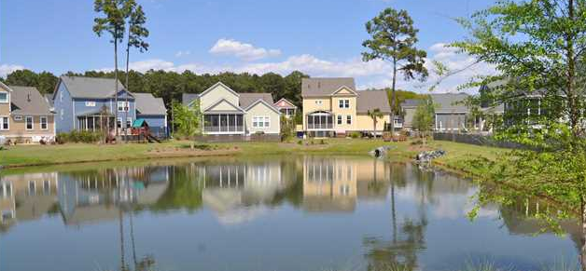
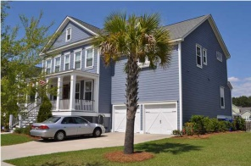
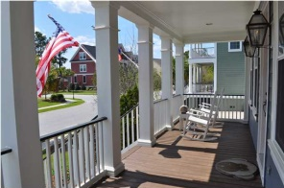
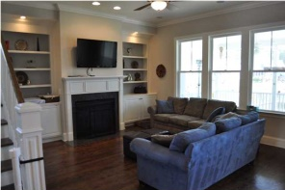
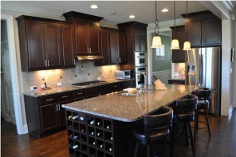
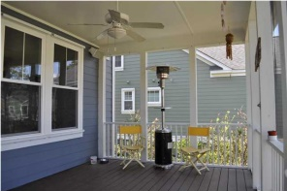
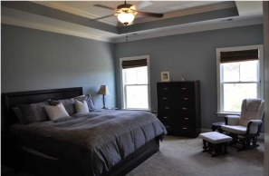
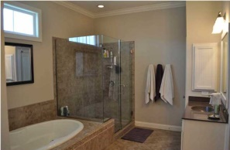
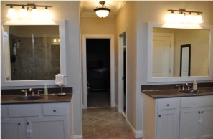
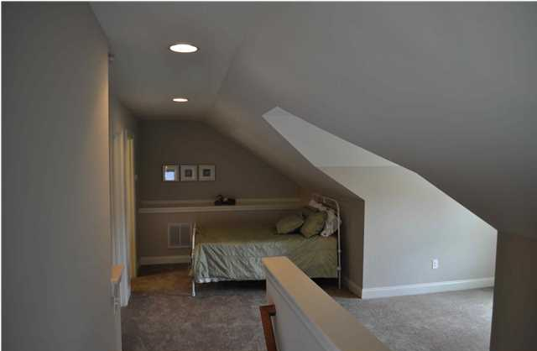
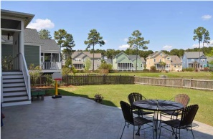


Pond-Front In Hamlin Plantation!
4204 Coolidge St - Mt Pleasant - MLS# 1410000 - $595,000
BEAUTIFUL Hampshire model, pond-front home with awesome outdoor space! Great condition! HEAPS of interior space including 6 bedrooms/5 full baths and a 400+ sq. ft. finished third floor suite. The owners upgraded many features from the standard Wieland finishes including: wood flooring throughout first floor; gas lanterns on the front porch; built-in speakers in living room and screened porch; numerous kitchen upgrades; full tile shower with frame-less glass in the Master bathroom; and much more. The first floor features a huge Chef's Kitchen opening to the Great Room and breakfast area, a walk-in pantry, a guest bedroom and full bathroom, an office, a separate dining room, and a large screened porch. The second floor features 4 bedrooms and 3 full baths plus a large bonus room/media room. The massive Master Suite overlooks the pond on the back of the house, has two walk-in closets, and a gorgeous bathroom with two vanities, water closet, and separate tub and shower. Up another flight of stairs is the Third floor, which can be closed-off via the door on the landing. It makes a fantastic guest suite with lots of space and another full bathroom! The owners have continued to improve this beautiful home over the years, adding a fantastic poured-concrete patio (with great afternoon shade!) and fencing-in the backyard. They even upgraded the storm shutters! Grab your representative today and have them show you this gorgeous home!
The Boulevard Company, LLC
Mark Macpherson
mark@beachbreak-properties.com
843.367.5640 Mobile

