Slide 1
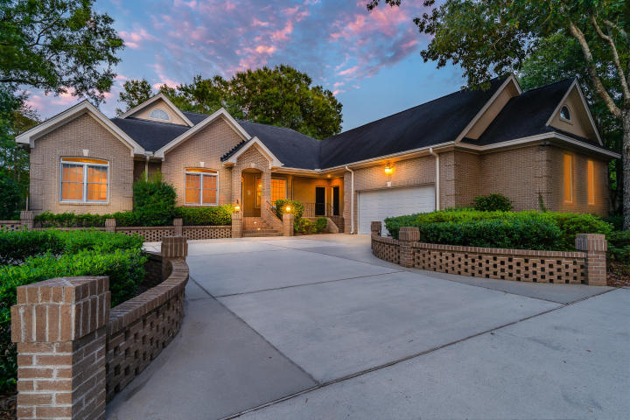
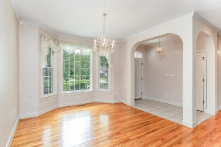
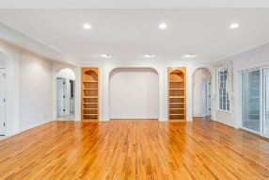
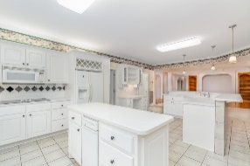
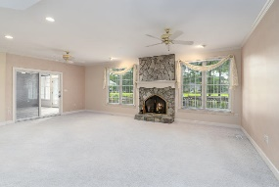
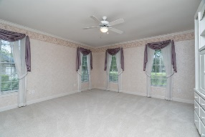
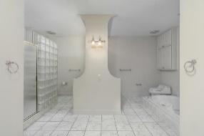
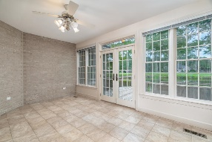
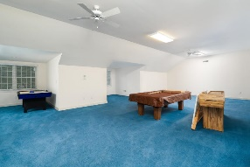
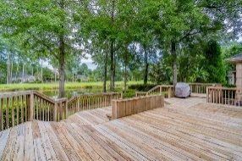
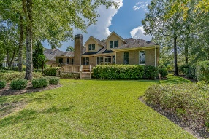
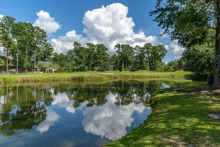
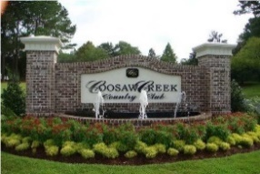


5BR, 5BA All On First Floor! On Golf Course!
4204 Persimmon Woods Dr
Coosaw Creek Country Club
North Charleston, SC 29420
MLS# 19024813
$599,000
5 Bedrooms | 5 Baths | 4,795 sf
This massive 4,795 Sq. Ft. custom built, brick, golf course home overlooks a pond and ALL 5 bedrooms are on the first floor with their own full bathroom! The wide-open floor plan features a huge kitchen with sitting bar and island open to both the family room with fireplace and a keeping room as well. The spacious kitchen offers double ovens, massive pantry, plentiful cabinet space and tons of counter space! 5 bedrooms on the ground floor all have their own full bathroom. The master bedroom is large and offers a master bathroom with dual vanities, separate tub and shower and dual walk-in closets as well as two toilets. The mother-in-law suite has its own kitchenette with small refrigerator, microwave and sink as well as a full bathroom and separate entrance / exit to the front porch.
The sunroom overlooks the golf course and pond with excellent views! The home also offers a separate dining room, bonus craft room / office, MASSIVE upstairs playroom or media room (pool table, air hockey and shuffleboard can all convey) and two car garage with attached workshop. The back deck offers great pond and golf course views and the gas grill can convey. Leave your stresses behind and come live the good life in Coosaw Creek! The neighborhood has 24 hour 7 day a week gated security, unlimited golf for all household members, and the location, wow...close to it all! Boeing, Bosch, AFB, Mercedes, Volvo- are all a short drive away. Come live the good life in a golf course community that has tons of activities and events, great food in the restaurant, great community pool with an award-winning swim team, and the most beautiful golf course you'll ever play on!
Larry & Kathy Mazalatis
Larry Cell 843-693-0529
Kathy Cell 843-693-0159
Office 843-871-9133
AGENTOWNED PREMIERE GROUP | 1800 TROLLEY RD | SUMMERVILLE, SC 29485

