Slide 1
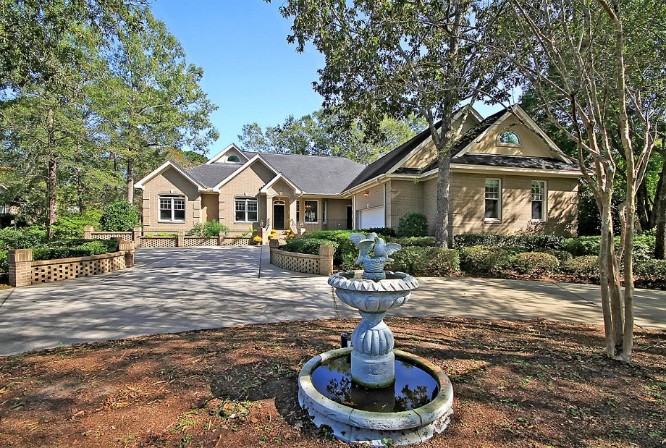
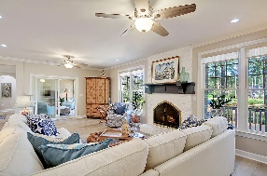
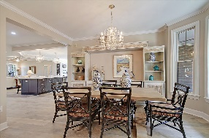
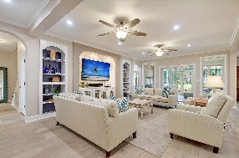
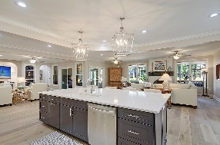
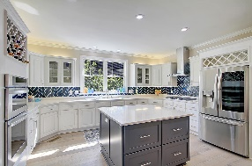
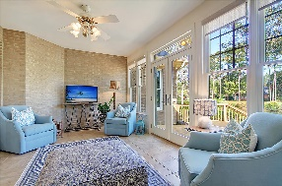
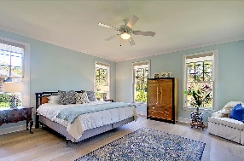
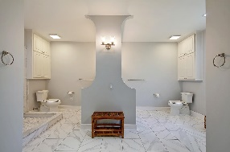
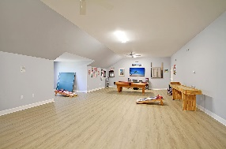
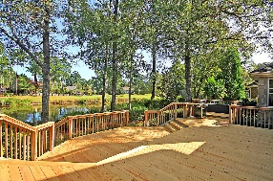

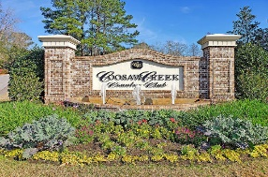
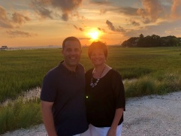

Stunning One Story on Golf Course ~ In-law Suite!!
4204 Persimmon Woods Dr
Coosaw Creek Country Club
North Charleston, SC 29420
MLS# 20030227
$734,990
5 Bedrooms | 5 Baths | 4,795 sf
This custom, brick, golf course home looks like a model home! Owners have spared no expense at renovating this one story beauty which offers its own mother-in-law suite! This stunning home is situated on the golf course in Coosaw Creek with lovely pond views. There is a circular driveway and courtyard parking area which has been landscaped nicely and has landscape lighting as well as a fountain. Upon entering, get ready for your jaw to drop! Stunning open floor plan with all new flooring throughout the entire home, an abundance of natural light and great views! The huge, gourmet kitchen is awesome! Two huge islands, sitting bar, quartz countertops, top of the line new appliances, two sinks, built in shelves and wine rack...it's amazing! Off of the kitchen is a large pantry / craft room with tons of cabinetry and a sink. You'll also find the laundry room off the kitchen, which also has a sink and room for an extra refrigerator. Down the hall from the laundry room, is the mother in law suite. This is such a great space offering a kitchenette, living room/bedroom area, large closet and full bath. This area is separate from the rest of the living space offering plenty of privacy and its own separate entrance. Back in to the living area, there is a great open flow of rooms. You can gather around the kitchen and sit in the keeping area that has a beautiful fireplace and mantel, or you can head over to the family room that has built ins and an area for a tv. Or you can head over to the dining room! Off the family room is a large sunroom which leads out to the fabulous back deck. Take in the views of the golf course, pond and all the wildlife that visits. Back inside, you'll find a bedroom, that could be used as a home office as well as a renovated half bath outside of it. On the other side of the house is the master suite. This room is a great size and offers awesome views. The master bathroom has had a total renovation and offers dual vanities, two walk in closets and an oversized shower. In the front of the home, are two additional bedrooms, each with their own bathroom, again, all having been updated. Head upstairs to the giant bonus space! This room has new flooring and can be used so many ways! Off of this room is some attic storage. Finding storage in this home will never be an issue! The neighborhood has 24 hour 7 day a week gated security, unlimited golf for all household members, and the location, wow...close to it all! Boeing, Bosch, AFB, Mercedes are all a short drive away. Come live the good life in a golf course community that has tons of activities and events, great food in the restaurant, great community pool with an award winning swim team, and the most beautiful golf course you'll ever play on!
Larry & Kathy Mazalatis
Larry Cell 843-693-0529
Kathy Cell 843-693-0159
Office 843-871-9133
AGENTOWNED PREMIERE GROUP | 1800 TROLLEY RD | SUMMERVILLE, SC 29485

