Slide 1
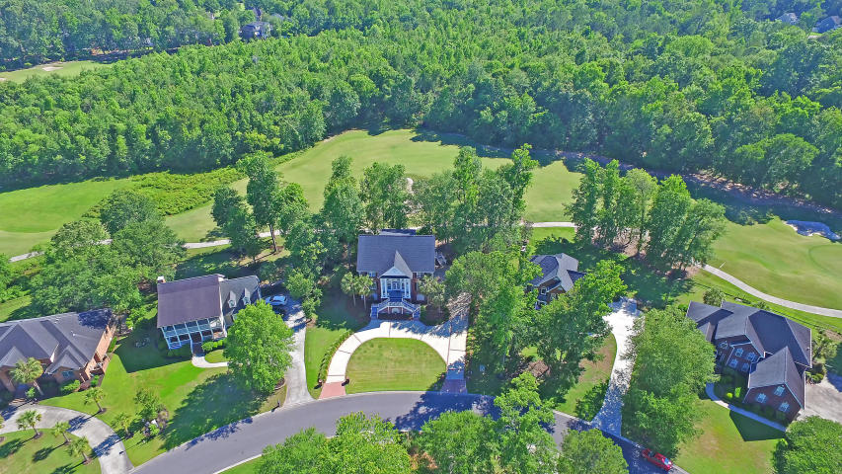
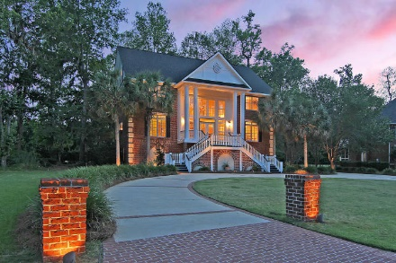
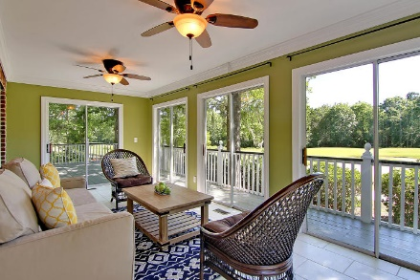
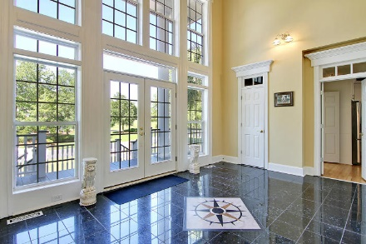
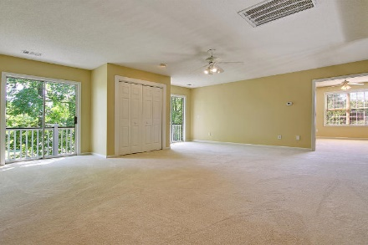
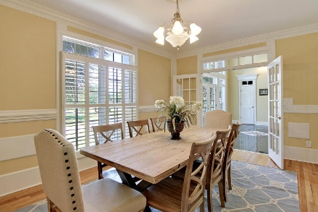
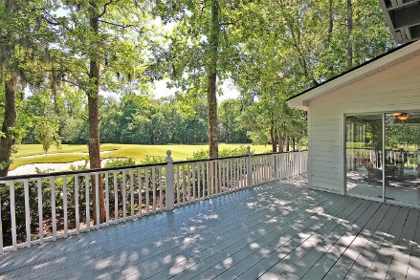
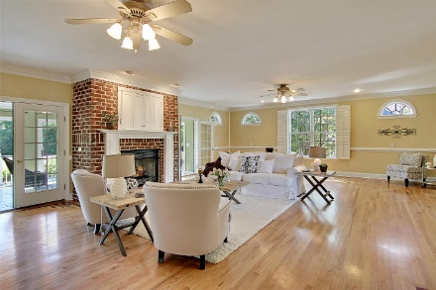
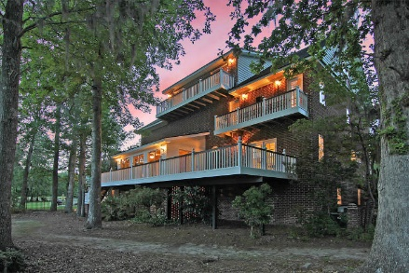
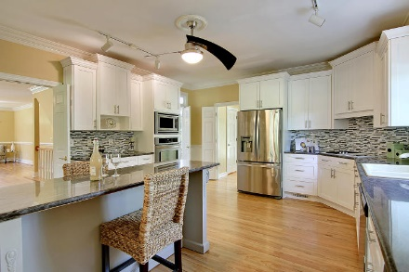
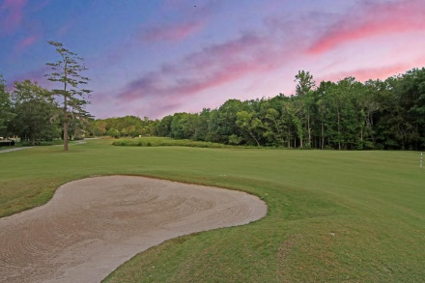
Price Reduced!
Seller Offering $20,000 Upgrade Concession
To Be Paid To Buyer With Seller Closing Proceeds
4205 Sawgrass Drive Coosaw Creek CC ~ Charleston, SC 29420 ~ MLS# 17012942 ~ $568,500
4205 Sawgrass Drive Coosaw Creek CC ~ Charleston, SC 29420 ~ MLS# 17012942 ~ $568,500
A three story foyer, four level living, three car garage, two balconies & a location that backs to the #1 hole on the golf course all come together for an exceptional house in Coosaw Creek. The circular driveway with brick columns at each entry loops past the professional landscaping, tropical palm trees & grand staircase all which are illuminated at night by the landscape lighting. An inviting foyer with stunning tile work, gigantic living room with fireplace, a sensational sunroom with views of the golf course, the renovated kitchen with eat-in area & formal dining room all compose the main living level of the home. The owner's retreat boasts a massive en-suite bath, a HUGE walk-in closet, fireplace & private balcony. Continue up to the top level where there's a wet bar & another balcony.
Additional features include:
Great views of #1 hole on the golf course from multiple decks
Kitchen features stainless steel appliances, large cabinets, granite countertops, a tile backsplash, and a breakfast bar
Semi-open floor plan with spacious family room with fireplace
The incredible master suite includes outdoor access with golf course views, a fireplace, a massive walk-in closet, and a master bathroom with dual vanities, a spacious jetted tub, and a large step-in double shower
Stunning inlaid hardwood and granite flooring on the main level
Brick exterior
Freshly painted throughout
Gated golf course community with Arthur Hills golf course
Community includes a swimming pool, tennis court, and club house with dining
Book your showing today!
Nate Gainey nate@mattoneillteam.com 843-513-2038

