Slide 1
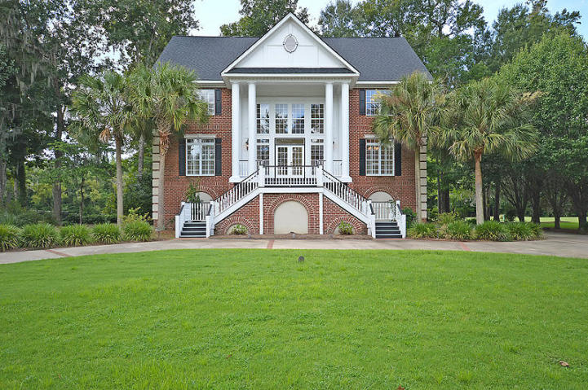
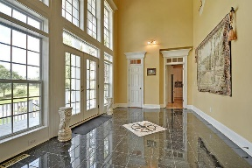
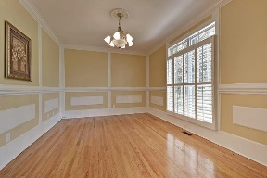
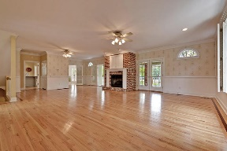
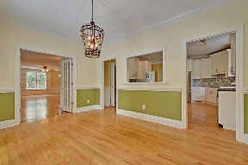
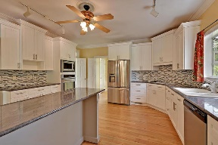
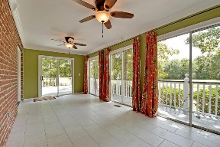
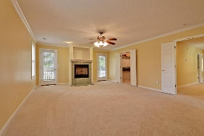
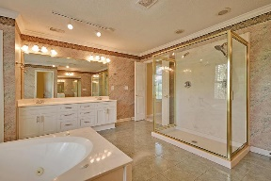
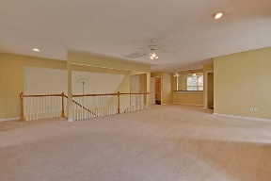
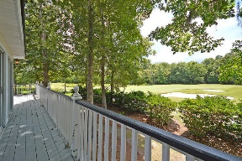
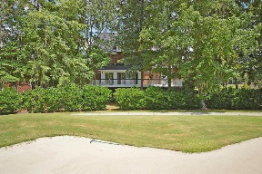



Coosaw Creek Beauty!
4205 Sawgrass Drive
Coosaw Creek Country Club
North Charleston, SC 29420
MLS# 16021910
$599,000
5 Bedrooms | 4½ Baths | 5,600 sf
Curb appeal galore! This house will WOW you! Need plenty of room? This house has it! It even has an elevator! Great location in a gated golf course community within walking distance to the club house, community pool and playground. A Grand staircase welcomes you to an amazing entryway. The foyer offers the best first impression, you’ll feel like you’ve stepped back in time. A true Southern welcome with windows from floor to ceiling. The formal living room is to your right upon entering and can be used as an office. This room has transom windows above, wood floors and French Doors. Then step in to the family room, which is huge and offers wood floors, beautiful brick fireplace and two french doors leading to the sunroom. The sunroom has great views of the golf course and is newly tiled. The kitchen has all new appliances, eat at island, trash compactor, tons of cabinet space, wood floors and off of it, a large combination pantry and laundry room. There's even a laundry chute! Off of the kitchen is a good size dining room with view of the golf course. The next floor has all new carpeting and has two big bedrooms with big closets (one bedroom has two closets!), plantation shutters and they share a full bath in the hall. The master bedroom is very large with a fireplace, huge walk in closet with his and hers sides, access to its own porch overlooking the golf course and a large master bath. The master bath has dual vanities, double size shower, jetted tub, linen closet (access to the laundry chute) and water closet. Then head up to the top floor! This floor has balcony access and is a huge bonus room. This room can be used any way you choose! There's a wet bar, refrigerator hook up and sink. Off the bonus room is another bedroom with two closets and attic storage. There's also another full bath on this floor! Take the elevator back to the ground floor! There, you'll find a mother in law suite with a bedroom, den and full bath. There's plenty of room to add a kitchen! The three car garage is a storage dream! There's even golf cart parking outside the garage under the back deck! Tons of extras in this home, gas line for grilling, exterior landscape lighting, brick columns at the end of the driveway with lights, central vacuum...this home is a must see!! Close to everything!! Bosch, Boeing, AFB, Airport. Make your commute a short one!!
Larry & Kathy Mazalatis
Larry Cell 843-693-0529
Kathy Cell 843-693-0159
Office 843-871-9133
AGENTOWNED PREMIERE GROUP | 1800 TROLLEY RD | SUMMERVILLE, SC 29485

