Slide 1
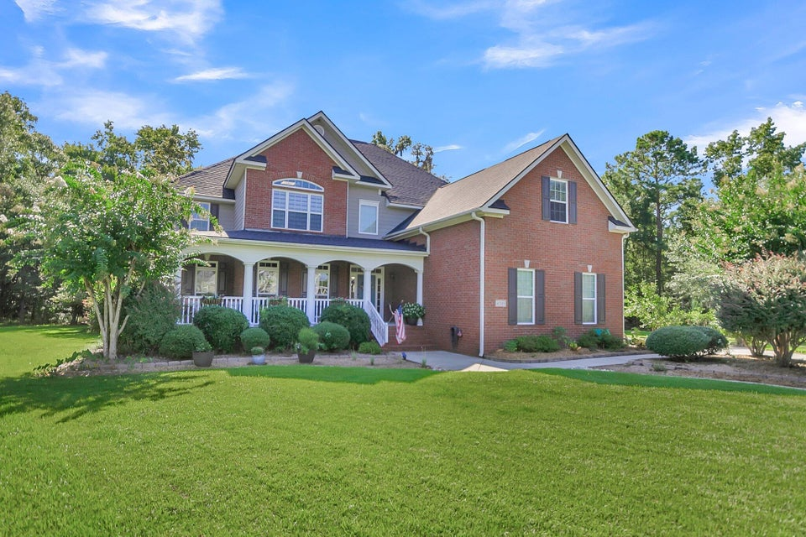
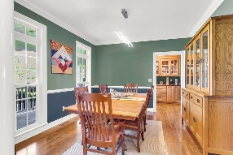
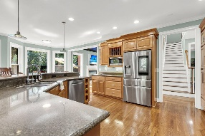
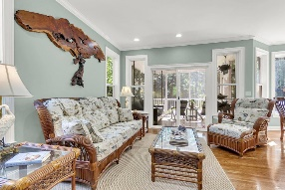
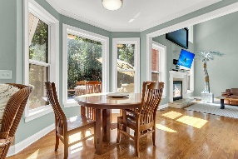
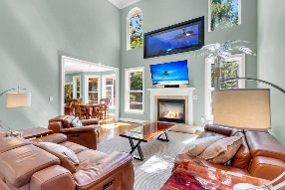
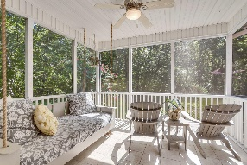
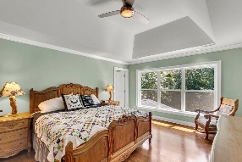
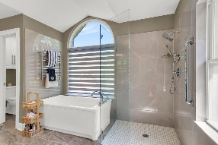
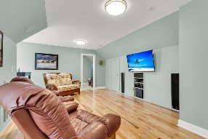
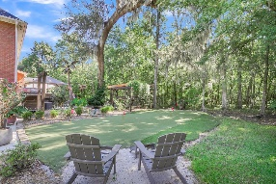
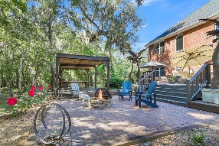
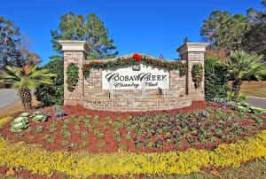
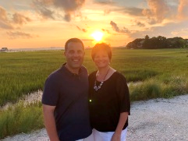

Cul-de-sac ~ Wooded Backyard ~ Gated Community
4205 Magnolia Court
Coosaw Creek Country Club
North Charleston, SC 29420
MLS# 24021216
$749,900
5 Bedrooms | 4 Baths | 3,527 sf
Welcome to 4205 Magnolia Court in the beautiful Coosaw Creek Country Club neighborhood! Seller is willing to pay the $15,000 initial fee with an acceptable offer!! This home is located on a private wooded lot on a cul-de-sac with a large front porch welcoming you home. Walk on in and you'll find a lovely two story foyer and notice all the wood flooring thought out the home. Immediately to your left is a large dining room which is a great entertainment spot as the butler pantry right off of it offers a buffet area and cabinetry for extra storage. The kitchen is a beauty! It has a large walk in pantry and a desk space with a built in book shelf. The gas cooktop has a pot filler mounted above, the custom cabinetry also has a wine rack and dish rack built in. Top of the line appliances, granite countertops, breakfast bar as well as an eat in area and keeping room. Off of the kitchen is the living room with a gas fireplace, vaulted ceilings and tons of natural light. On the first floor you'll also find a guest bedroom with a full bathroom off of it. Perfect for visitors. Also off of the kitchen is the screened in porch. Off of the porch, you'll find a backyard that is built for entertaining! And privacy galore! Tons of deck space for relaxing, an outdoor kitchen, a covered patio area that offers tons of shade and a putting green to get you ready for the golf course! Outside of the three car garage is additional built in storage. Back inside, head upstairs and check out the large primary bedroom with attached bath. The bathroom has a zero entrance shower, an air jetted tub and a huge walk in closet with built in shelving. Another bedroom also with its own full bathroom is located next to the primary. Head down the hall to the laundry room which offers a large utility sink and cabinets for storage. Then what can be a mother in law suite, a teen suite...you name it, is at the end of the hall. There's a bedroom with a jack and jill bathroom, but owners had converted this area into a mother in law suite so there is a mini kitchen area with a small fridge and sink which connects to a large bonus room that has built in storage, an office and attic storage. The bonus room can also be a sixth bedroom if needed! The possibilities are endless! Don't hesitate and miss out on this beautiful home! Living in Coosaw Creek gives you an opportunity to have a golf membership for all of your household members, the security of living in a gated community, pickleball courts, tennis courts, neighborhood pool and playground, access to an active clubhouse and restaurant. So many fun events and activities are always on the calendar which makes it a great way to meet people! This neighborhood is also convenient to the airport, AFB, Bosch and Boeing. Dorchester District Two Schools! Come live the good life!
Larry & Kathy Mazalatis
Larry Cell 843-693-0529
Kathy Cell 843-693-0159
mazteamrealty@gmail.com
AGENTOWNED PREMIERE GROUP | 1800 TROLLEY RD | SUMMERVILLE, SC 29485

