Slide 1
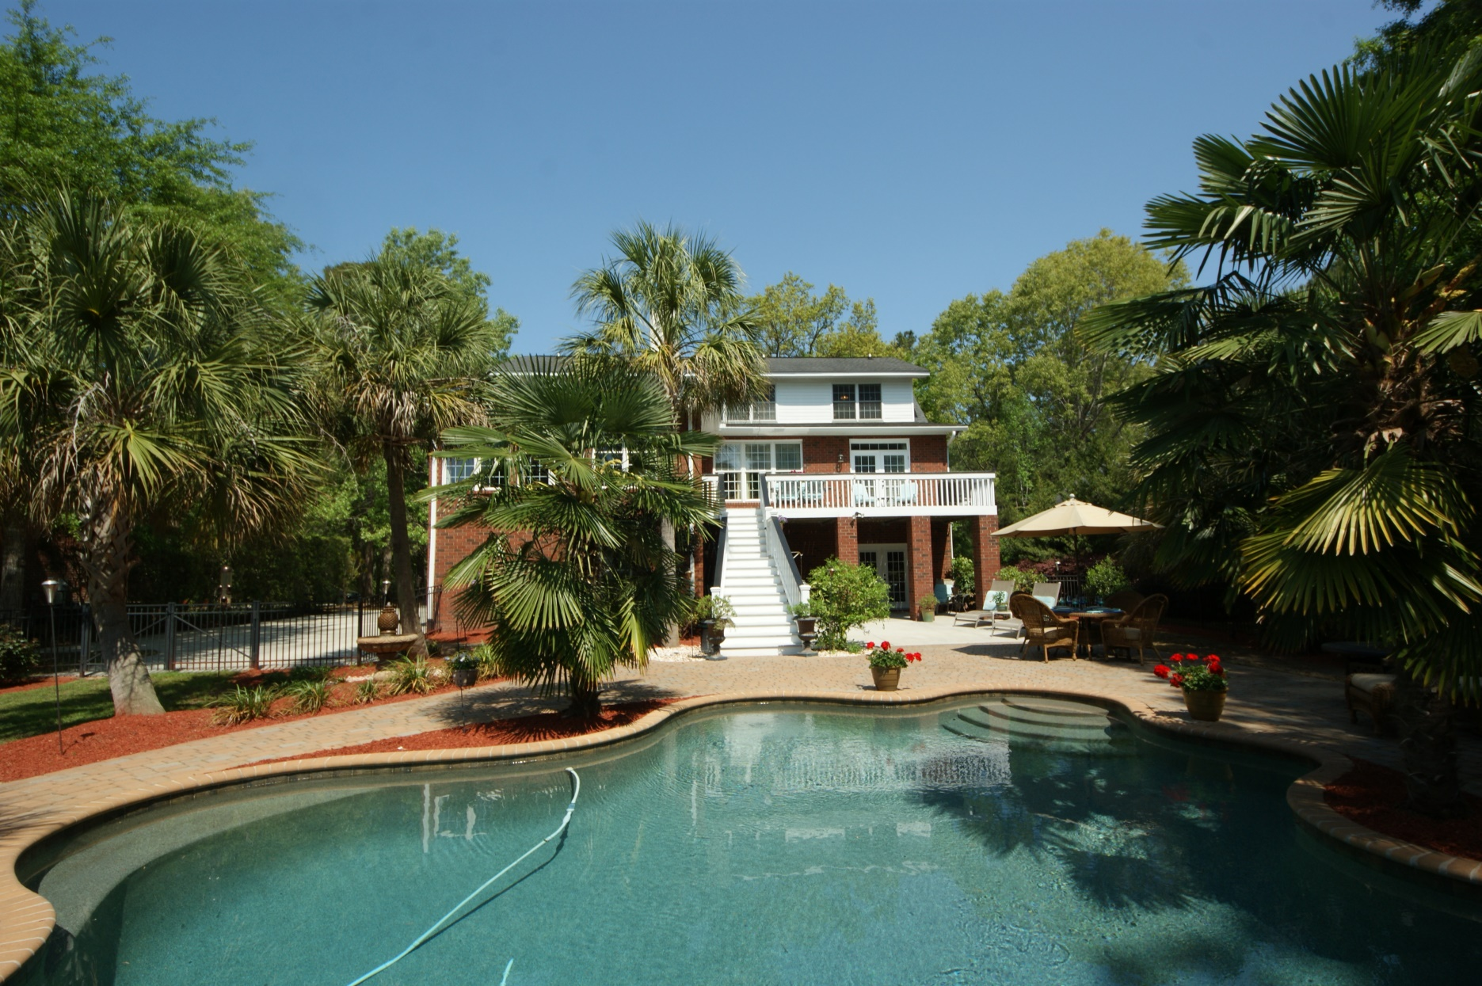
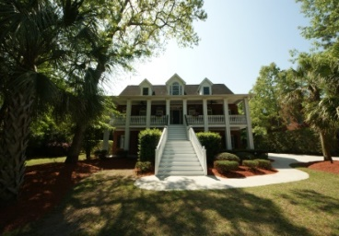
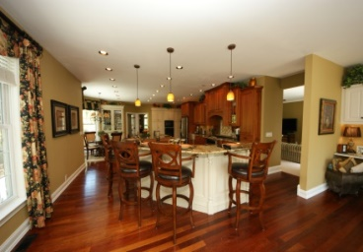
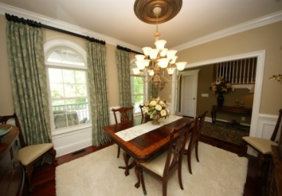
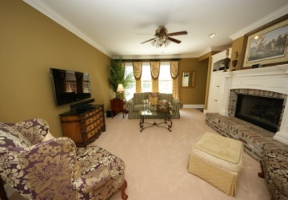
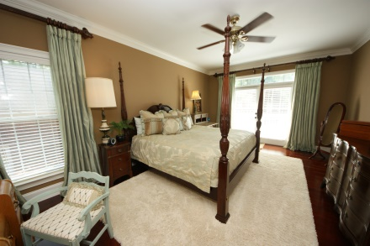
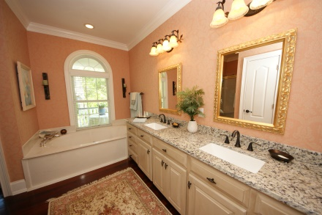
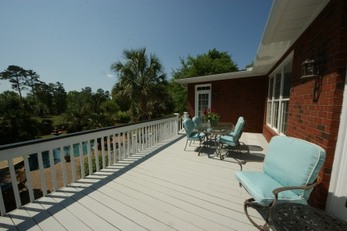
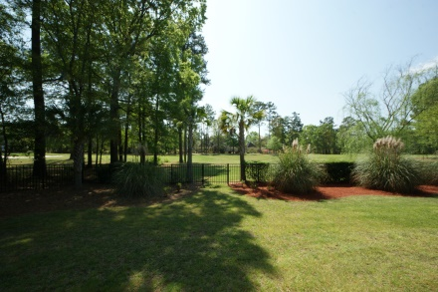

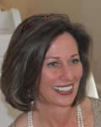
Amazing Lowcountry Home in Gated Country Club Community
JUST REDUCED!
4209 Buck Creek Court
North Charleston | Coosaw Creek CC | MLS# 15009349 | $689,500
Lovely brick home in Coosaw Creek Country Club. TWO Master Bedrooms - one up, one down. Four of the five bedrooms has a dedicated en suite bathroom for privacy. Ground level is comprised of 2 bedrooms and a full bath. One BR is being used as an office (but HUGE walk-in closet) and the other leads out onto the large patio and deck area off the GORGEOUS CUSTOM POOL! The main floor level has the ~first~ Master BR and the second floor has two bedrooms and two baths...one of these bedrooms is super large (2nd Master BR)...both with en suite baths and super large walk-in closets. Walk into the Entry Foyer and notice the beautiful mouldings and detail....soaring ceiling with a chandelier that is amazing. The Formal Dining Room is to your right and Family Room with fireplace is straight ahead. This KITCHEN is absolutely the nicest in Coosaw! Two large islands and stainless appliances. 2 ovens. Lovely granite countertops and stunning cabinetry - a cook's delight. Off the Kitchen area is a Gathering Room and the views of the golf course views of the 2nd hole are amazing from nearly every vantage point. This is Country Club living at it's best. Golf, your own personal resort with a POOL in the back yard and dining at the Country Club dining room when you don't want to cook dinner...even though this kitchen will beckon you to! The back of the house has a huge open deck off the Family Room that leads down to the patio and lounging area. The pool is surrounded by stone pavers. This pool was designed by the owners and is custom made to suit the lovely palm trees swaying in the breeze. Metal fence surrounds the yard in the back making this super child and pet friendly. GARAGES - can you say 4? This is the only available home in Coosaw with a 4-Bay garage. Plenty of room for your cars and toys and workspace for the handy man.
Call for an appointment today!
$5,000 Buyer's Agent Bonus at Closing!
Susan Weeks
(843) 813-0495
susanweeksdesign@gmail.com
www.agentownedrealty.com
AgentOwned Charleston Group
902 Savannah Hwy
Charleston, SC 29407-7802

