Slide 1
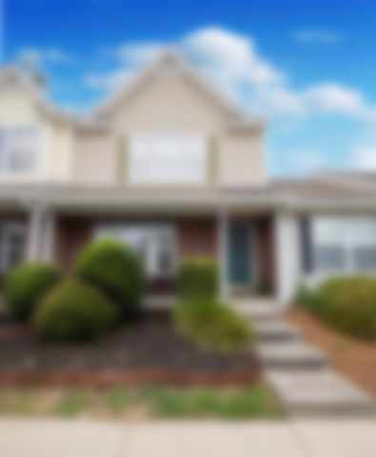
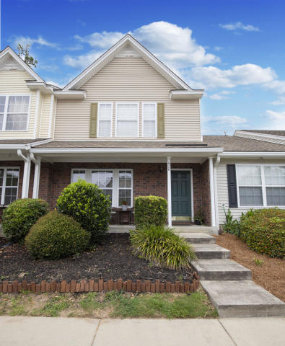
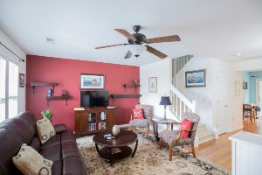
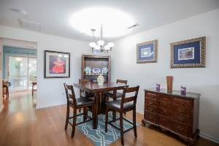
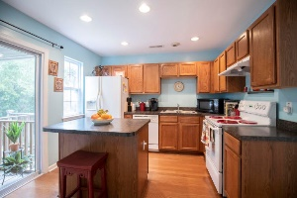
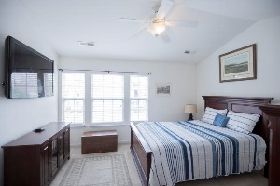
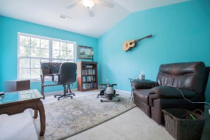
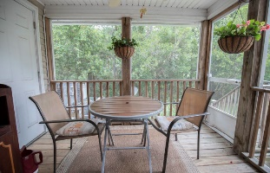

Price Improvement! Motivated Seller in Beresford Commons
420 Doane Way
Beresford Commons | Wando, SC 29492
MLS# 20015594 | $189,900
Welcome home to 420 Doane! Charming, second owner townhouse invites you home upon entering. Custom bookcases create a welcoming foyer & focal shelves in the family and dining room. Delightful screened porch off rear kitchen provides the perfect spot for your morning coffee or evening cocktail, overlooking the wooded wetlands. The dual, vaulted-ceiling master suites are complete with their own walk-in closets, linen closets, and full bathrooms. This townhouse has plenty of storage space with an upstairs hall closet, large closet under the staircase, and off patio storage. There is also a dedicated laundry room across from the 1st floor powder room and kitchen pantry. Charming features and those little extra amenities are what sets this townhouse apart from the rest!
Marthe Teixeira (917) 325-8033
marthe@agentownedrealty.com
AgentOwned Preferred Group
824 Johnnie Dodds Blvd
Mt Pleasant, SC 29464

