Slide 1
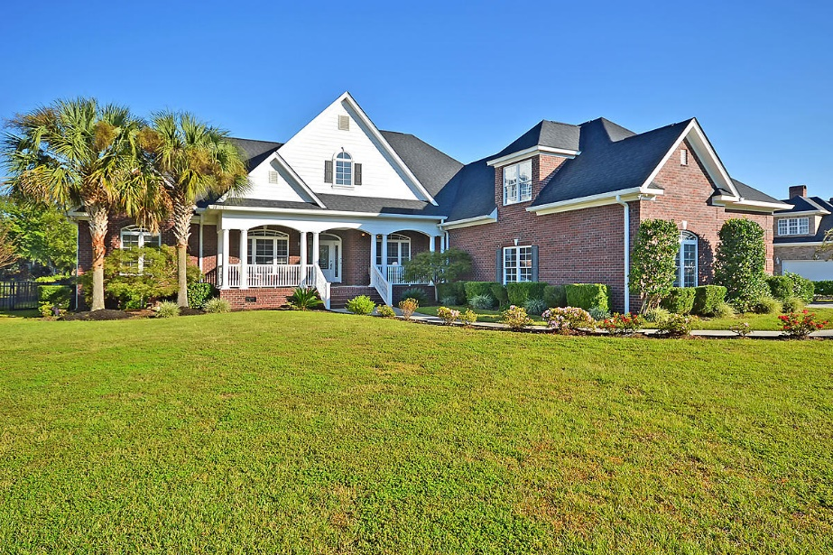
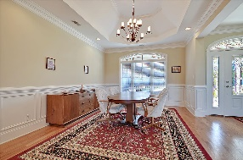
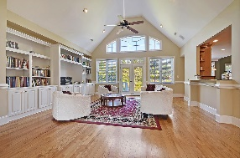
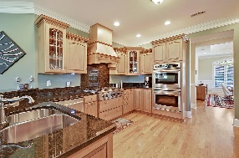
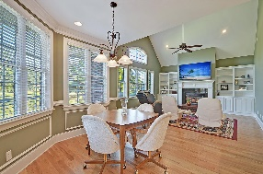
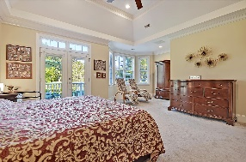
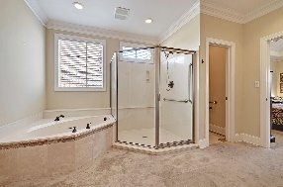
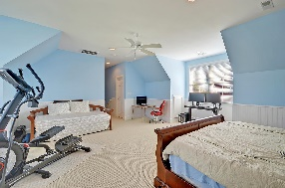
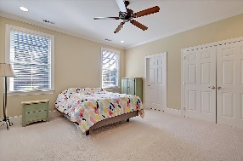
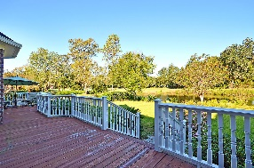
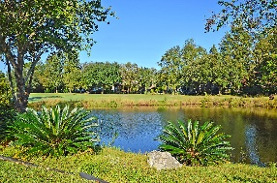
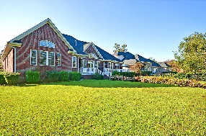
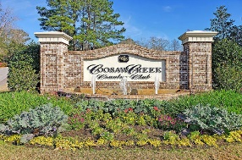
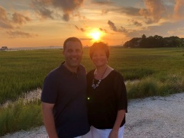

Gated Community-One Story-On Golf Course!
4210 Club Course Drive
Coosaw Creek Country Club
North Charleston, SC 29420
MLS# 20029872
$549,900
5 Bedrooms | 4 Baths | 3,761 sf
SHOWING SATURDAY, NOVEMBER 7TH ONLY!
This beautiful, brick ONE STORY home is custom built and offers 5 bedrooms, 4 bathrooms and 3,761 Sq. Ft. as well as a 3 car garage! The pond and golf course views are exceptional and the home is in excellent condition. The gourmet kitchen offers a 6 burner Dacor gas cooktop, sitting bar, double ovens and custom cabinetry and is open to both the keeping room / living room as well as the family room. There is a separate dining room and beautiful hardwood floors throughout the main living areas. The roof was replaced in 2018 and the HVAC unit is fairly new as well. The master suite has a sitting area, private entranced to the back deck, a luxurious master bathroom and oversized walk-in closet. In addition to the master bedroom, there are three more bedrooms on the main level and also a FROG or spacious bonus room which could be used as a 5th bedroom if desired. The bonus room has a full bathroom and lots of storage access which leads to a spacious floored attic. The crawl space was encapsulated and is humidity controlled. New tankless water heater installed in 2020 for continuous hot water. New dishwasher installed 2019. Don't delay in seeing it! One-story homes with 3-car garages on beautiful pond sites such as this do not become available frequently in Coosaw Creek Country Club. This home is a must see within Coosaw Creek! COOSAW CREEK OFFERS AN EXCELLENT CLUBHOUSE WITH RESTAURANT AND BAR, NEIGHBORHOOD POOL, TENNIS COURTS AS WELL AS AN EXCELLENT GOLF COURSE. PLANNED EVENTS AND MEALS IN THE VERY ACTIVE CLUBHOUSE ARE COMMON AND GOLF MEMBERS ENJOY THE NUMEROUS MONTHLY GOLF EVENTS OFFERED WITHIN THIS PRIVATE GATED COMMUNITY...
Larry & Kathy Mazalatis
Larry Cell 843-693-0529
Kathy Cell 843-693-0159
Office 843-871-9133
AGENTOWNED PREMIERE GROUP | 1800 TROLLEY RD | SUMMERVILLE, SC 29485

