Slide 1
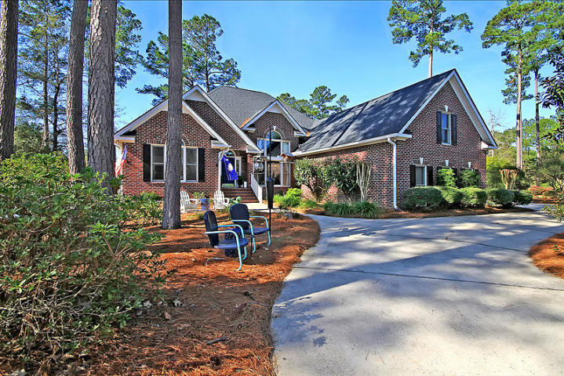
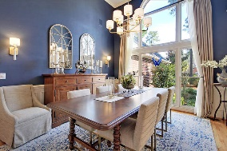
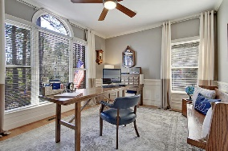
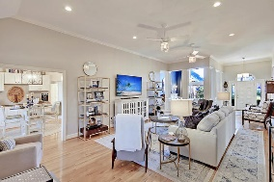
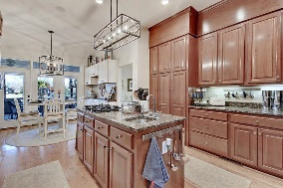
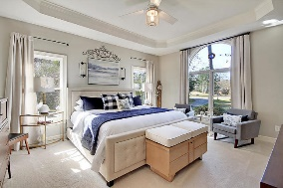
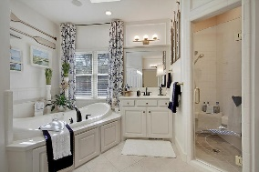
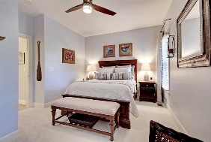
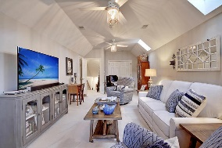
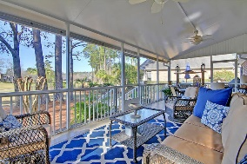
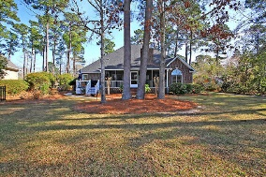
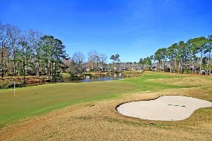



Stunning One Story on Golf Course in Gated Community
4211 Sweet Gum Crossing
Coosaw Creek Country Club
North Charleston, SC 29420
MLS# 20002231
$419,000
4 Bedrooms | 3 Baths | 2,920 sf
This is the one! Gorgeous one story stunner in the gated golf course community of Coosaw Creek! A large circular driveway, lovely landscaping and the three car garage grab your attention right away upon arriving. When you enter, get ready to be wowed! To your right is the dining room, surrounded by decorative columns and open to the living room. To your left, is the first of the bedrooms, but is currently being used as an office. The living room is light and bright with tall ceilings, a gas fireplace and surround sound. Be sure you look up while touring this home, every light fixture has been updated and they are beautiful! The kitchen has so much storage and is a kitchen area overlooking the golf course. Off of the kitchen, is a second bedroom with its own full bath. Down the hall, you'll find bedroom #3 which has a full bathroom just outside of it in the hall. Also on this side of the home, is a large laundry room, which offers even more storage! Back to the other side of the home you'll find the master suite. This room has golf course views as well as two closets, a large master bath that offers dual vanities, a large shower and a separate tub. Head out back to sit in the large screened in porch with beautiful golf course and pond views. Off of the screened porch is a brand new deck, perfect for grilling! Upstairs is a bonus room which could be a 5th bedroom if needed, a media room, playroom, you name it! Tons of attic storage off of this room. You'll never be at a loss for storage! This home is a dream come true! It is so well maintained, freshly painted interior, gorgeous light fixtures, extra trim work and shiplapping give this home a fresh updated look. The crawl space is fully encapsulated and has a dehumidifier. Come see this home as soon as you can because it will not last! The neighborhood has 24 hour 7 day a week gated security, unlimited golf for all household members, and the location, wow...close to it all! Boeing, Bosch, AFB, Mercedes are all a short drive away. Come live the good life in a golf course community that has tons of activities and events, great food in the restaurant, great community pool with an award winning swim team, tennis courts, basketball courts, playground and the most beautiful golf course you'll ever play on!
Larry & Kathy Mazalatis
Larry Cell 843-693-0529
Kathy Cell 843-693-0159
Office 843-871-9133
AGENTOWNED PREMIERE GROUP | 1800 TROLLEY RD | SUMMERVILLE, SC 29485

