Slide 1
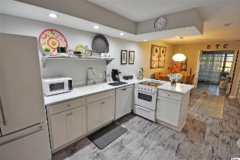
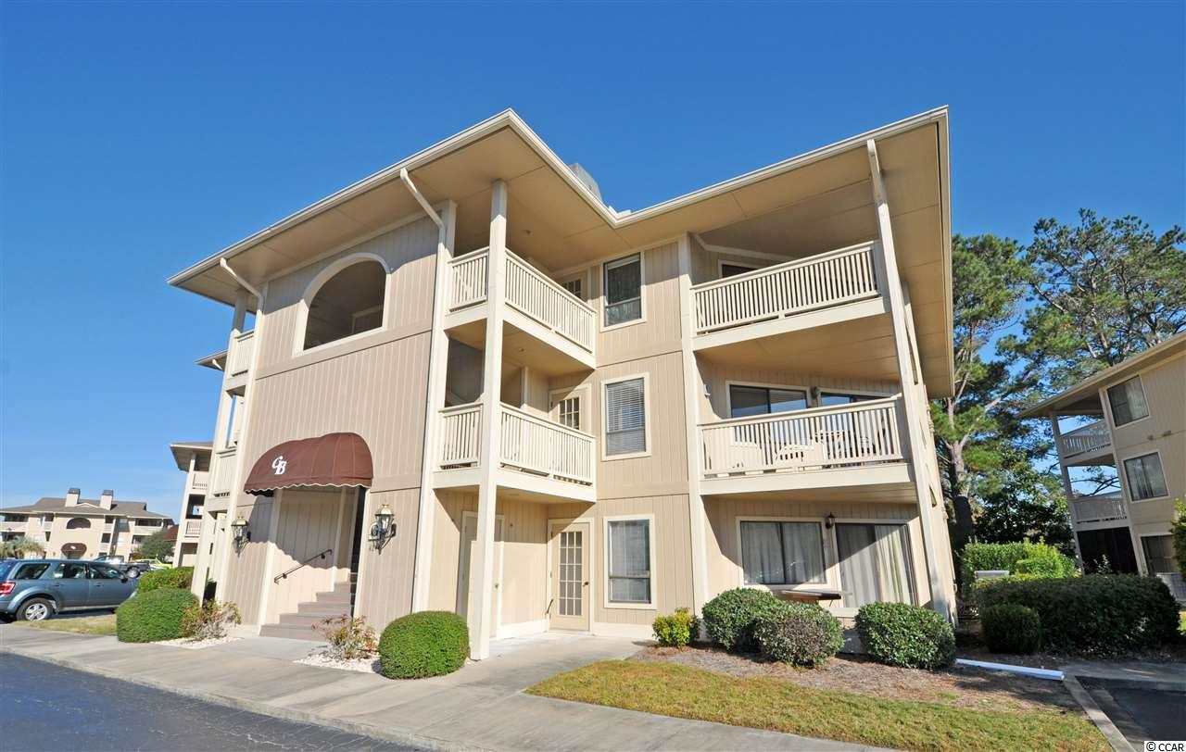
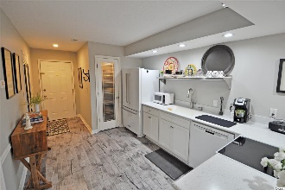
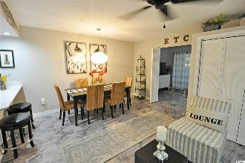
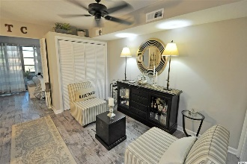
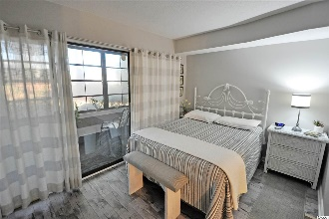
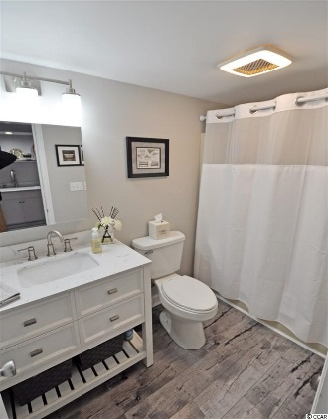
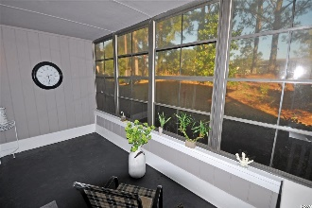
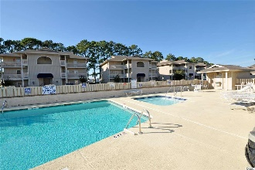
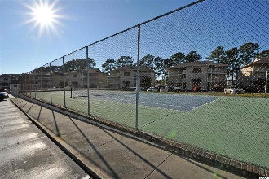


4214 Pinehurst Circle Unit G2
Cypress Bay I ~ Little River, SC 29566
MLS# 1924927 ~ $82,500
Simple, elegant and low maintenance yet the best of everything, including high design in what would normally be called a small space but which is anything but that... this newly redecorated condo masterpiece lives LARGE in luxury and value... You will immediately notice this Cypress Bay I complex and the low-rise 4214 building are as impeccably maintained as this stunning condo itself -- and quiet. The back view from this building is nicely secluded as well and allows opportunity for privacy and for enjoyment of the birds and wildlife from the many windows in this roomy, relaxing, big 4-season room/screened porch, adjoining and directly off of the luxurious master bedroom. The bedroom features good space for the bed, nightstand, dresser with large-screen TV and more... the master closet conveniently adjoins the bedroom and handsomely serves as the partition between the bedroom and the fabulous living/dining area, the heart of the home. You may never want to leave the comfort, convenience and beauty of this wonderfully designed, livable condo; but, if you do, Cypress Bay offers pools, spa/hot tub and tennis and is perfect for a home, second home or long-term rental-investment property. Owners are allowed pets, and this pet-friendly first-floor home has easy access to the building's surrounding green space. It is also a safe, walk-able community. Popular Cypress Bay is located near the best of everything on the North Strand in the heart of the historic Hamlet of Little River, Horry County's second oldest town, which is renown for its proximity to the Atlantic Ocean via the Intracoastal Waterway "ICW" and rich nautical history including being an infamous pirate port. Ingress and egress to and from charming Cypress Bay is easily accessed from any direction by a stop light with turn lane managing neighborhood traffic from Hwy 17 N & S. There are close-by signature golf courses, restaurants, antique and thrift trails, recreation, shopping, access to major highways and medical services, and excellent schools and parks. It adjoins North Myrtle Beach, which was recently named one of the safest cities in the nation and with one of the best beaches in the U.S., the nearby Cherry Grove Beach, minutes away. However, taxes are levied at even lower Horry County rates. So let's walk to the front door. Parking is close; entry is easy to the front door and to the owner's closet next to one another through a nice, covered, weather-protected foyer leading to three units. G2 is in the middle. There is a new storm door and the entrance door. Open the door and enter into an all newly redone, upscale luxury lay-out, maximizing every square inch with great features and top-of-the-line upgrades... There is a magnificent, mirrored entry hallway, desirable gray-toned walls and extraordinary coordinating gray high-tech manufactured flooring. Stunning, as is the kitchen with lighted pantry with glass door, new full-sized refrigerator, Bosch dishwasher, and all new appliances, including washer/dryer in the hallway laundry area. The cabinets and open shelving are likewise all new. Counter-tops are solid surface correan and extended to accommodate a welcoming breakfast bar and lots more open shelves, storage and display niches. Light fixtures are a combination of new recessed lighting, a cool silver-metal globe chandelier and other tasteful improvements. The bath vanity and sink are designer and pick up on the gray and white color pallet, with subtle swirls of carrara marble-like touches. The bath, again, as well as the home, has abundant storage, too, and is well-lighted. The memorable dining area is quite large, rectangular and seats six. It extends to the main-living area of comfortable space for cabinets and over-sized lounge-chair seating and signature lamps. An overhead fan adds to the airy feel of this amazing family and entertaining space. The HVAC, water heater, washer/dryer & upgraded appliances are newer and convey...Truly, the best of everything!
Deborah Collins
843-424-9013
dctidewater@yahoo.com
Connie Ross-Karl
702-306-2643
conniesross@aol.com
NEW WAY PROPERTIES MYRTLE BEACH

