Slide 1
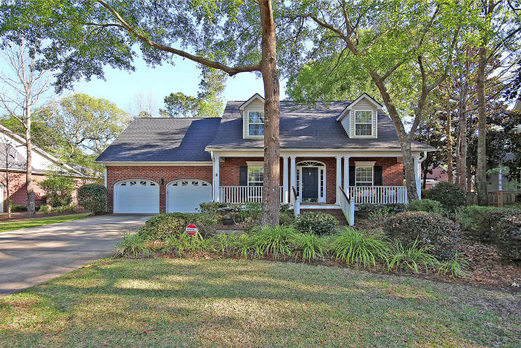
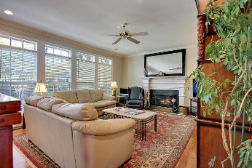
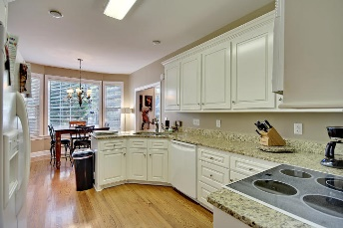
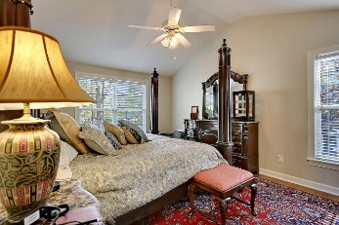
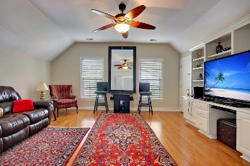
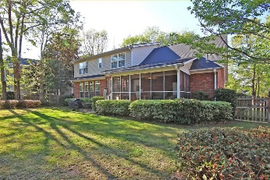


MOTIVATED SELLER! PRICE REDUCED!
4216 Wildwood Landing
Coosaw Creek CC
N Charleston, SC 29420
MLS# 17009682
$339,900
Welcome to this astounding home in the gated community of Coosaw Creek Country Club! This home offers 5 bedrooms and 3 full bathrooms. You enter the home from the full front porch and walk inside to all hardwood floors downstairs and upstairs! To the left you have a formal dinning room and to the right you have a bedroom or office that has access to a full bathroom. In front of you is a hallway that leads you to the large living room. The kitchen has been updated with granite counter tops and lots of cabinet space! Off of the kitchen is a door that leads you to the screened in porch. You also have two stair ways that lead upstairs to the master bedroom, 2 full bathrooms and 3 additional bedrooms. Also upstairs is your laundry room. Come see this home today!
The sellers had a new roof put on the home in August of 2016. Age, sqft, taxes, acreage, and schools are approximate buyer to verify any and all information deemed necessary.
Mason Thurber
(843) 709-5109 – C (843) 576-2699 – O
mason@theeverettgroup.net
RE/MAX Pro Realty, 9209 University Blvd, Charleston, SC 29406

