Slide 1
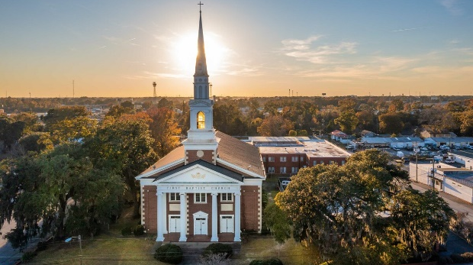
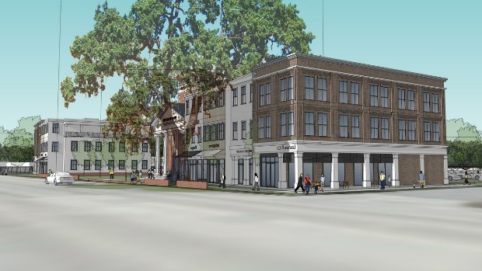
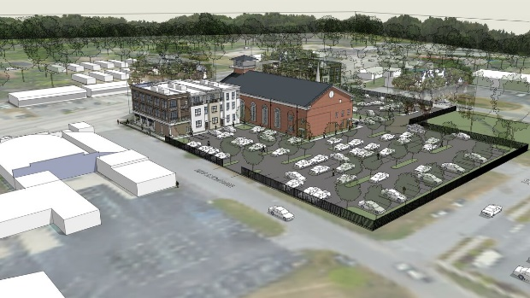
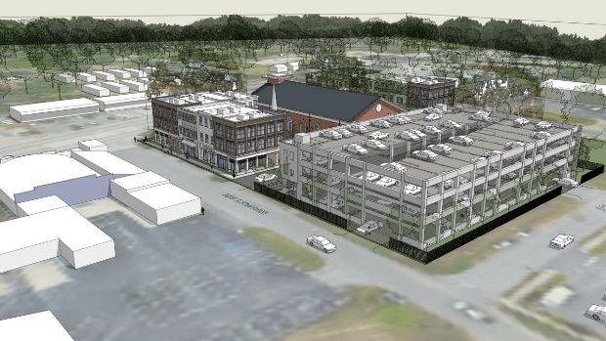
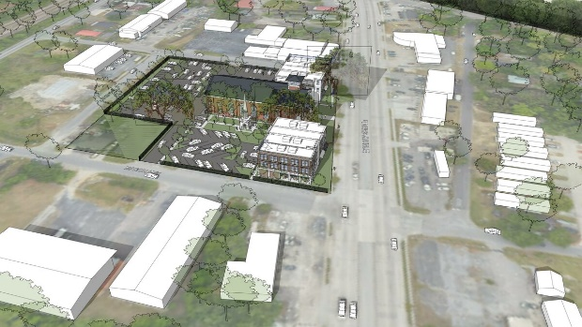
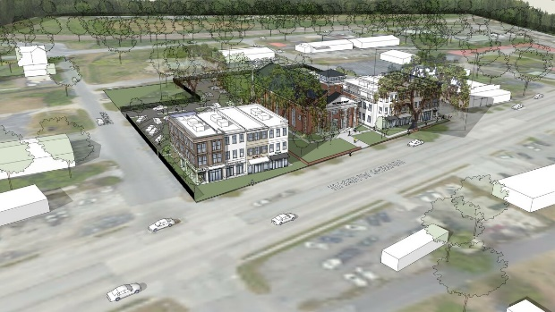
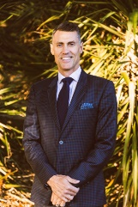

Multi-Family/Mixed Use Redevelopment Site With Flexible Zoning
4217 Rivers Ave
North Charleston, SC 29405
2.214 acres with exceptional redevelopment potential on a mass transit line that is only getting better in North Charleston, South Carolina. The City of North Charleston has adopted the Rivers Avenue South Overlay which will utilize the Lowcountry Rapid Transit Line and all efforts towards mixed use, transit and pedestrian friendly developments. The property has flexible zoning (B-2) and consists of two parcels. The property presently has two structures totaling 43,803 square feet (9,118 SQFT of Sanctuary/Worship Facility and 34,685 of Office/Classrooms including a commercial grade kitchen facility). Formerly The First Baptist Church of North Charleston, the sanctuary and classroom building has adaptive reuse potential and tremendous parking potential (surface and structured). Owner would consider build to suit lease options for the right mix of tenants.
MLS ID: | 30780124 | County: | Charleston
Property Subtypes: | Duplex/Fourplex, Government Subsidized, High-Rise, Low-Rise/Garden, Mid-Rise, Mixed Use, Senior Living, Other | Number of Units: | 100 Units
Building Size (RSF): | 43,803 SF | Tax ID/APN: | 4701100049 and 050
Sale Price: | $4,950,000 | Zoning: | B-2 B-2, General Business District
Property Use Type: | Investment, Vacant/Owner-User | Taxing Authority: | North Charleston, Charleston County
Property Located Between: | Beaufort and Macon Avenues | Total Number of Buildings: | 2
Highway Access: | Rivers Avenue is a main thoroughfare in North Charleston with close proximity to Park Circle and i-526. | Site Description: | Excellent location that is relatively flat with access to regrade if that suits your business purposes.
Lot Frontage: | 256 | Lot Depth: | 405
Nearest MSA: | Charleston-North Charleston | Submarket/Township: | 31 - N.Charleston Area inside I-526
David H Seay
CCIM, BIC, CCIM, REALTOR®
843-364-6720
david@seaydevelopment.com
The Brokerage, LLC
3404-202A Salterbeck Street
Mt. Pleasant, SC 29466
thebrokerageyouwinhere.com
John Teffeau
REALTOR®/Co-Owner
843-813-1228
l.johnteffeau@gmail.com

