Slide 1
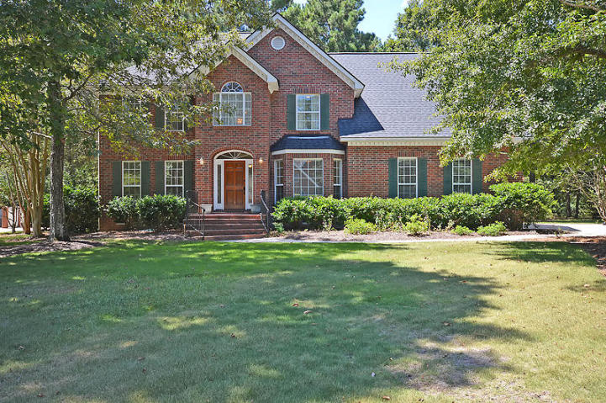
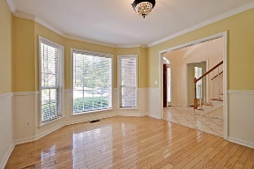
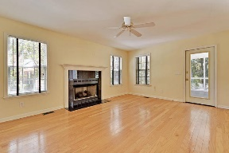
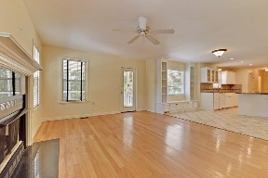
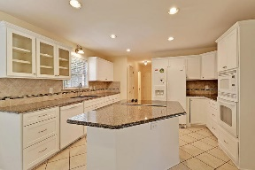
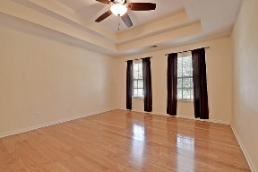
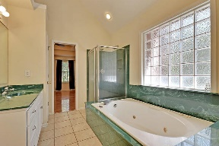
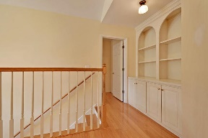
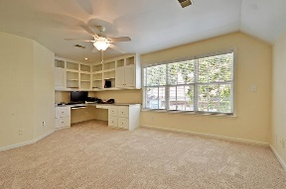
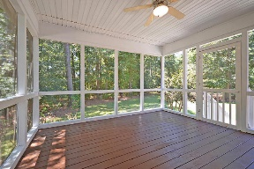
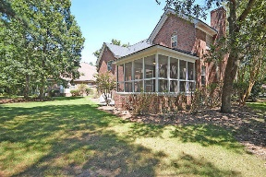
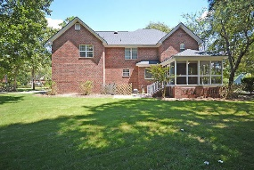



Coosaw Creek Under $300k!!
4218 Buck Creek Court
Coosaw Creek Country Club
North Charleston, SC 29420
MLS# 16023097
$299,500
4 Bedrooms | 2½ Baths | 2,772 sf
Welcome home! Be a part of the Coosaw Creek Country club for under $300k!! Walk in and you'll immediately notice the gorgeous wood floors. To the left you'll find the formal living room which could be used as an office. To the right, the formal dining room. Through the dining room, you'll enter the kitchen, which has just had a fresh makeover! Tons of storage, glass front cabinetry, island with cooktop. All of this overlooking the family room! The family room also offers wood floors, a gas fireplace and access to the huge screened in porch! Head upstairs and you'll immediately notice the custom shelving and cabinets offering extra storage in the hall. The large master offers wood floors, ceiling fan, large master bath and walk in closet. Back down the hall, you'll find three more bedrooms, all with large closets, a laundry room and a bonus room. The bonus room could be a 5th bedroom, a media room, or an office (as it has a built in desk, shelving and cabinets). The possibilities are endless! This home has so much to offer. Great location, close to Boeing, AFB, Bosch, Mercedes, active golf course community with a calendar of events! Great restaurant at the club, poolside food service, unlimited golf for every household member. Really, this place has it all! Come see for yourself today!
Larry & Kathy Mazalatis
Larry Cell 843-693-0529
Kathy Cell 843-693-0159
Office 843-871-9133
AGENTOWNED PREMIERE GROUP | 1800 TROLLEY RD | SUMMERVILLE, SC 29485

