Slide 1
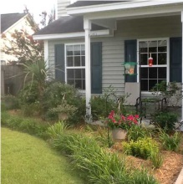
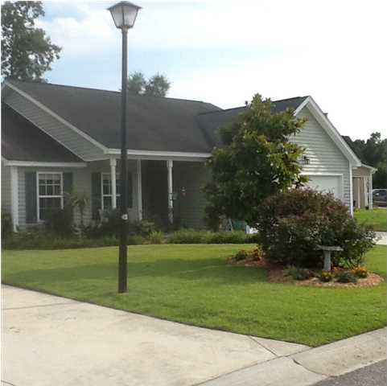
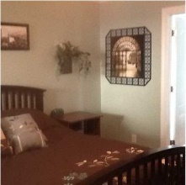
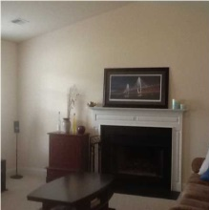
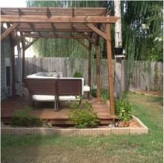
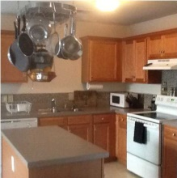
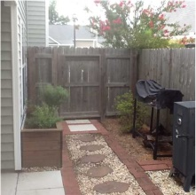
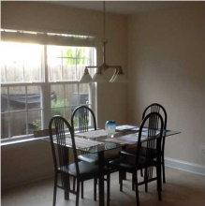
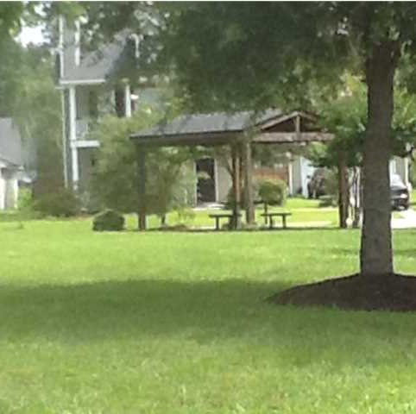
421 Equinox Cir
Heatherwoods ~ Ladson, SC ~ MLS# 1419534 ~ $159,000
Fantastic Price for a Home in Dorchester Dist. II
Really cute house in great location and has just been freshly painted. This 3 bedroom house has a split bedroom arrangement with master bedroom on one side of the house and the other 2 bedrooms on the other side. The master bedroom is a nice size and even has an extra alcove. The master bath has a separate tub and shower, double sinks in the vanity and a walk-in closet. Guest bedroom also has a walk in closet. Kitchen is open to the breakfast area and to the great room. Kitchen has a center island and lots of cabinet space. Large great room has a wood burning fireplace and windows and front storm door that allow lots of light to come in and make for a warm, bright room. Now, you will love the backyard. There is a patio, nice deck, nice landscaping and a privacy fence. There is plenty of room on the back deck to enjoy the outdoors for yourself or with friends. This house has lots of curb appeal with a front yard that is attractively landscaped. Sit on the front porch and enjoy watching the Hummingbirds and butterflies. This house is in move-in condition, ready for a new owner. Location is close to Boeing, Bosch, Wal-Mart with easy access to other Charleston areas.
Marian Bennett
Mobile - (843) 693-4017
marian_bennett@att.net
Harbourtowne Real Estate | 672 Marina Drive, Ste 110 | Daniel Island, SC 29492

