Slide 1
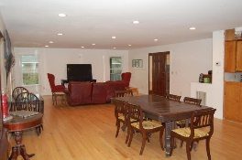
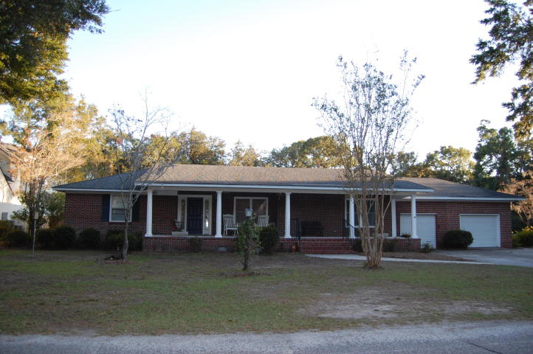
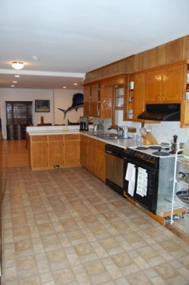
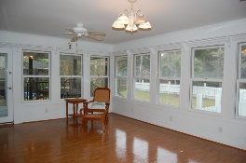
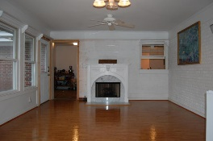
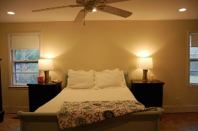
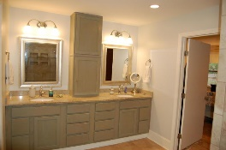
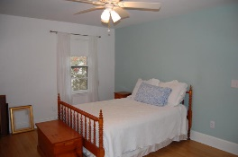
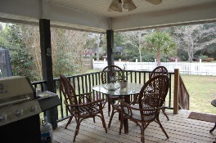
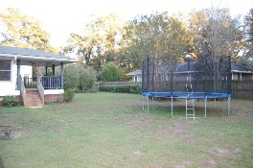


421 Shannon Drive Mount Pleasant, SC 29464 | MLS# 19031375 | $750,000
Renovate in The Groves!
Great time to renovate in The Groves! Get in and make this one-story sprawling ranch style house your home. This neighborhood is going through its re-birth due to being one of the best locations in South Mt Pleasant and one of the oldest established neighborhoods in the area. Large lots (no subdividing so no cramped neighbors!), beautiful oak trees adorn the streets and the neighborhood park. Walkability is phenomenal to Coleman and Shem Creek! Take a bike/ golf cart to Whole Foods shopping center, Trader Joe's.
Historic Charleston is 15-20 minute drive.
I-526 is easy access via Coleman Blvd to The Charleston Airport!
This home has a very open ranch floor plan with master on the backside of the home while 2 bedrooms have a Jack & Jill bath and the remaining 2 bedrooms have a hall bath. Large sunroom adjacent to the kitchen where you could remodel for that dream kitchen- there is plenty of footprint! Porch off the sunroom overlooking the spacious fenced backyard. Renovated homes right around 421 Shannon Dr. have sold for much higher price point. This is a side street in The Groves- a sweet spot in an "All American City Mt Pleasant 2018 winner"
Get in while you can and renovate to your liking!
Leslie Evans (843) 343-5290 | levans@carolinaone.com www.leslieevansrealestate.com
Carolina One Real Estate | 628 Long Point Rd. | Mt Pleasant, SC 29464-3032

