Slide 1
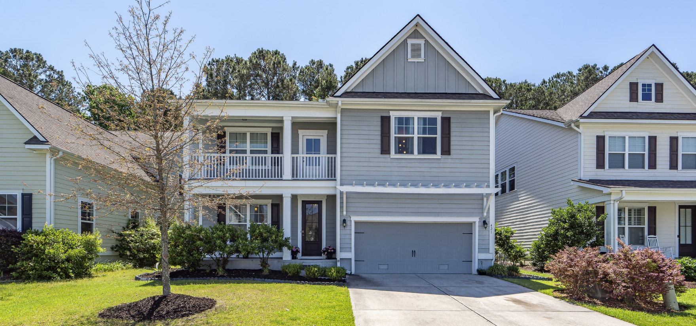
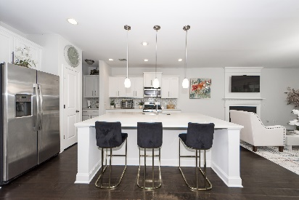
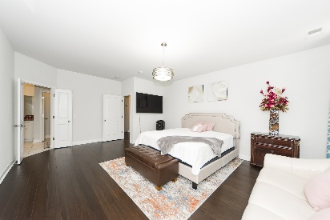
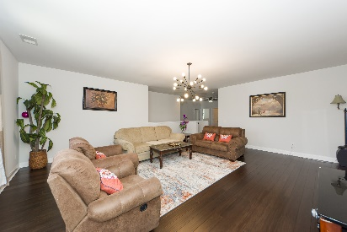
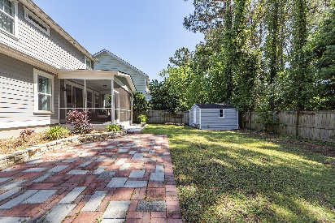

$5,000 Toward Closing Costs + Additional $2,000 For Buyer’s Agent With A Ratified Contract By May 6th!
421 Turnstone Street
Tidal Walk | Mount Pleasant, SC 29464 | MLS# 24009446
Now Offering at $958,400
Great house with great location! Move in ready!
Second story loft can be used as a home office or work out area!
Home warranty until 2028!
Virtual Tour
Lisa Deaton
843-224-7878
lisamdeaton@comcast.net
AgentOwned Charleston Group
902 Savannah Hwy
Charleston, SC 29407-7802

