Slide 1
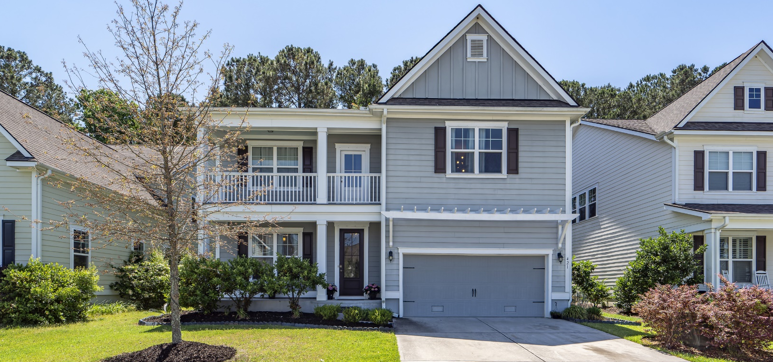
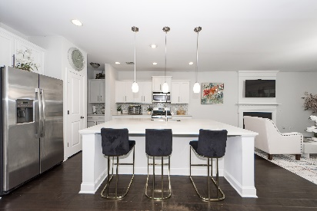
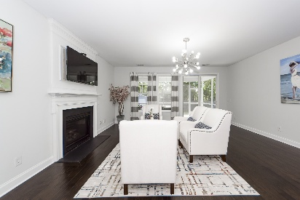
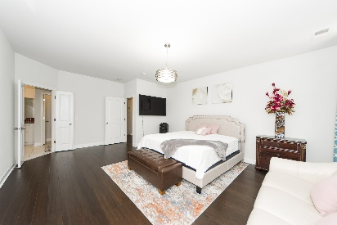
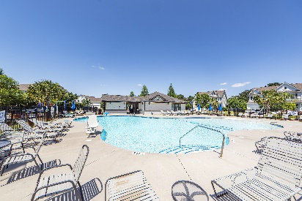

SELLER IS MOTIVATED! MOVE IN READY! SELLER WILL GIVE $10,000 TOWARD CLOSING OR RATE RATIO + 3% BAC WITH RATIFIED CONTRACT BY AUGUST 30TH!
421 Turnstone Street
Tidal Walk | Mount Pleasant, SC 29464 | MLS# 25021398 | $895,000
GREAT home in a GREAT location. Second story loft can be used as an office or workout area! Home newly painted and owners have moved to their new home. New stove, new refrigerator, and new dishwasher.
Pictures reflect when owners lived in the home. Easy to show! Sound barrier wall starts in 2026. Home warranty until 2028!
Take a Virtual Tour
Lisa Deaton
843-224-7878
lisamdeaton@comcast.net
AgentOwned Charleston Group
902 Savannah Hwy
Charleston, SC 29407-7802

