Slide 1
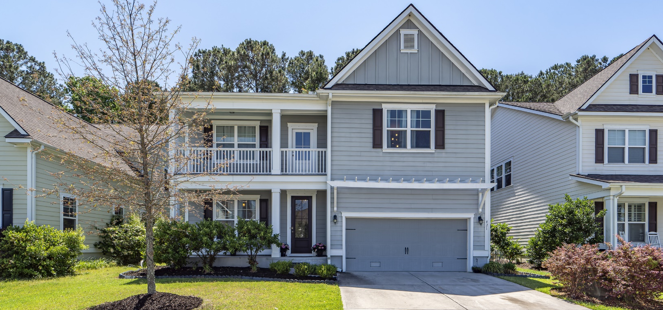
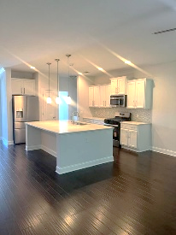
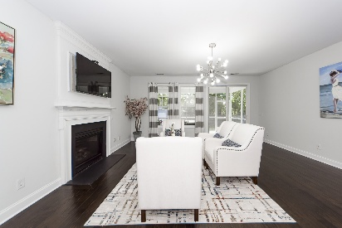
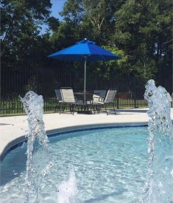

PRICE REDUCED TO $874,900
$20,000 TOWARD CLOSING COST OR RATE BUY DOWN!
421 Turnstone Street
Tidal Walk | Mount Pleasant, SC 29464 | MLS# 25021398
GREAT home in a GREAT location. Second story loft can be used as an office or workout area! Home newly painted and owners have moved to their new home. New stove, new refrigerator, and new dishwasher.
Pictures reflect when owners lived in the home. Easy to show!
Home warranty until 2028! Move-in Ready!!
NOW OFFERING $20,000 TOWARD CLOSING COST OR RATE BUY DOWN
WITH RATIFIED CONTRACT BY SEPT. 15TH
Take a Virtual Tour
Lisa Deaton
843-224-7878
lisamdeaton@comcast.net
AgentOwned Charleston Group
902 Savannah Hwy
Charleston, SC 29407-7802

